Slide 1
STRUCTURES, EARTHQUAKES AND GRID
Using Supercomputers for Suburbs
(or at least trying to)
Europe – Latin America e-Infrastructures
Rio de Janeiro | October 17 and 18, 2011

Slide 2
Luis Nuñez University of Los Andes (Venezuela)
Maria Eugenia Marante University Lisandro Alvarado (Venezuela)
Maylett Uzcátegui University of Zulia (Venezuela)
Maria Elena Perdomo
Ricardo Picón
Nestor Guerrero
Vanessa Hamar
Jormany Quintero
Scarlet Montilla
Betsy Vera
Lorena Suarez
Jorge Redondo
Pether Inglessis
Sebastián Delgado
Gilberto Díaz
Julio Flórez-López iflorez@ula.ve

Slide 3
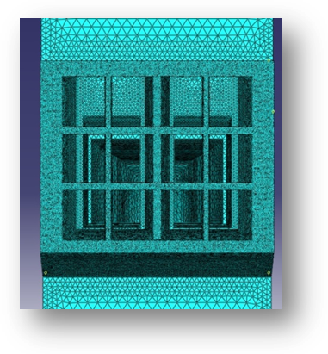
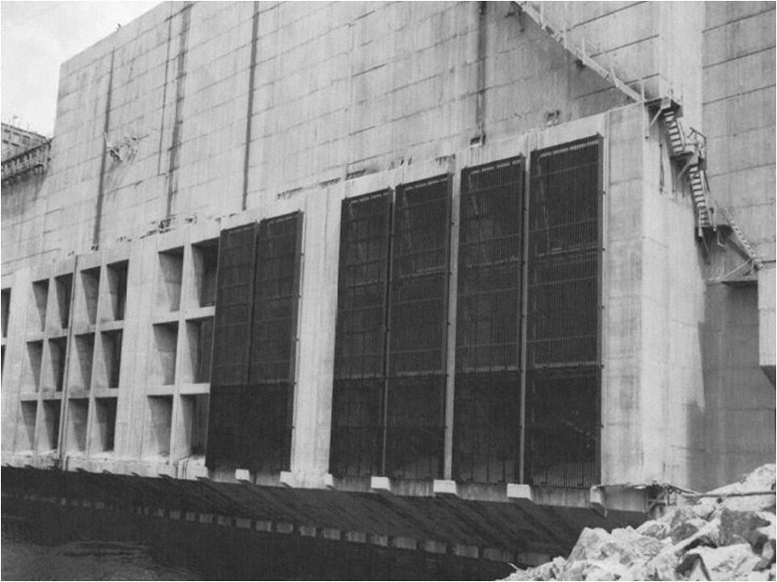
Fundamental tool of Structural Engineering :
The Finite Element Method

Slide 4
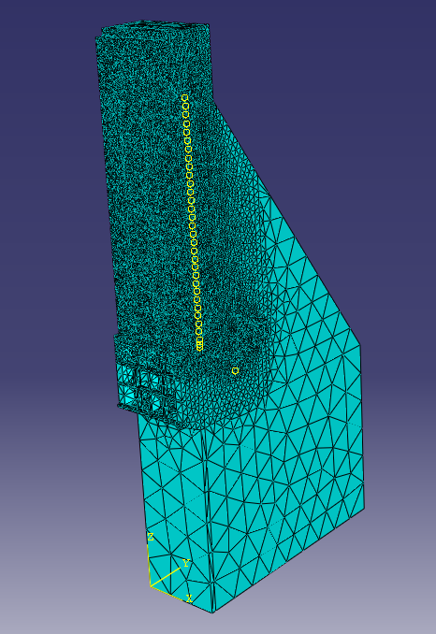
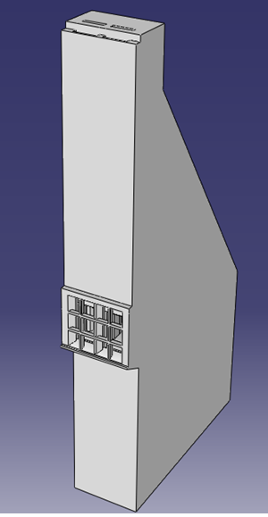
Pozo M
Pozo O
Toma

Slide 5
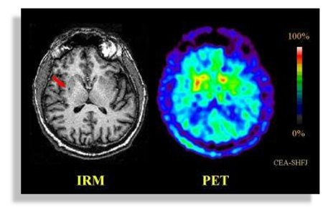
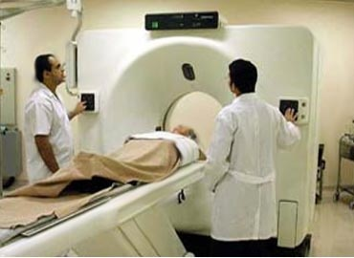

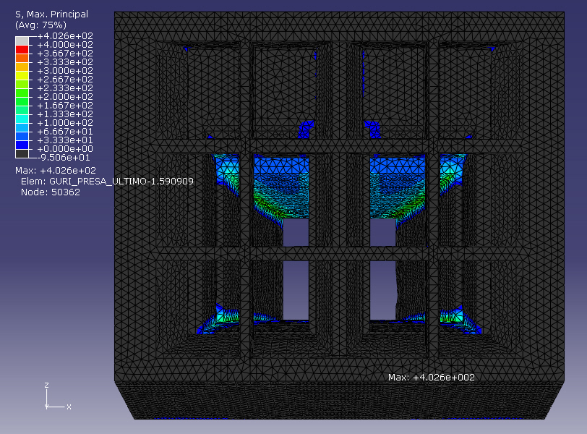
Diagnosis using FEM

Slide 6

Linear Finite Elements
σ
E
ε

Slide 7
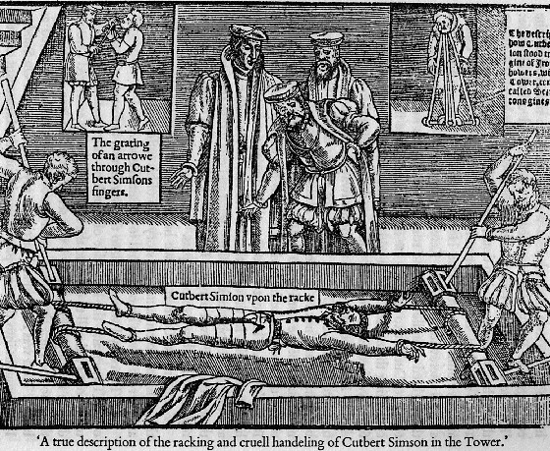
Nonlinear Finite Element
Continuum Damage Mechanics
Crack propagation using FEM
σ
E
ε

Slide 8
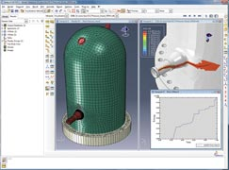
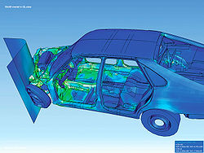

Nonlinear analyses are difficult and very expensive

Slide 9
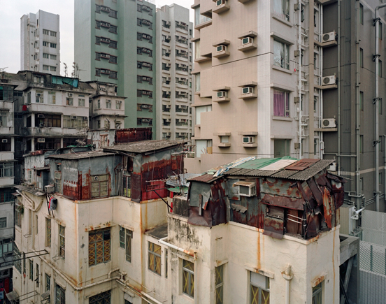
http://technoccult.net/archives/2010/05/30/hong-kong%E2%80%99s-rooftop-shanty-towns/

Slide 10
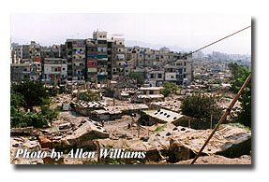
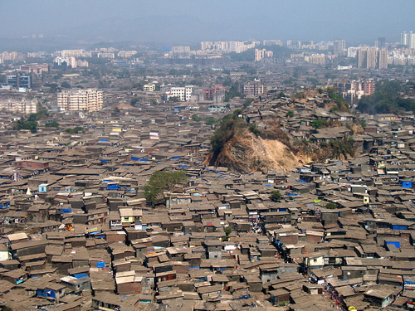
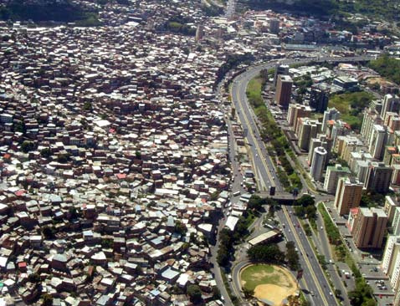
http://propertymalaysia.blogsome.com/2007/09/

Slide 11
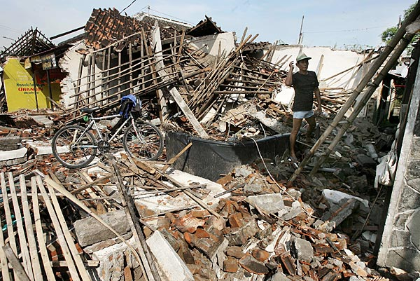
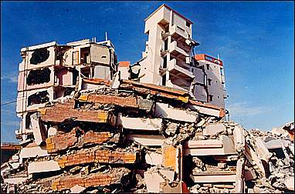
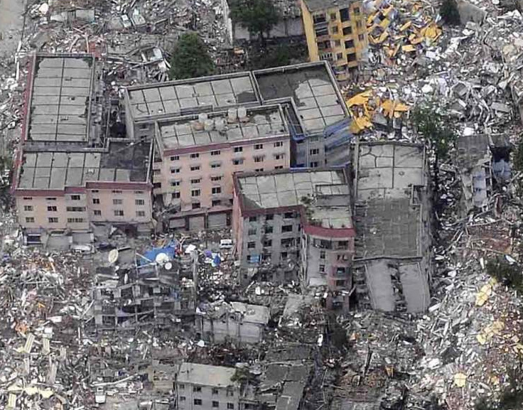
http://scrapetv.com/News/News%20Pages/Everyone%20Else/pages-3/Indonesian-earthquake-kills-mostly-jerks-Scrape-TV-The-World-on-your-side.html
http://www.tiptoptens.com/2011/03/28/10-worst-natural-disasters-of-21st-century/

Slide 12
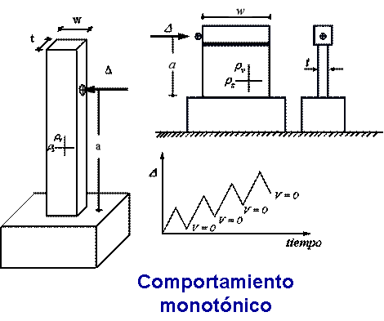
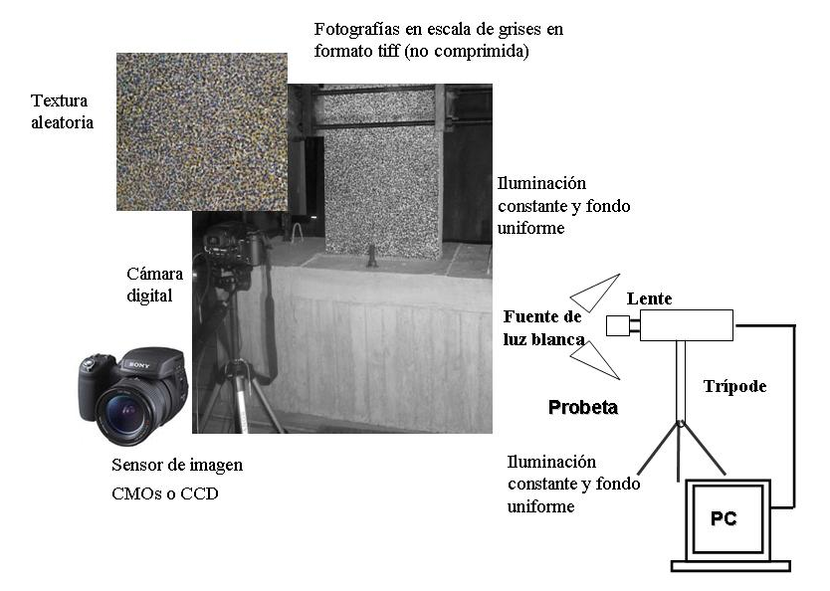
DEVELOPING NONLINEAR FINITE ELEMENT THEORY FOR SUBURBS
(Simplified Damage Mechanics )
Characterization of the users
Identification of crack patterns in reinforced concrete specimens using Digital Image Correlation (DIC) Techniques

Slide 13
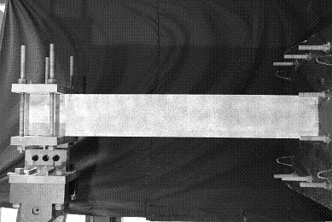

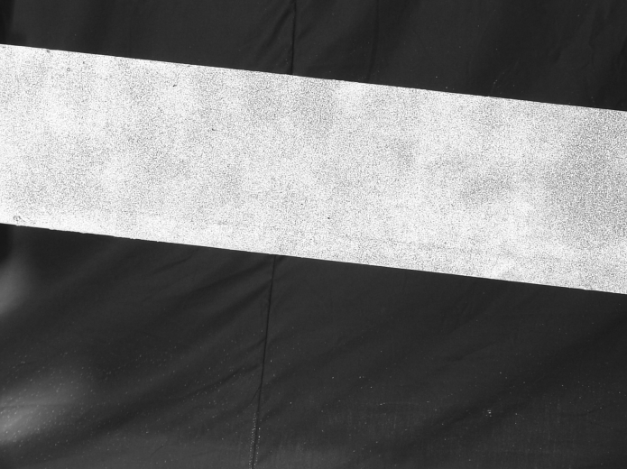

Slide 14
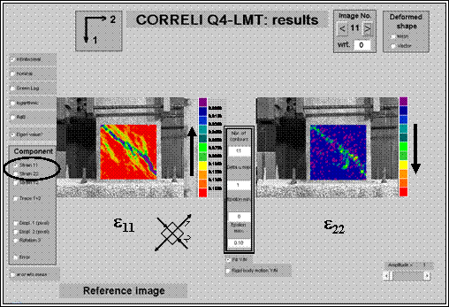
CORRELI-Q4

Slide 15
H
t
V
1750 mm
250 mm
L
250 mm
Cross-section
550 mm
1000 mm

Slide 16
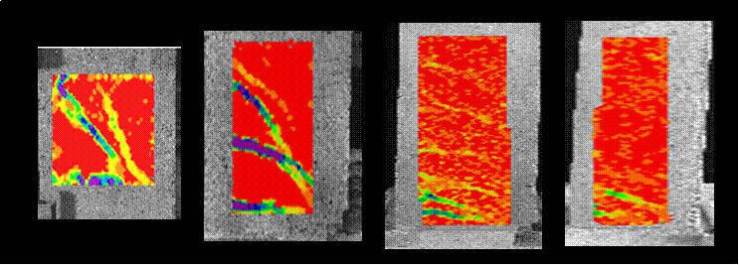
Cracking patterns
Aspect ratio (L/H)
Low: 1.78 intermediate: 3.55 intermediate : 5.33 High: 7.110
diagonal tension cracks by shear force
+
flexure cracks by bending moment
B1
B2
B3
B4
Low: Shear Cracks ------------------------------------------------------- High: Flexure Cracks
3 6

Slide 17
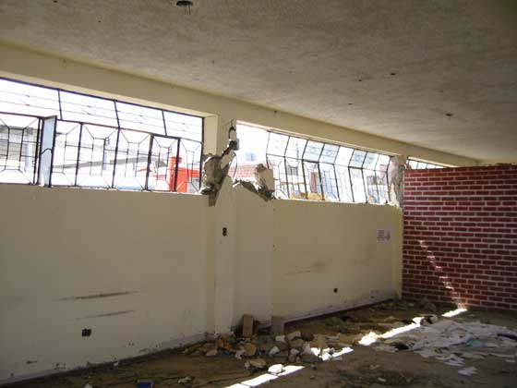

Slide 18
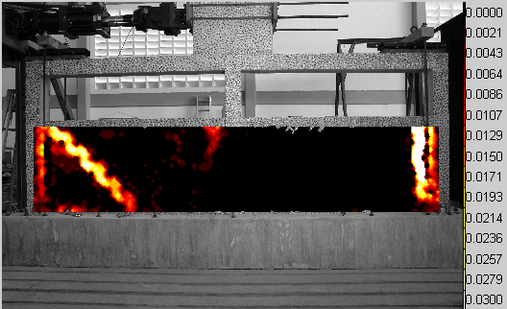
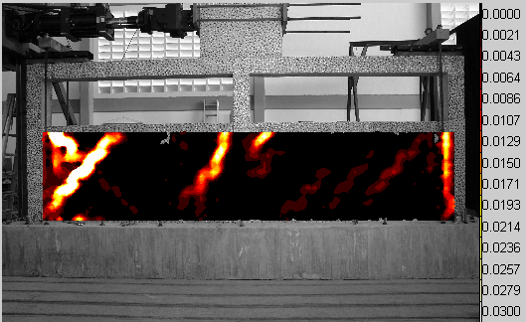
Double Bay Frame With Partially Confined Masonry

Slide 19
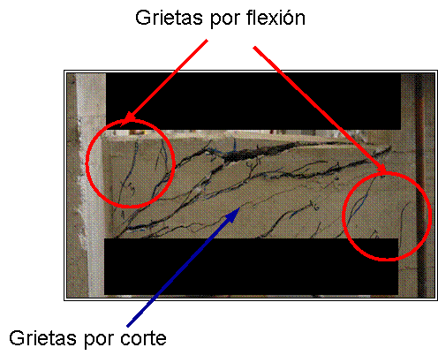
Flexure Cracks
Cargas aplicadas
Shear Cracks
(d_{i}, d_{j}) : Flexure damage
d_{s} : Shear damage
0 ≤ d_{s} ≤ 1
0 ≤ d_{i} ≤ 1
0 ≤ d_{j} ≤ 1

Slide 20
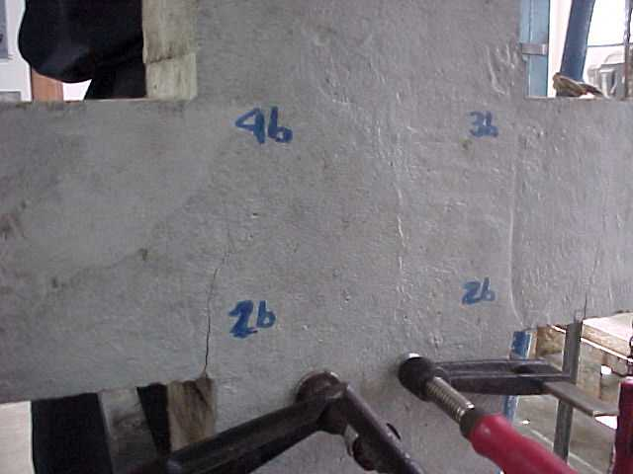
d ≅ 0.30

Slide 21
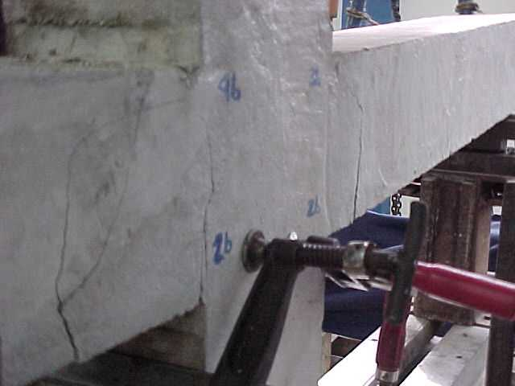
d ≅ 0.62

Slide 22
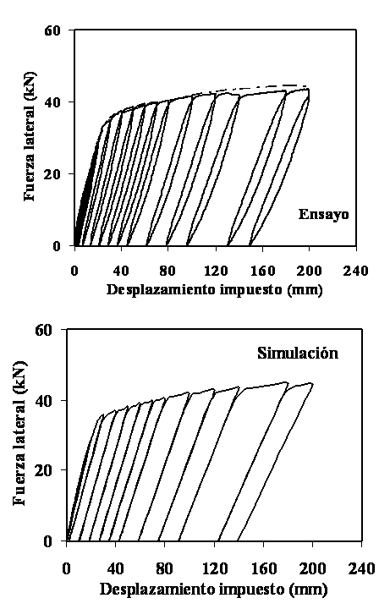
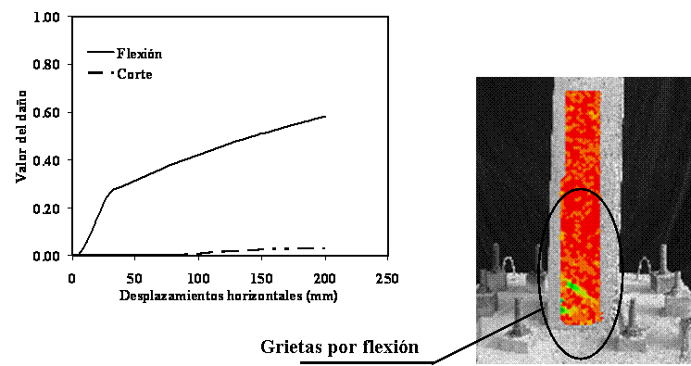
Slender beam (L/H = 7.11)
Damage evolution
B4
Δ = 30 mm
Flexure
Shear
B4
test
Flexure Cracks
simulation
ds = 0.03
Damage Values for 200 mm
d = 0.58

Slide 23
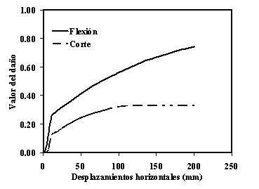
Intermediate beam (L/H = 5.36)
Damage evolution
Flexure
Shear
B3
Δ = 50 mm
test
B3
ds = 0.33
Shear Cracks
d = 0.74
simulation
Flexure Cracks
Damage Values for 200 mm

Slide 24
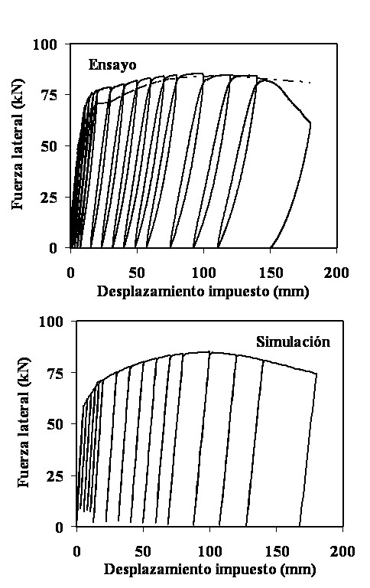
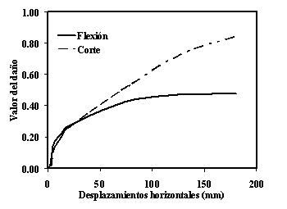
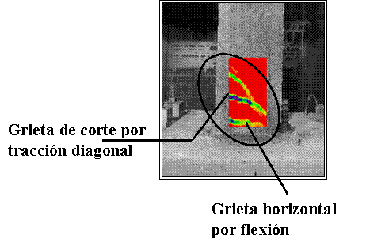
Intermediate beam (L/H = 3.56)
Damage Values for 180 mm
Damage evolution
test
ds = 0.85
Flexure
Shear
d = 0.47
B2
Δ = 50 mm
B2
simulation
Shear Cracks
Flexure Cracks

Slide 25
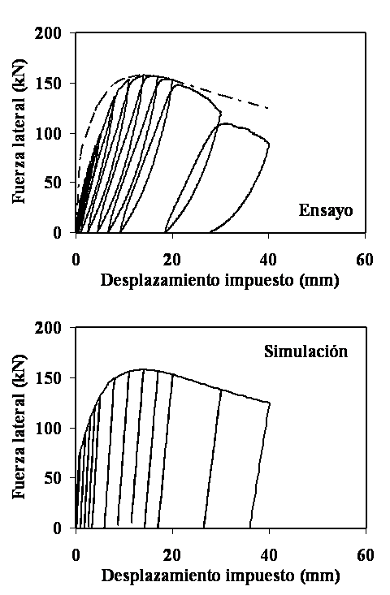
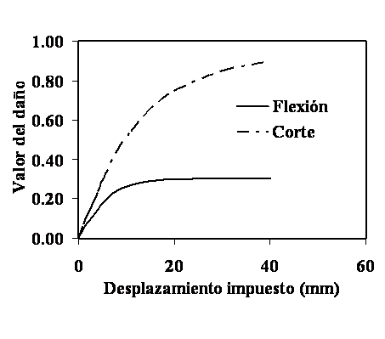
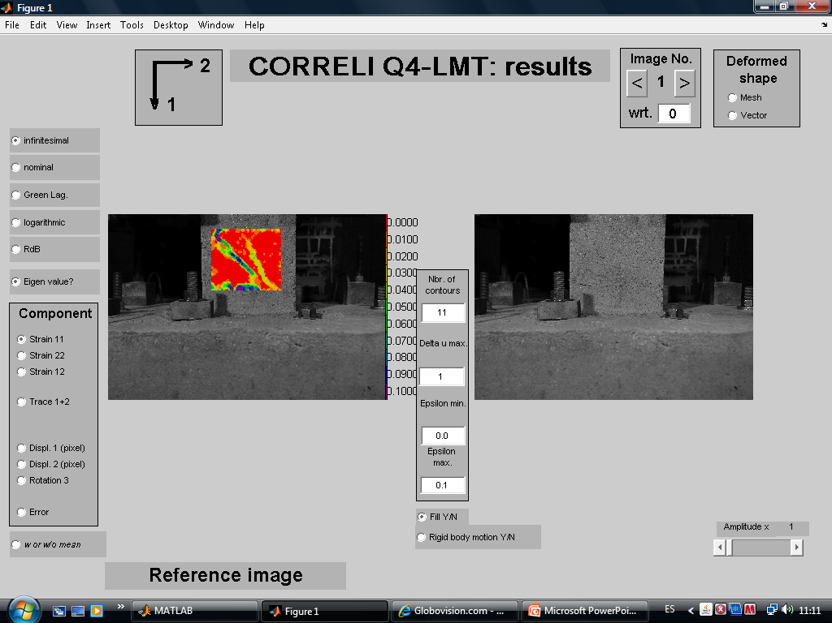

Short beam (L/H = 1.78)
Damage evolution
B1
B1
Flexure
Shear
test
Δ = 14 mm
Damage Values for 40 mm
simulation
ds = 0.85
d = 0.31
Shear Cracks
Flexure Cracks

Slide 26
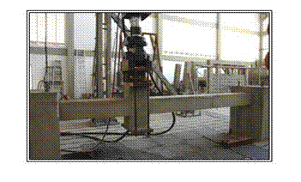
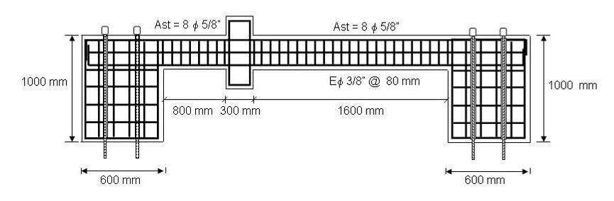

Slide 27
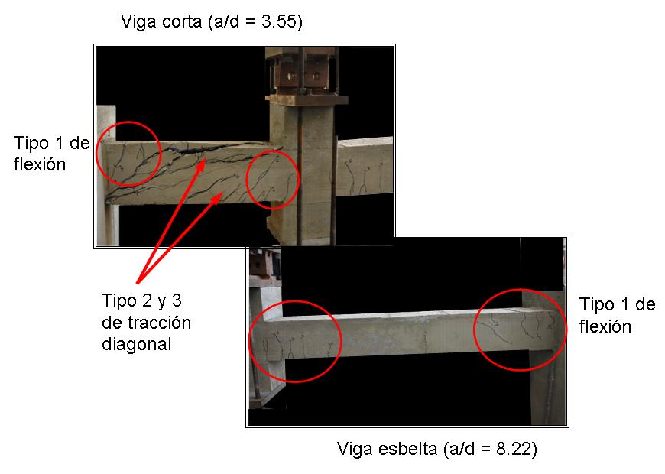

Slide 28
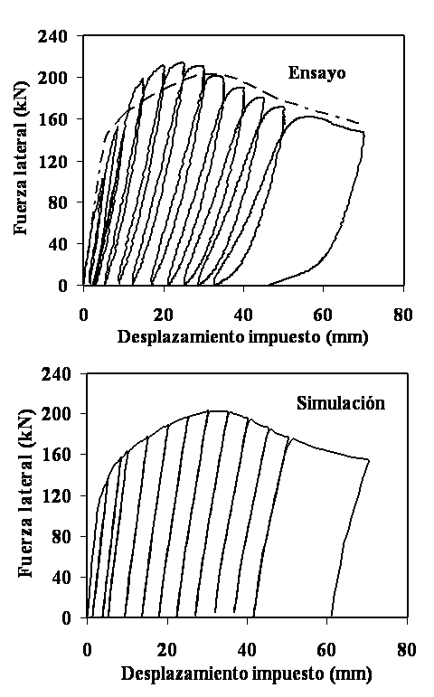
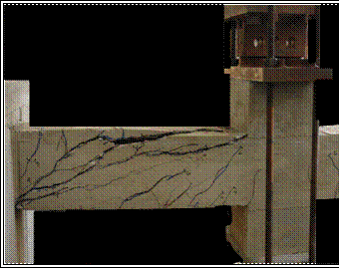
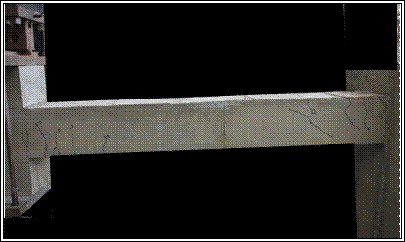
Damage evolution – short beam
Δ = 70 mm
test
ds = 0.94
d = 0.35
simulation
Δ = 70 mm
Flexure
Shear
ds = 0.07
d = 0.27
Damage evolution – slender beam

Slide 29
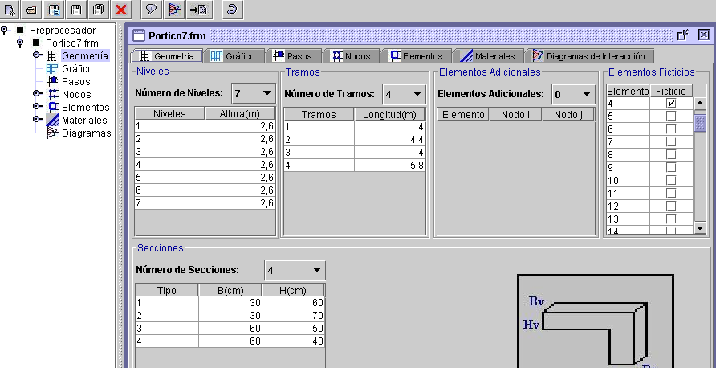
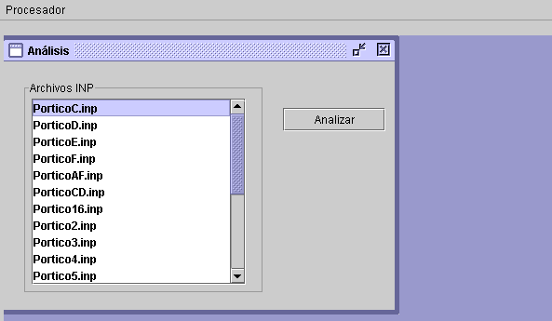
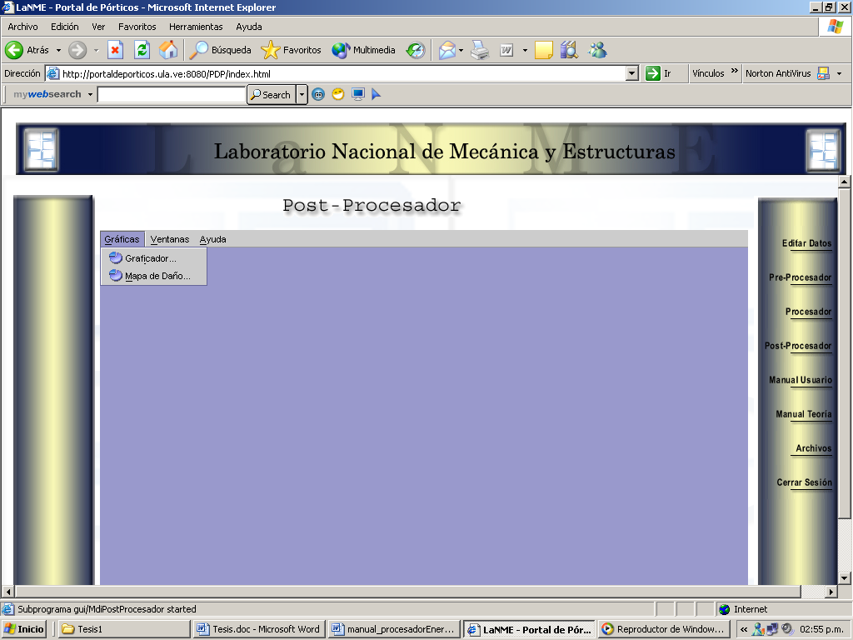
Portal of Damage: The nonlinear finite element program for suburbs (web-based since 2002)
The system consists of 3 main modules:
  Pre-processor,
  Processor
  Post-processor.

Slide 30
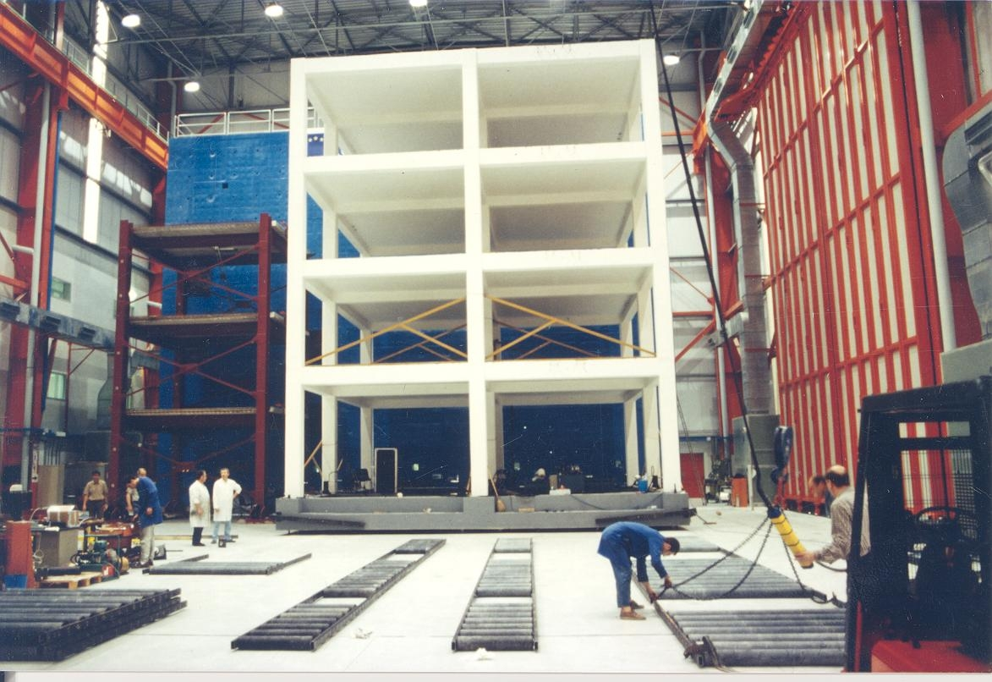
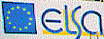

Slide 31
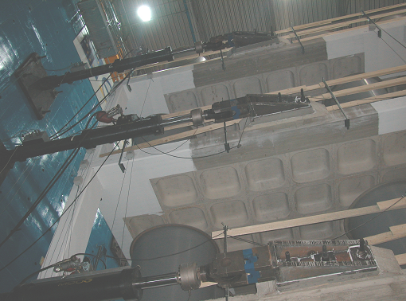

Slide 32
- - Test
___ Simulation
Total Force (KN)
1500
1000
500
0
-500
-1000
-1500
0 1000 2000 3000 4000 5000 6000 7000 8000
Time (seg)

Slide 33
150
0
-150
Total Force (kN)
Numerical simulation with the portal
-250 -100 0 100 200
Displacement at the top (mm)
Total Force (kN)
150
0
-150
Test
-250 -100 0 100 200
Desplacement at the top (mm)

Slide 34

http://portaldeporticos.ula.ve
Damage distribution

Slide 35


Slide 36

= 0.73
= 0.42
= 0.17

Slide 37

Portal of Damage on Grid
PoD on Grid Architecture

Slide 38

Portal of Damage 3D

Slide 39
Difficulties
I don't care to belong to a club that accepts people like me as members.
Groucho Marx
Portal of Damage is still a University Software
Networks of training centers, Internet connectivity, etc.
Fixing weak structures

Slide 40



Slide 41
Obrigado

