Slide 1
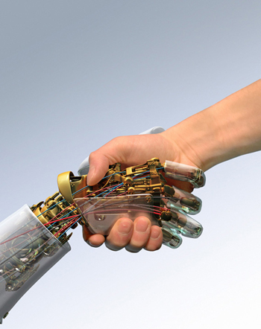
Ivani Santana ivani.santana@pq.cnpq.br / ivani@ufba.br ivani_santana@uol.com.br Federal University of Bahia Institutit of Humanities, Arts and Science Prof. Milton Santos Professor of Art and Contemporary Technology (ArTeC) and Master and PH.D. Program of Theater and Dance Research Group Technological Poetics www.poeticatecnologica.ufba.br Map and Program of Art in Digital Dance www.mapad2.ufba.br Choreographer, dancer, research of art/dance and tecnology
“A hole in space” a “non-place”
(network) to Performing Arts

Slide 2
RESEARCH:
_ ACADEMIC/THEORETICAL
_ ARTISTIC/PRACTICAL
Since 2005
TELEMATIC DANCE
NETWORKING PERFOMANCE
MAPA D2
Map an Program for Art in Digital Dance
- Networking for development and divulgation of this field in Ibero-America .

Slide 3
MAPA D2
Map and Program for Art in Digital Dance
MAPA D2 promote the interchange between artists and researchers
from Ibero-America;
-MAPA D2 connect artists and university;
MAPA D2 gives space to the artist from Ibero America to show his/her art work;
-MAPA D2 has a huge bibliographical reference about the art technology;
-MAPA D2 gives information about festival, educational center, etc;
MAPA D2 is a display of dance and performance production in Ibero America;
Etc....

Slide 4
RESEARCH:
video
TELEMATIC DANCE
NETWORKING PERFOMANCE
ARTHRON,
developed with Digital Video Lab
Coord. Dr. Guido Lemos
GTMAD (RNP) Coord. Dra. Tatiana Aires
e_Pormundos Afeto (2009,2010,2011)
Research Group Poetical Technological
+
Konic Thtr
RNP + i2Cat
2010 + INNOVA Red

Slide 5
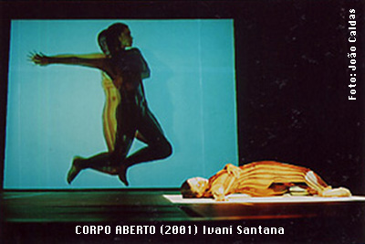
Câmera em tempo presente

Slide 6
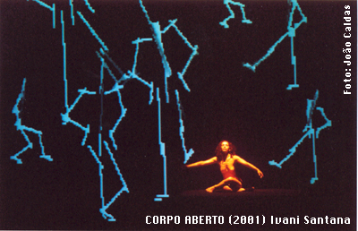
Life Forms

Slide 7
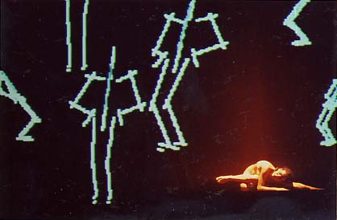
Life Forms

Slide 8
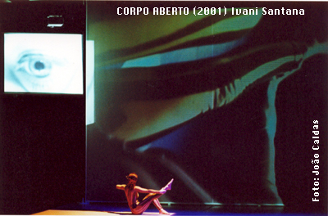
Micro-câmera

Slide 9
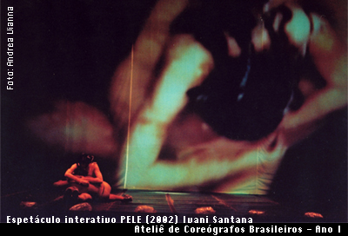
“Close-circuit” - circuito fechado de câmera

Slide 10
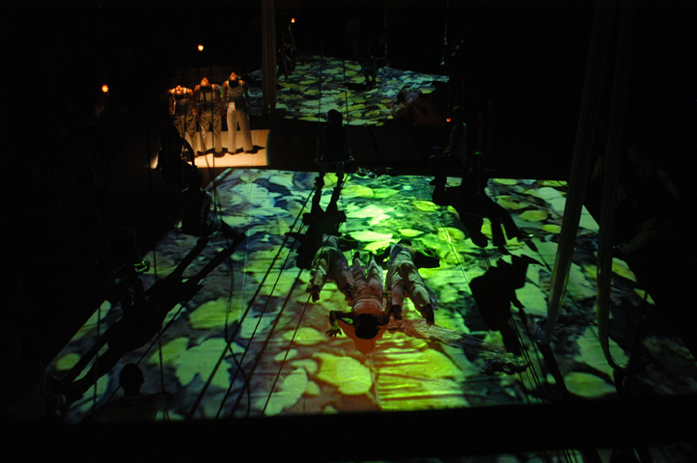
E fez o homem sua diferença (2005)

Slide 11
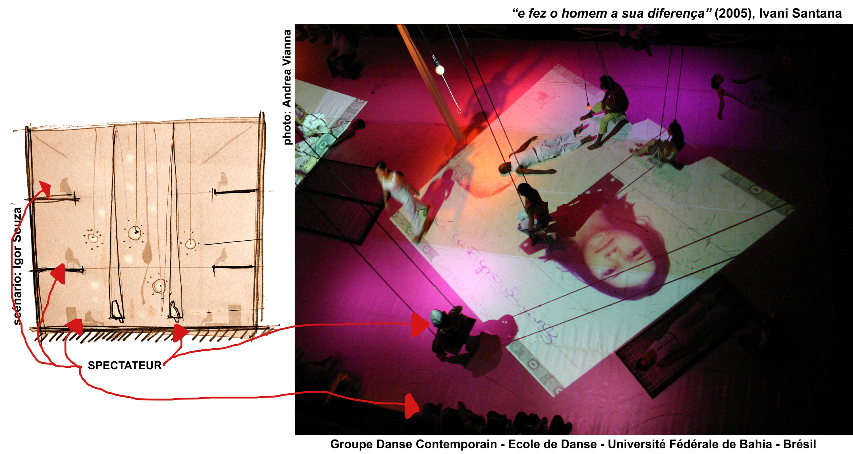

Slide 12
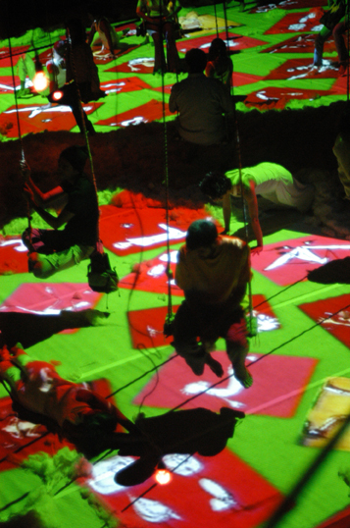
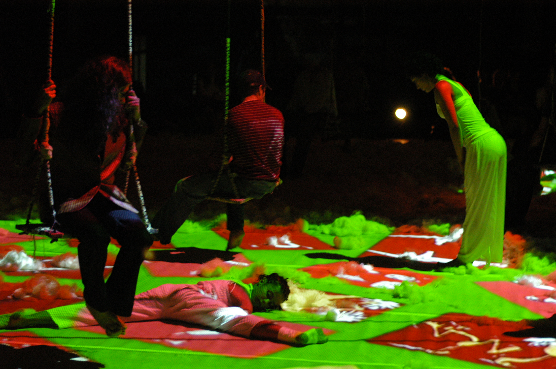
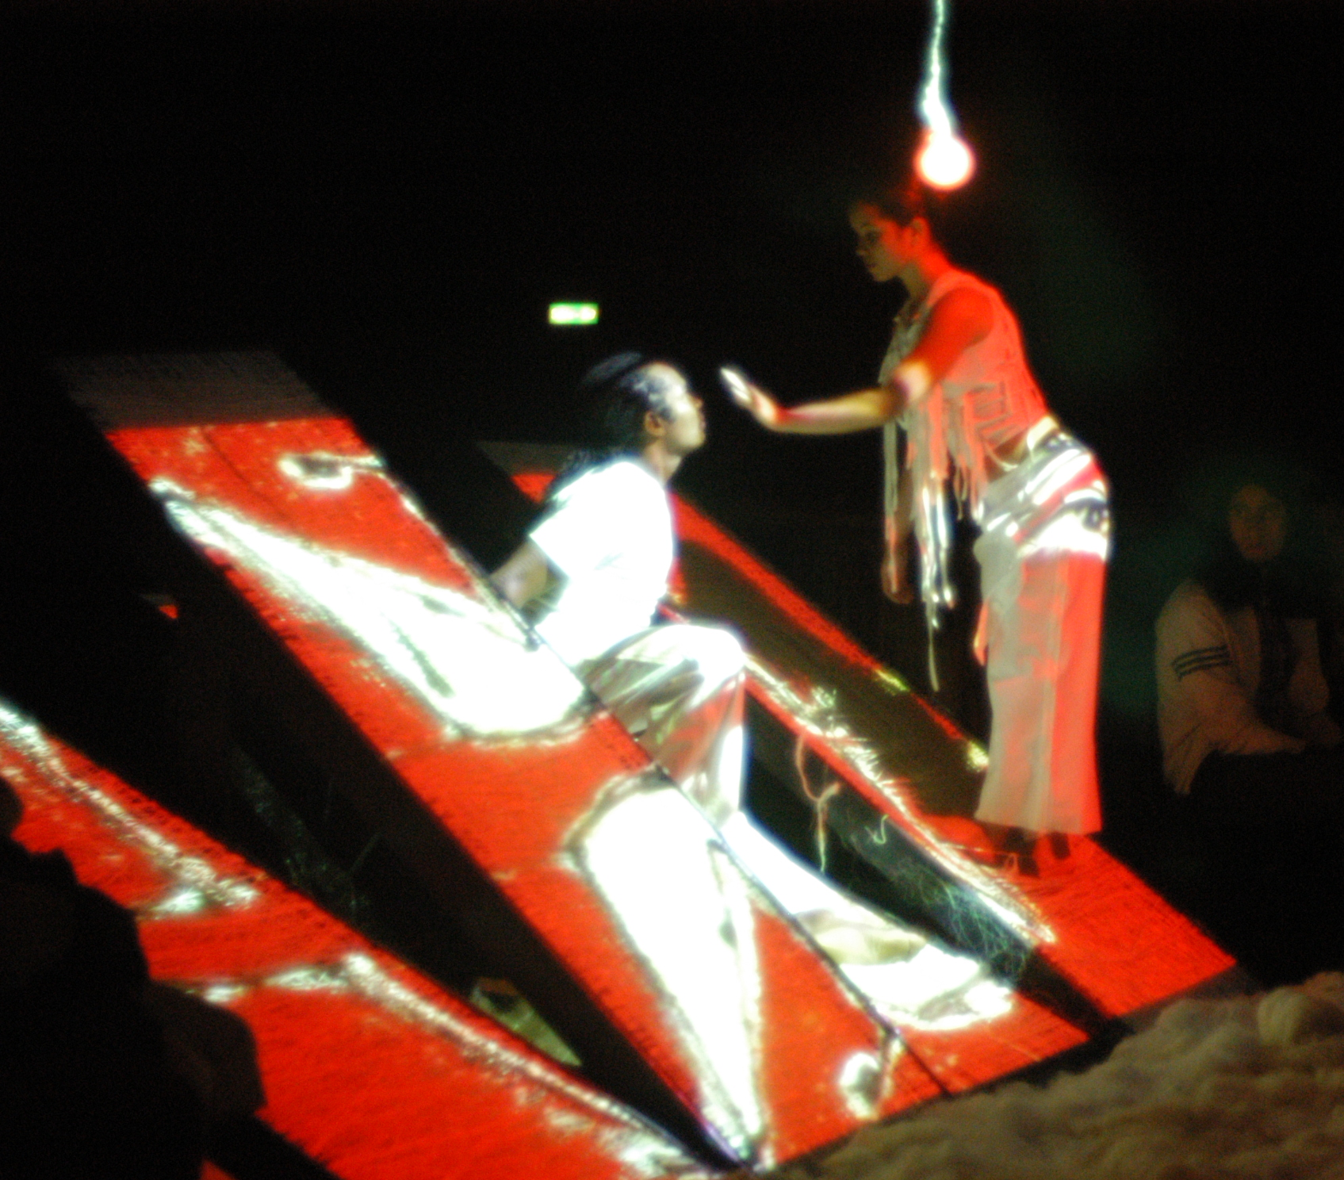
E fez o homem sua diferença (2005)

Slide 13
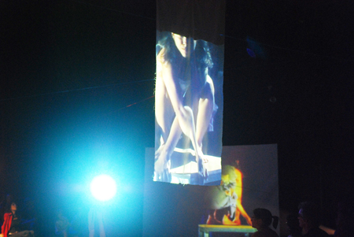
Le Moi Le Cristal et L’Eau
(2007)
Centre Choregraphique National
Pavillon Noir
Aix en Provance – France
Grant from Monaco Dance Forum

Slide 14
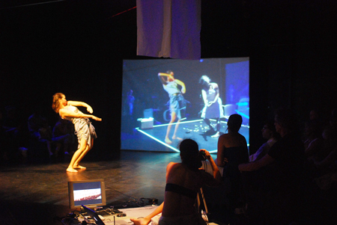
Le Moi Le Cristal et L’Eau
(2007)

Slide 15
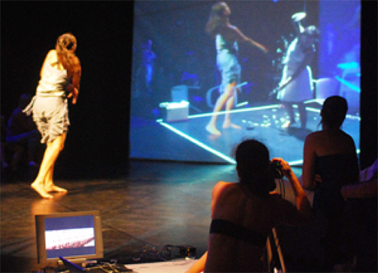
Le Moi Le Cristal et L’Eau
(2007)

Slide 16
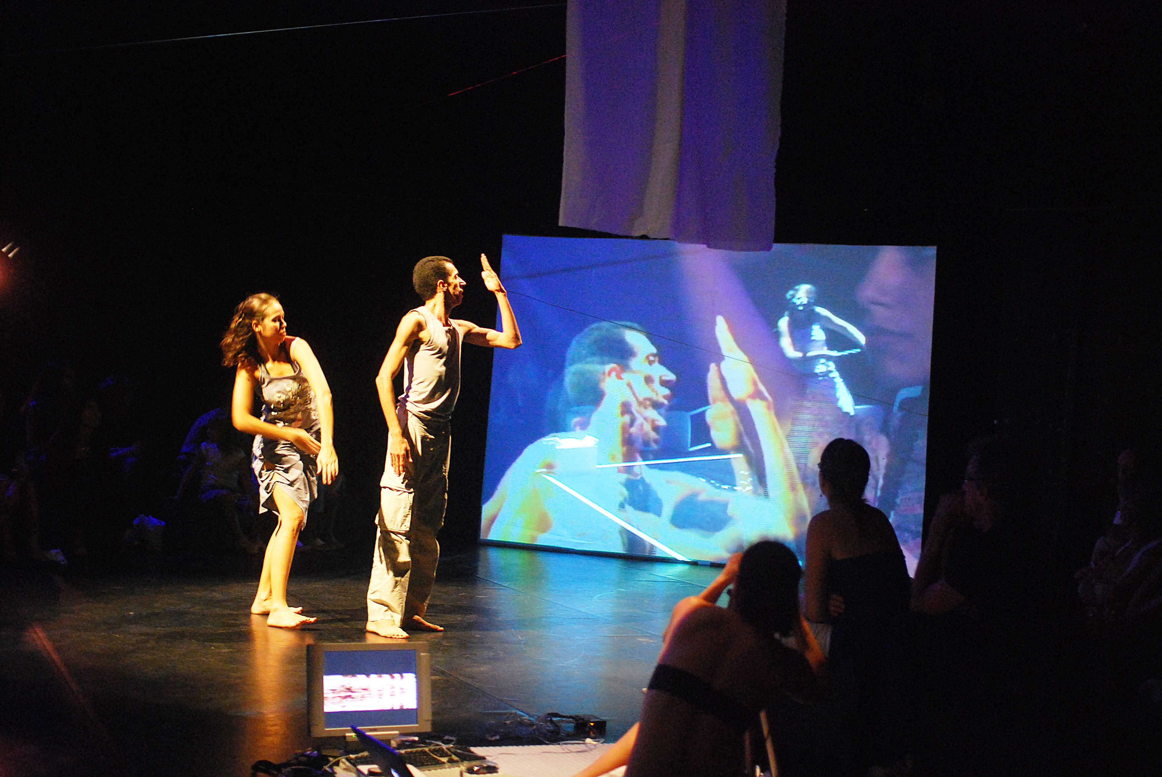
Le Moi Le Cristal et L’Eau
(2007)

Slide 17
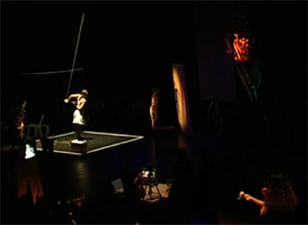
Le Moi Le Cristal et L’Eau
(2007)

Slide 18
“A hole in space”. A “non-place” (network) to Performing Arts. Ivani Santana
The intimate space of the subject has been invaded in various ways in the digital culture. Globalization, through telecommunication devices, has promoted telematics exchanges in many spheres: the artistic, the social, the economic and the personal.

Slide 19
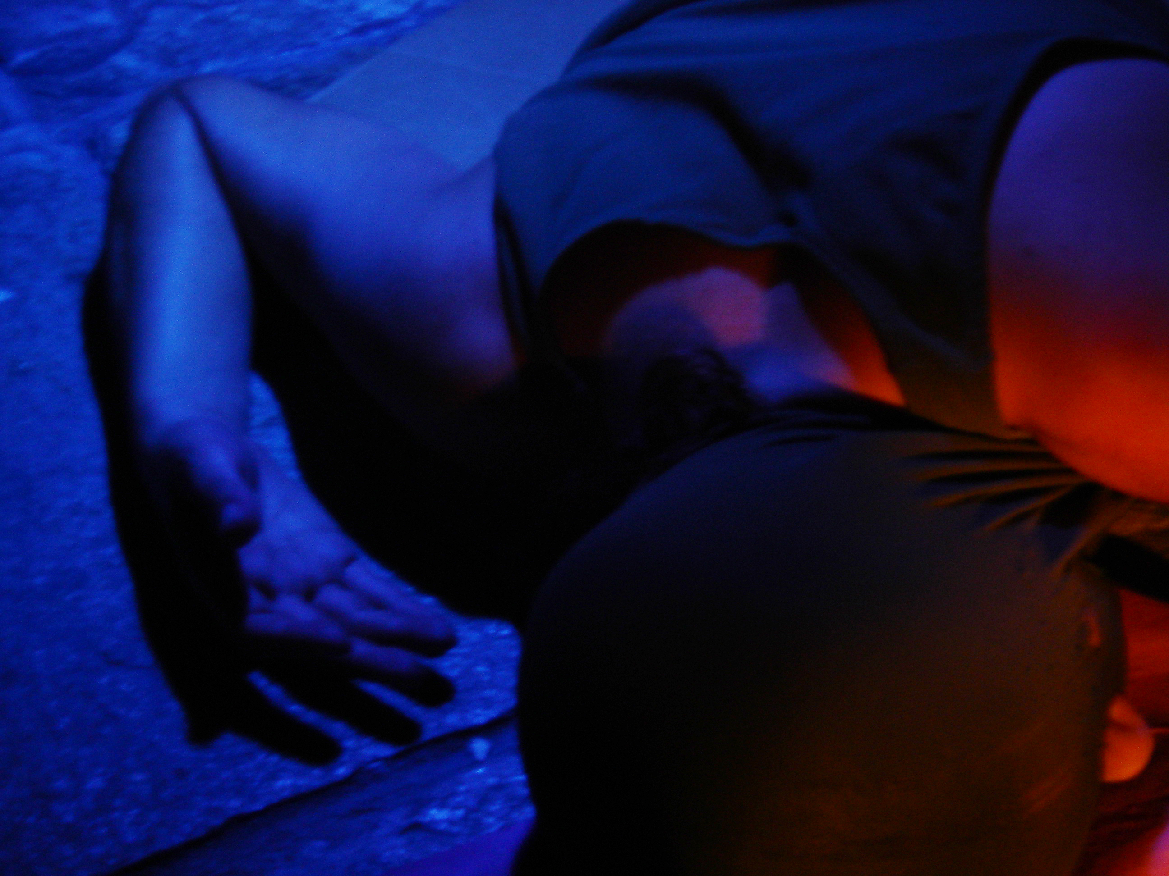
Casa de Nina (2004) Ivani Santana

Slide 20
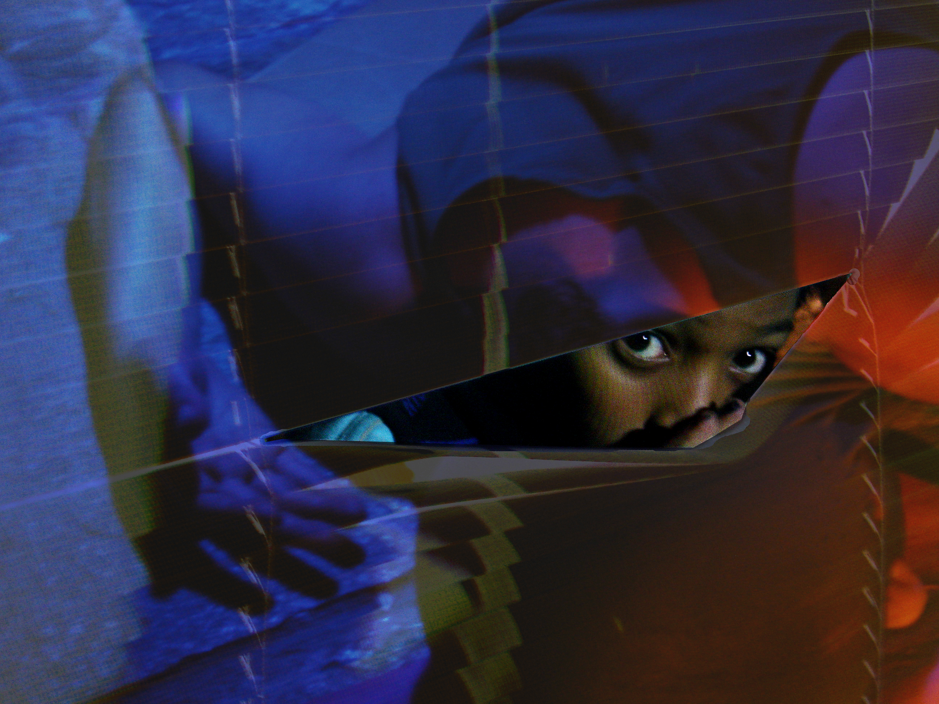

Slide 21
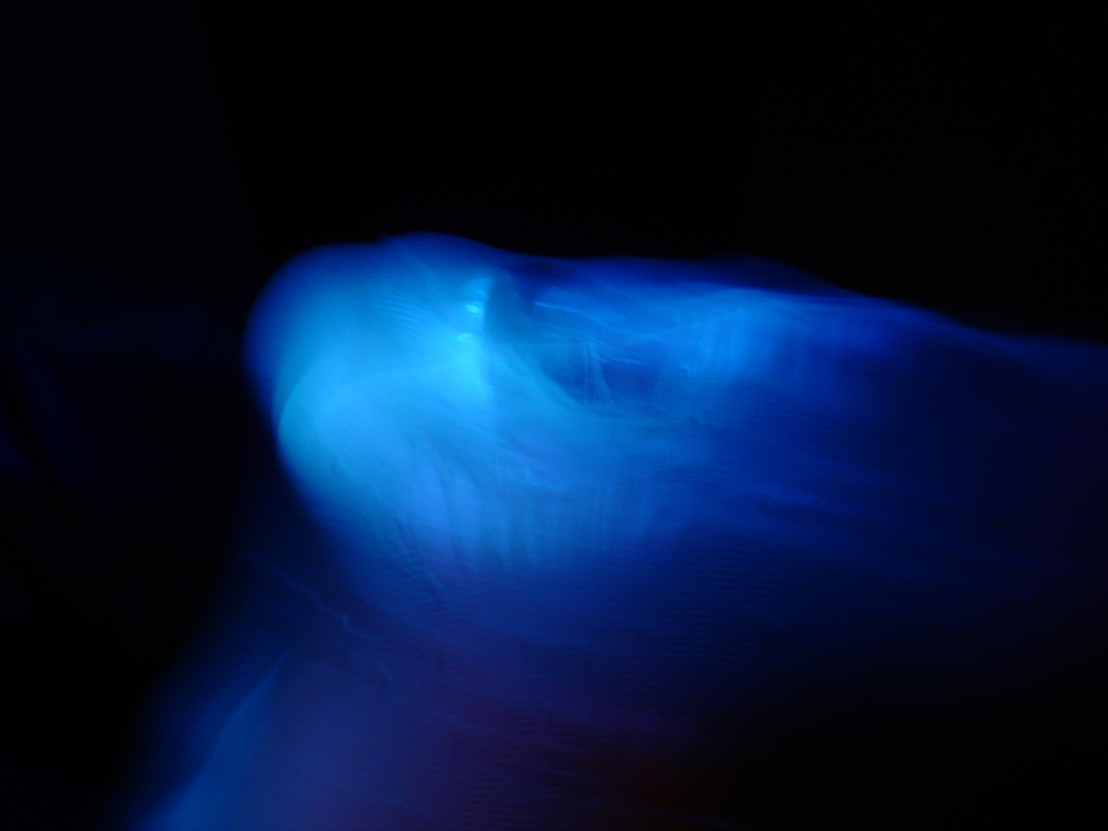
Casa de Nina (2004) Ivani Santana

Slide 22
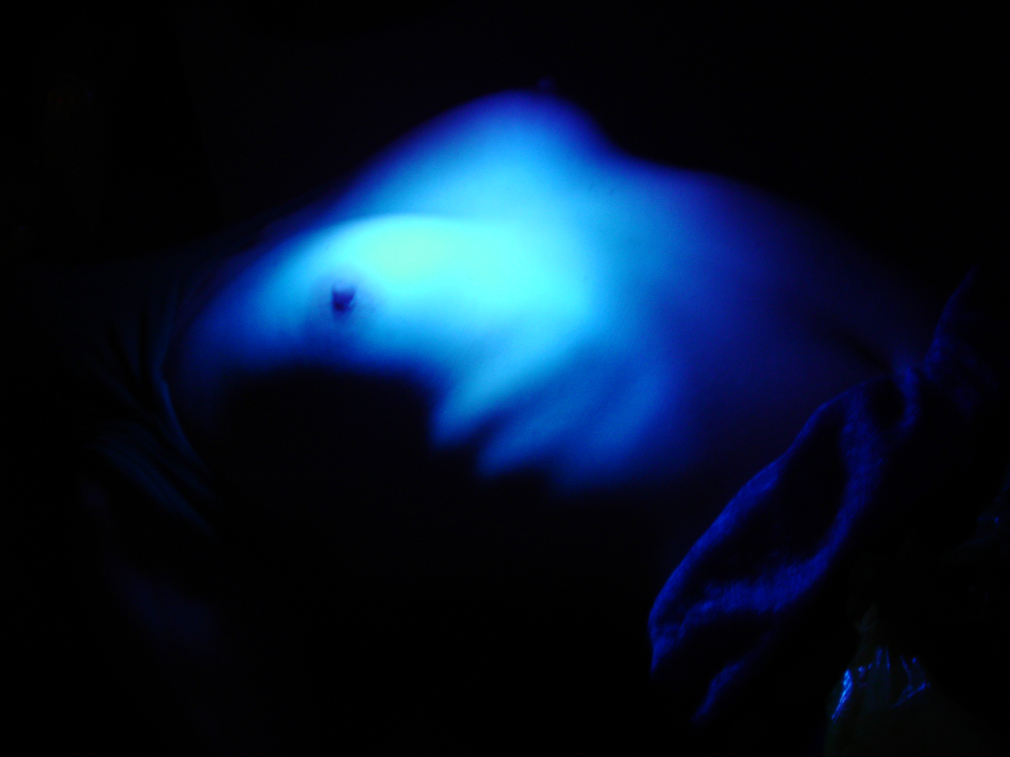
Casa de Nina (2004) Ivani Santana

Slide 23
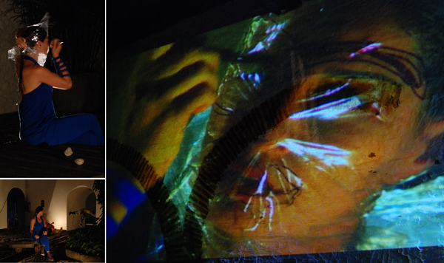
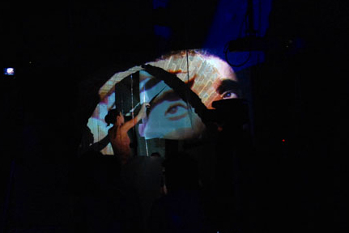
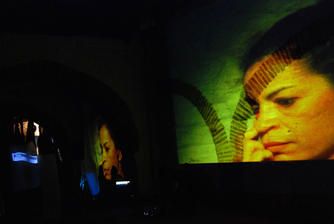
EU
(2008)
Ivani Santana
Festival Internacional de Arte Cênica

Slide 24
EU (2008) - Ivani Santana - Festival Internacional de Arte Cênica

Slide 25
EU (2008) - Ivani Santana - Festival Internacional de Arte Cênica

Slide 26
“A hole in space”. A “non-place” (network) toPerforming Arts Ivani Santana
The reconfigured intimacy of the subject fosters a new understanding of presence, proximity, and interpersonal relationships. Telematics is directly responsible for this reconfiguration, since it promotes technological mediation of a remote presence. There is a transfer of the ‘self’, so to speak.

Slide 27
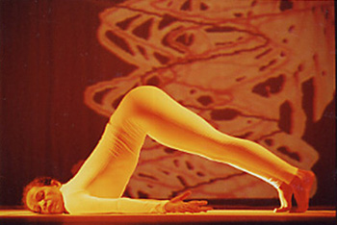
CORPO ABERTO (2005) - Ivani Santana - Festival Internacional de Arte Cênica

Slide 28

CORPO ABERTO (2005) - Ivani Santana - Festival Internacional de Arte Cênica

Slide 29
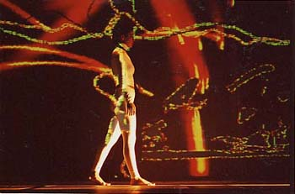
CORPO ABERTO (2005) - Ivani Santana - Festival Internacional de Arte Cênica

Slide 30
e-Pormundos Afeto (2011) Barcelona/Spain, Salvador/Brasil – Ivani Santana

Slide 31
e-Pormundos Afeto (2011) Barcelona/Spain, Salvador/Brasil – Ivani Santana

Slide 32
e-Pormundos Afeto (2011) Barcelona/Spain, Salvador/Brasil – Ivani Santana

Slide 33
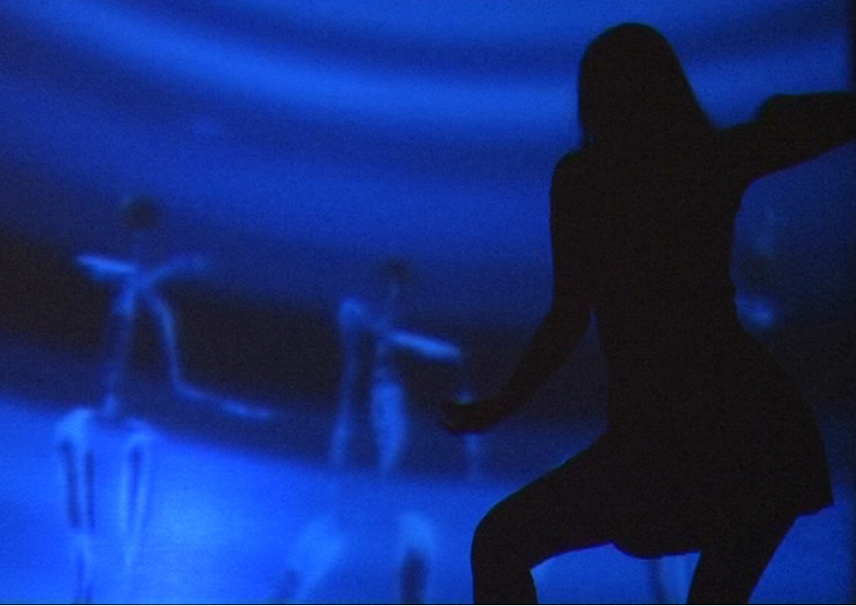
e-Pormundos Afeto (2011) Barcelona/Spain, Salvador/Brasil – Ivani Santana

Slide 34
“A hole in space”. A “non-place” (network) toPerforming Arts Ivani Santana
Telematics was first coined by Simon Nora and Alain Minc in The Computerization of Society(Cambridge: MIT Press, 1980). The telepresence term was coined by Marvin Minsky in 1980 to refer to the tele-operation system used in applications that manipulate remote objects, has also sparked the interest of those who were, at the beginning, antagonistic to this universe.

Slide 35
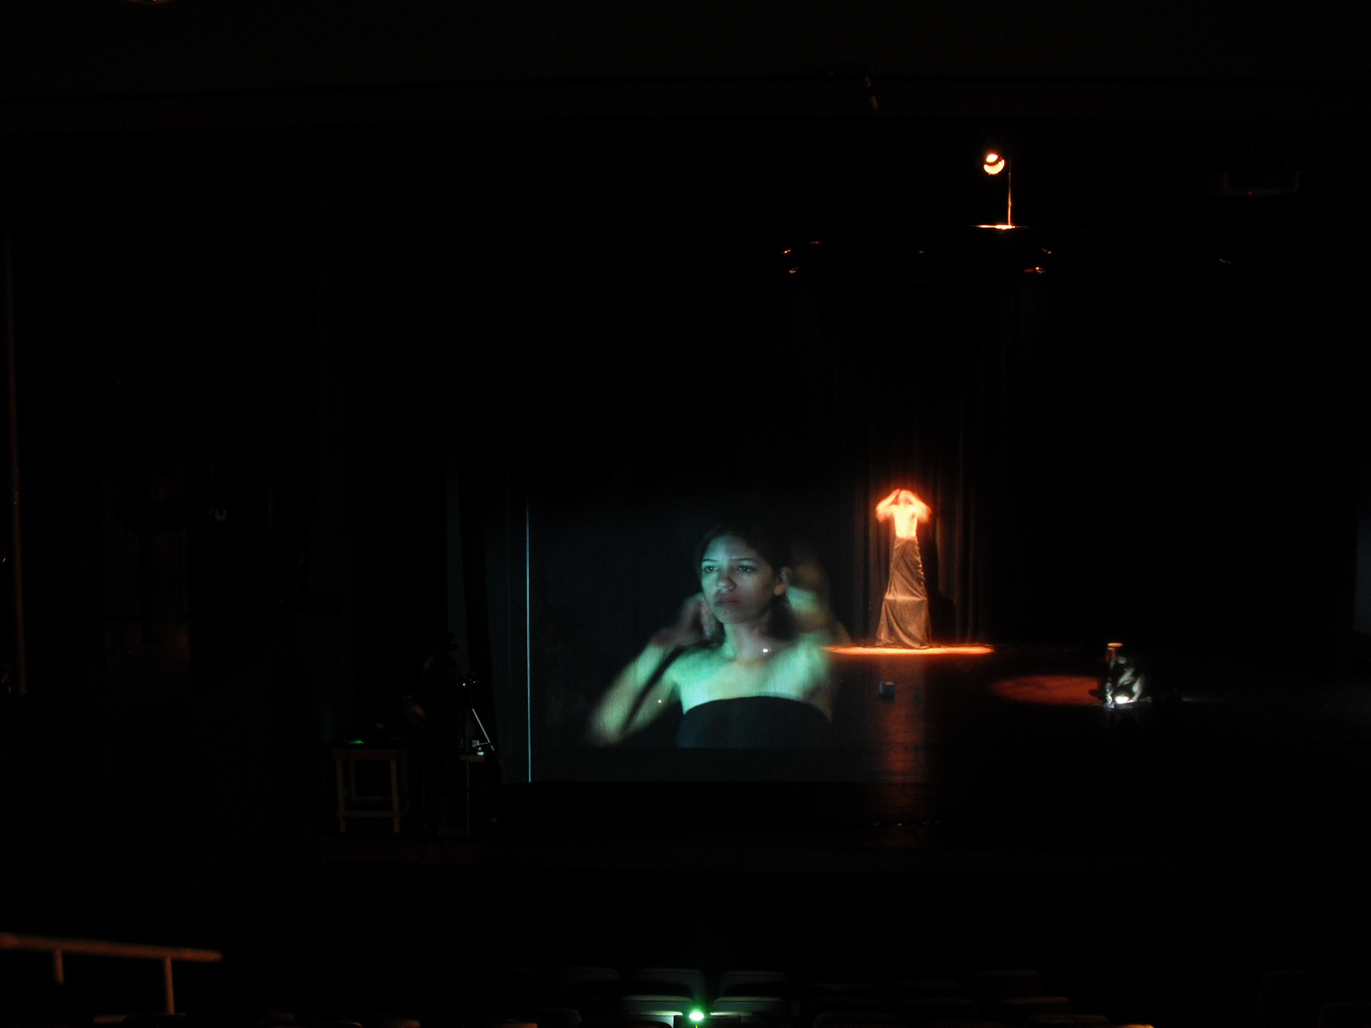
LABORATORIUM MAPA D2 – Salvador, Rio de Janeiro, Fortaleza/ CHINA Ivani Santana

Slide 36
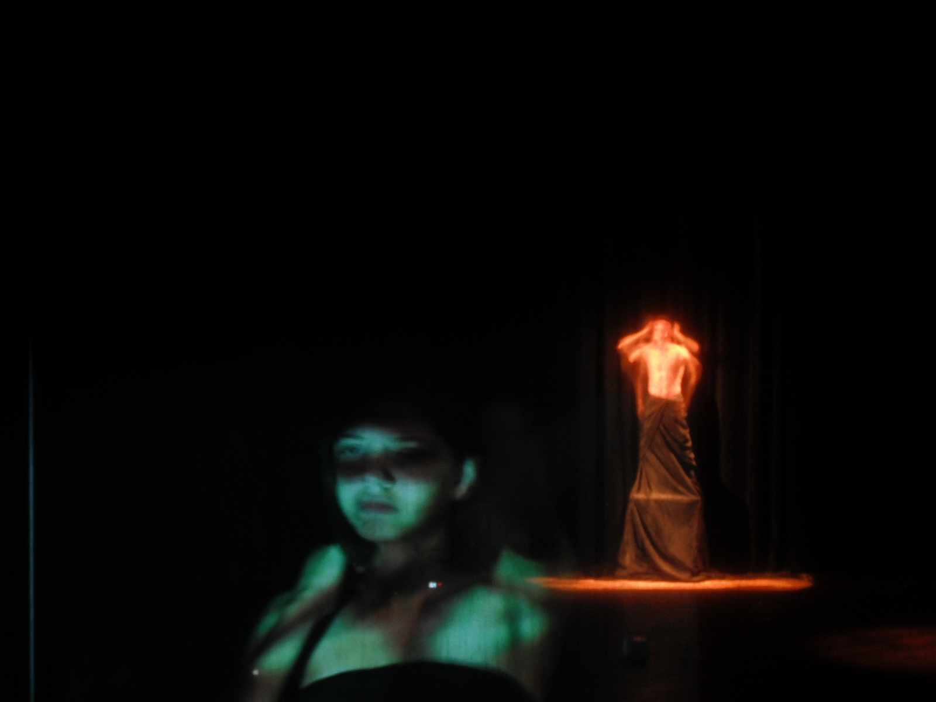
LABORATORIUM MAPA D2 – Salvador, Rio de Janeiro, Fortaleza/ CHINA Ivani Santana

Slide 37
LABORATORIUM MAPA D2 – Salvador, Rio de Janeiro, Fortaleza/ CHINA Ivani Santana

Slide 38
LABORATORIUM MAPA D2 – Salvador, Rio de Janeiro, Fortaleza/ CHINA Ivani Santana

Slide 39
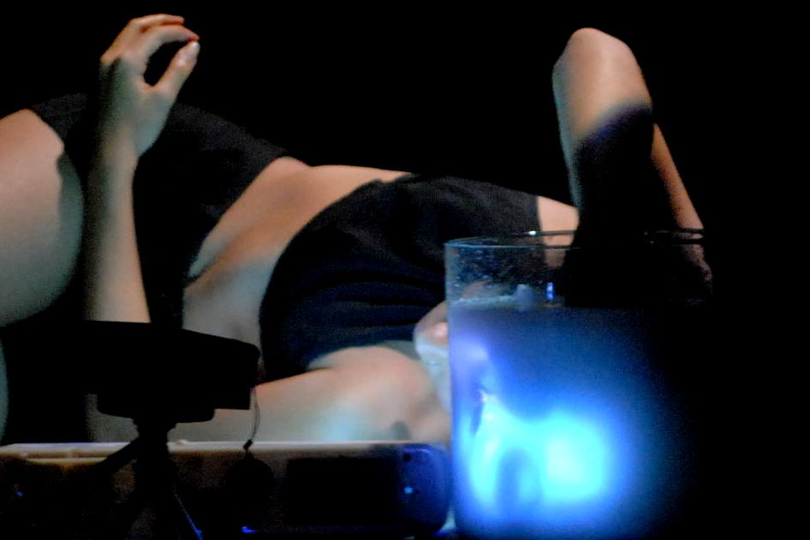
LABORATORIUM MAPA D2 – Salvador, Rio de Janeiro, Fortaleza/ CHINA Ivani Santana

Slide 40
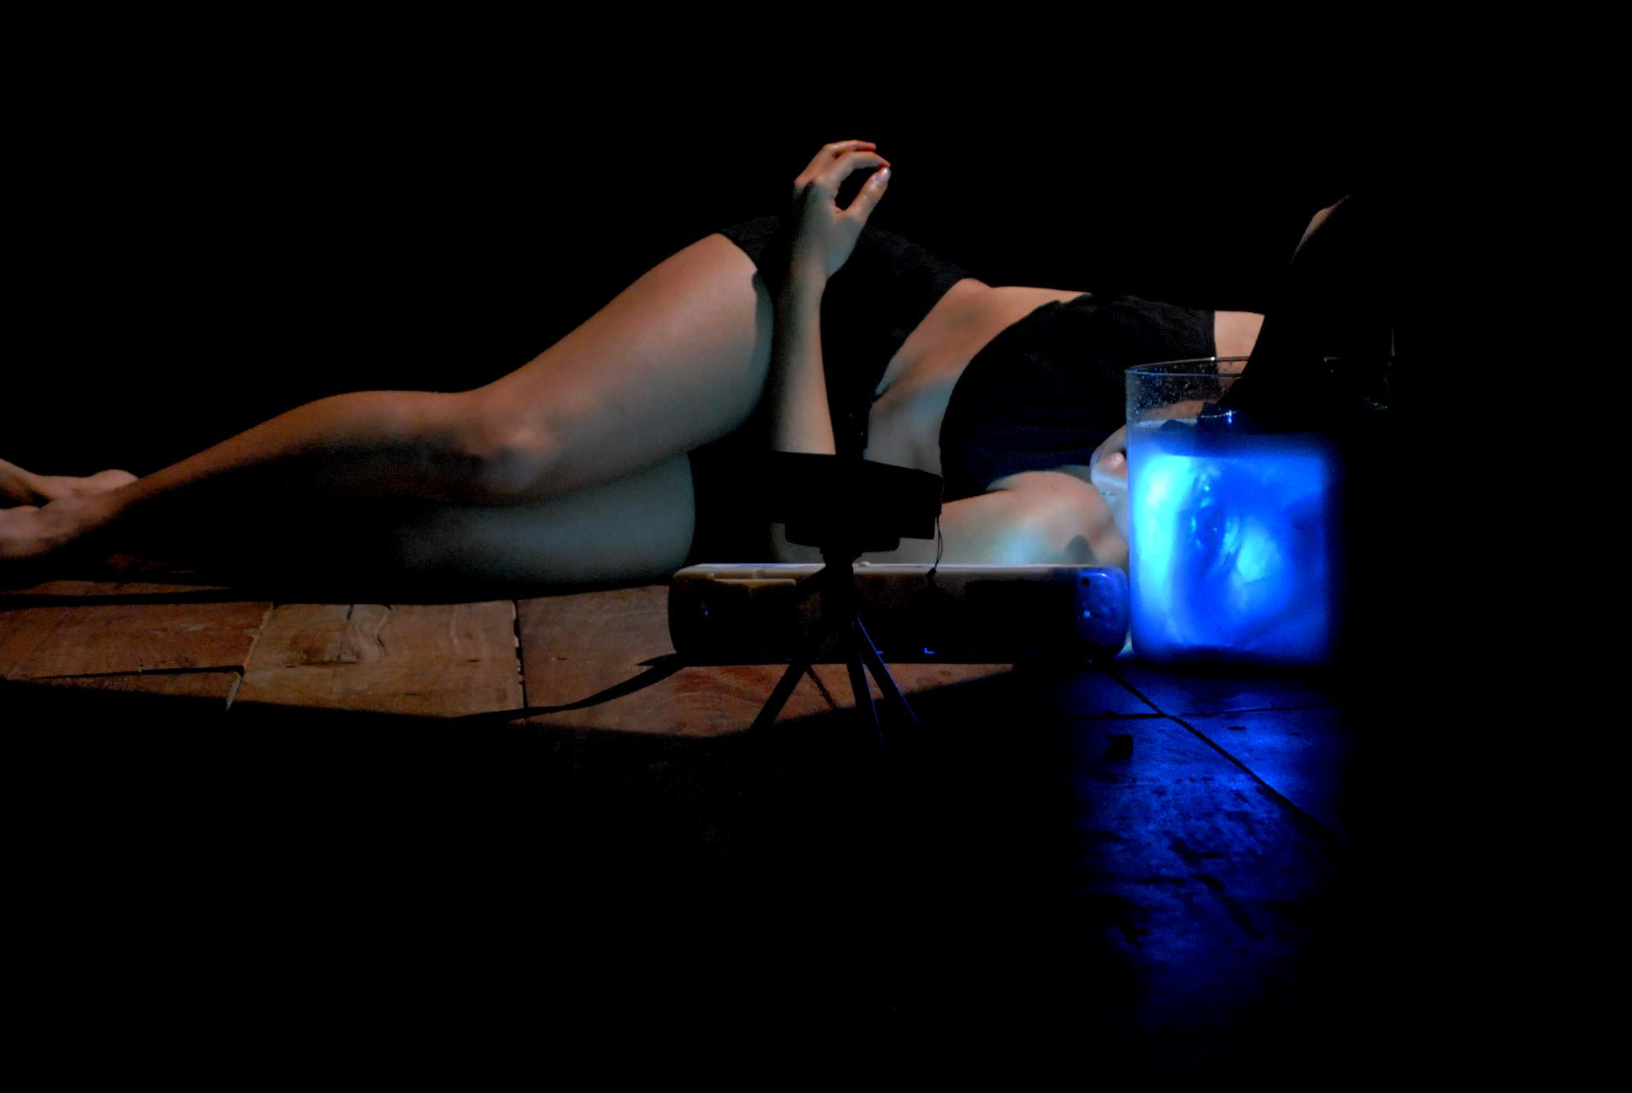
LABORATORIUM MAPA D2 – Salvador, Rio de Janeiro, Fortaleza/ CHINA Ivani Santana

Slide 41
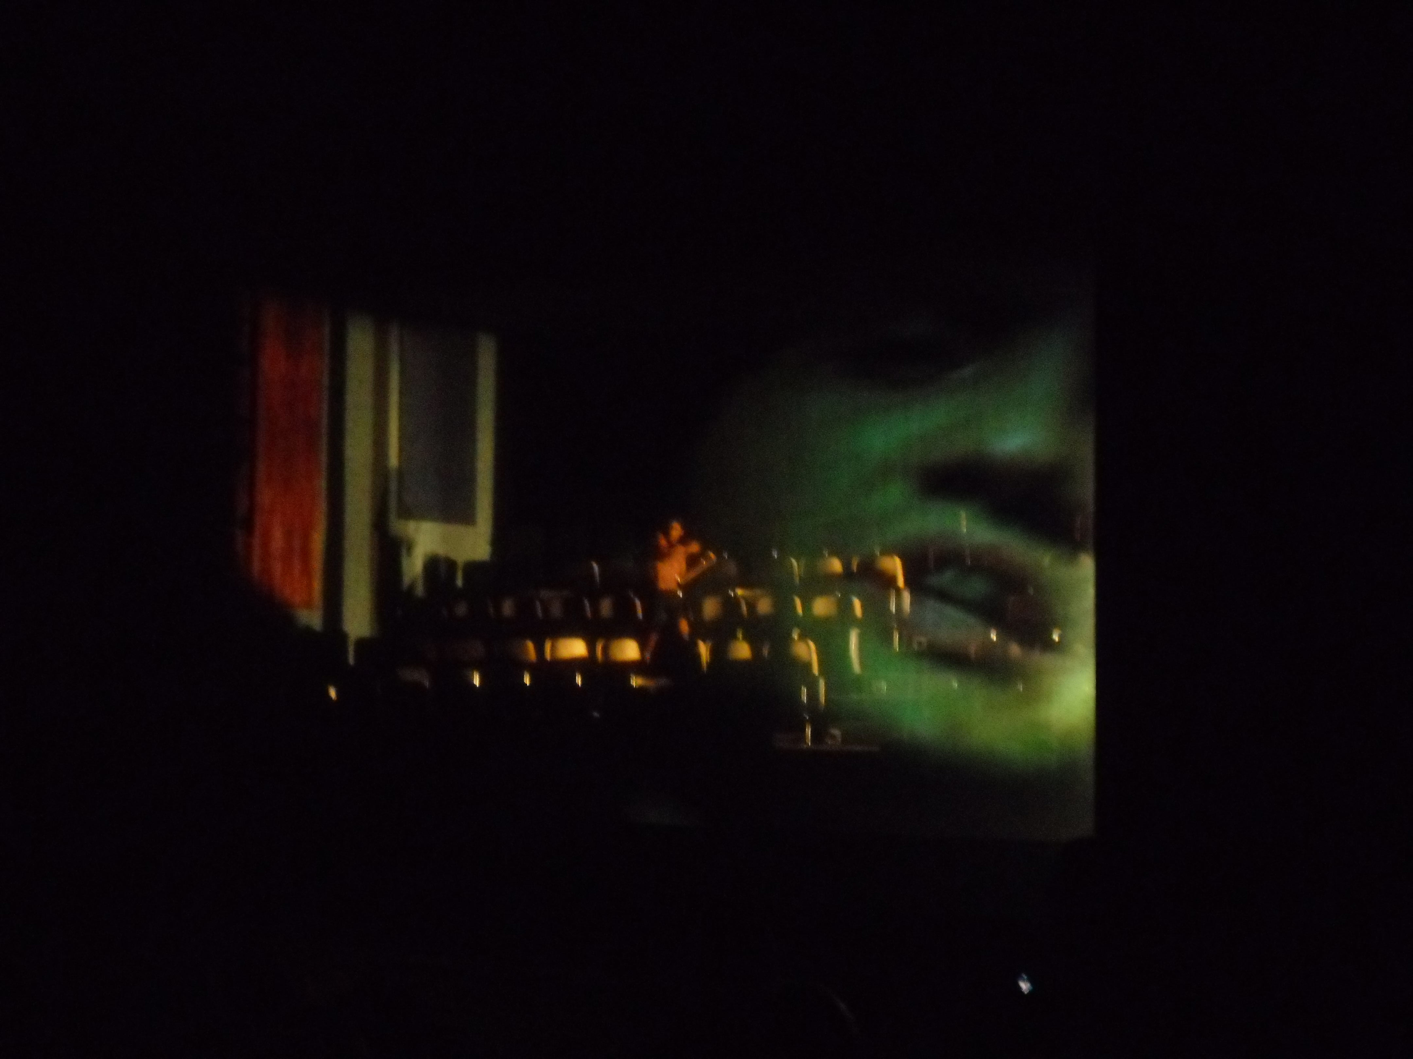
LABORATORIUM MAPA D2 – Salvador, Rio de Janeiro, Fortaleza/ CHINA Ivani Santana

Slide 42
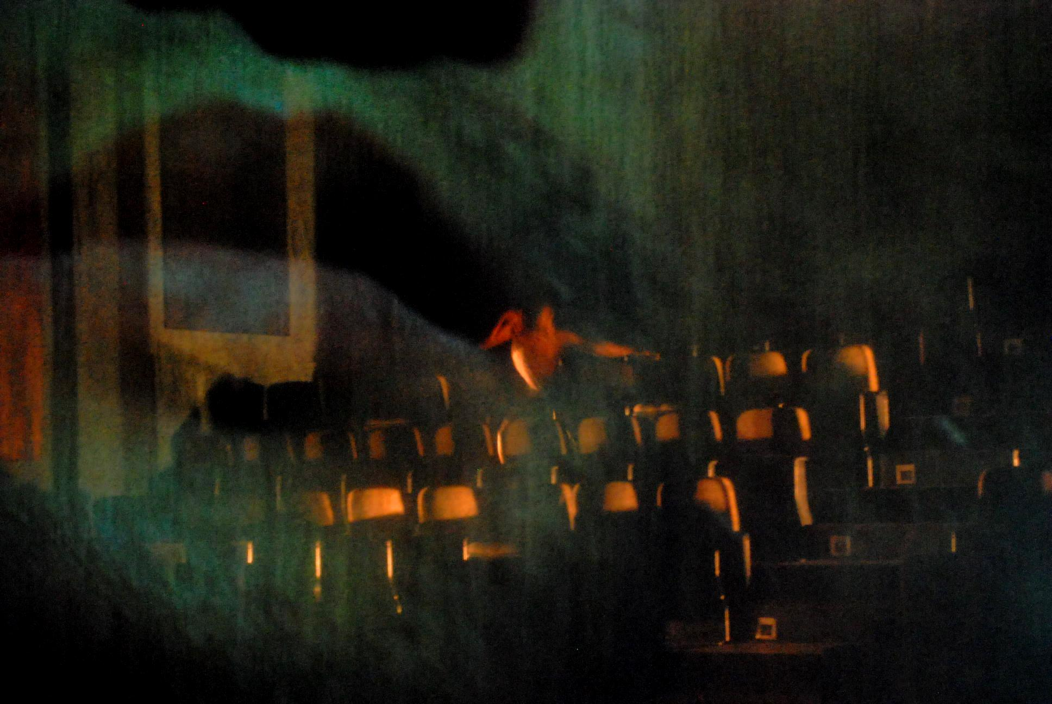
LABORATORIUM MAPA D2 – Salvador, Rio de Janeiro, Fortaleza/ CHINA Ivani Santana

Slide 43
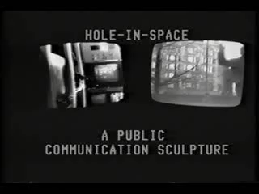
“A hole in space”. A “non-place” (network) toPerforming Arts

Slide 44
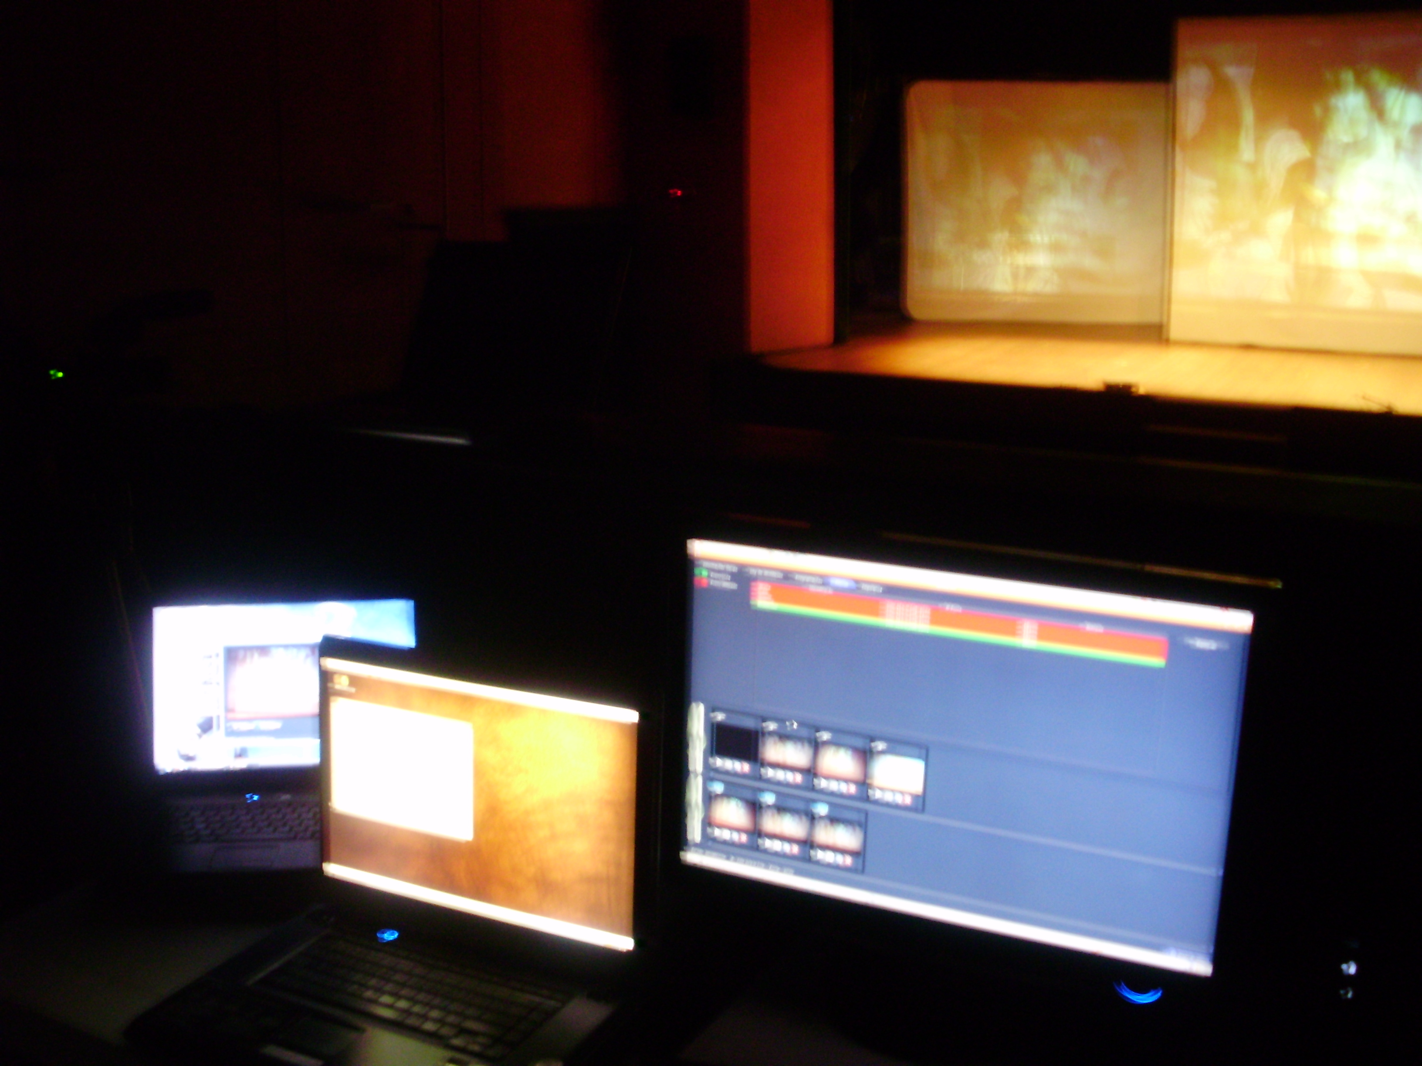
e-Pormundos Afeto (2011) Barcelona/Spain, Salvador/Brasil – Ivani Santana

Slide 45
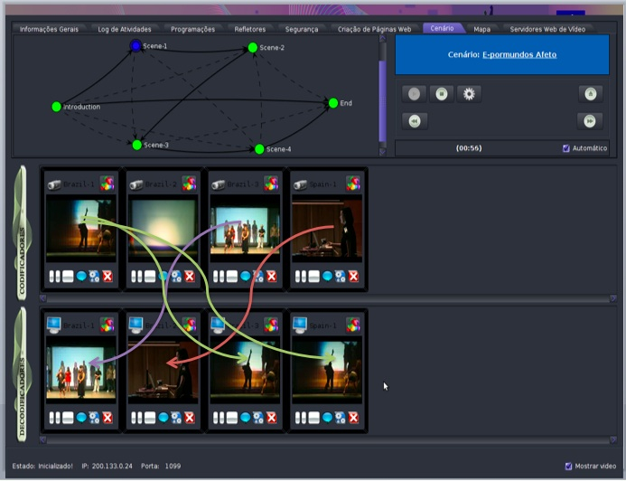

Slide 46
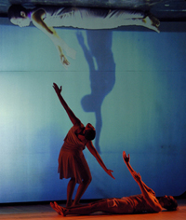
Versus (2005)
Salvador - dancer
Remote space 1
Internet Remote space 4
João Pessoa
music - )))))
Remote space 3
Brasília - dancer
Remote space 2
Experiment A - VERSUS - 2005

Slide 47
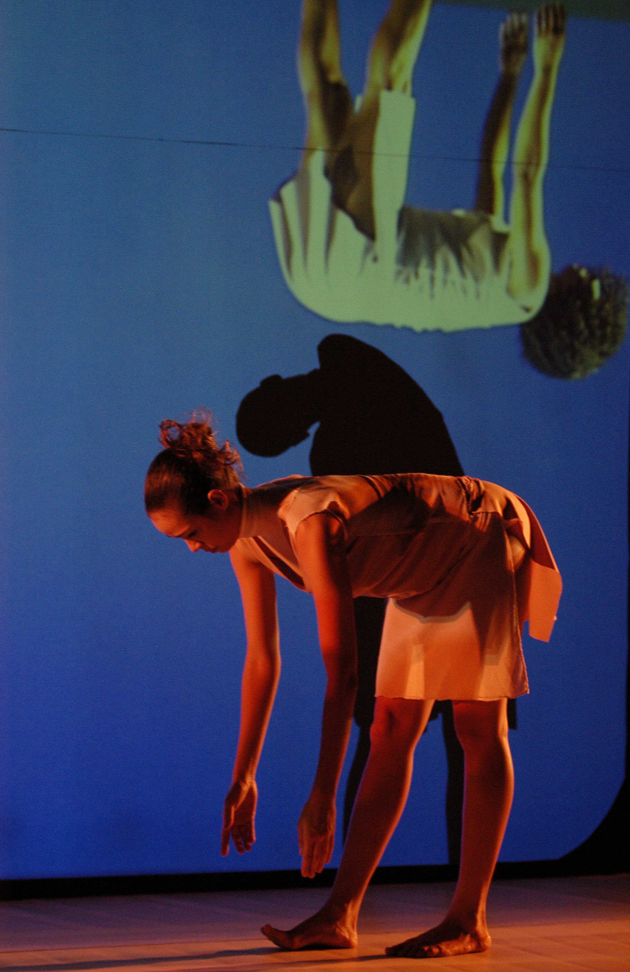
“A hole in space”. A “non-place” (network) to Performing Arts
Versus (2005)
Performing arts created since 2005 with support of RNP.

Slide 48
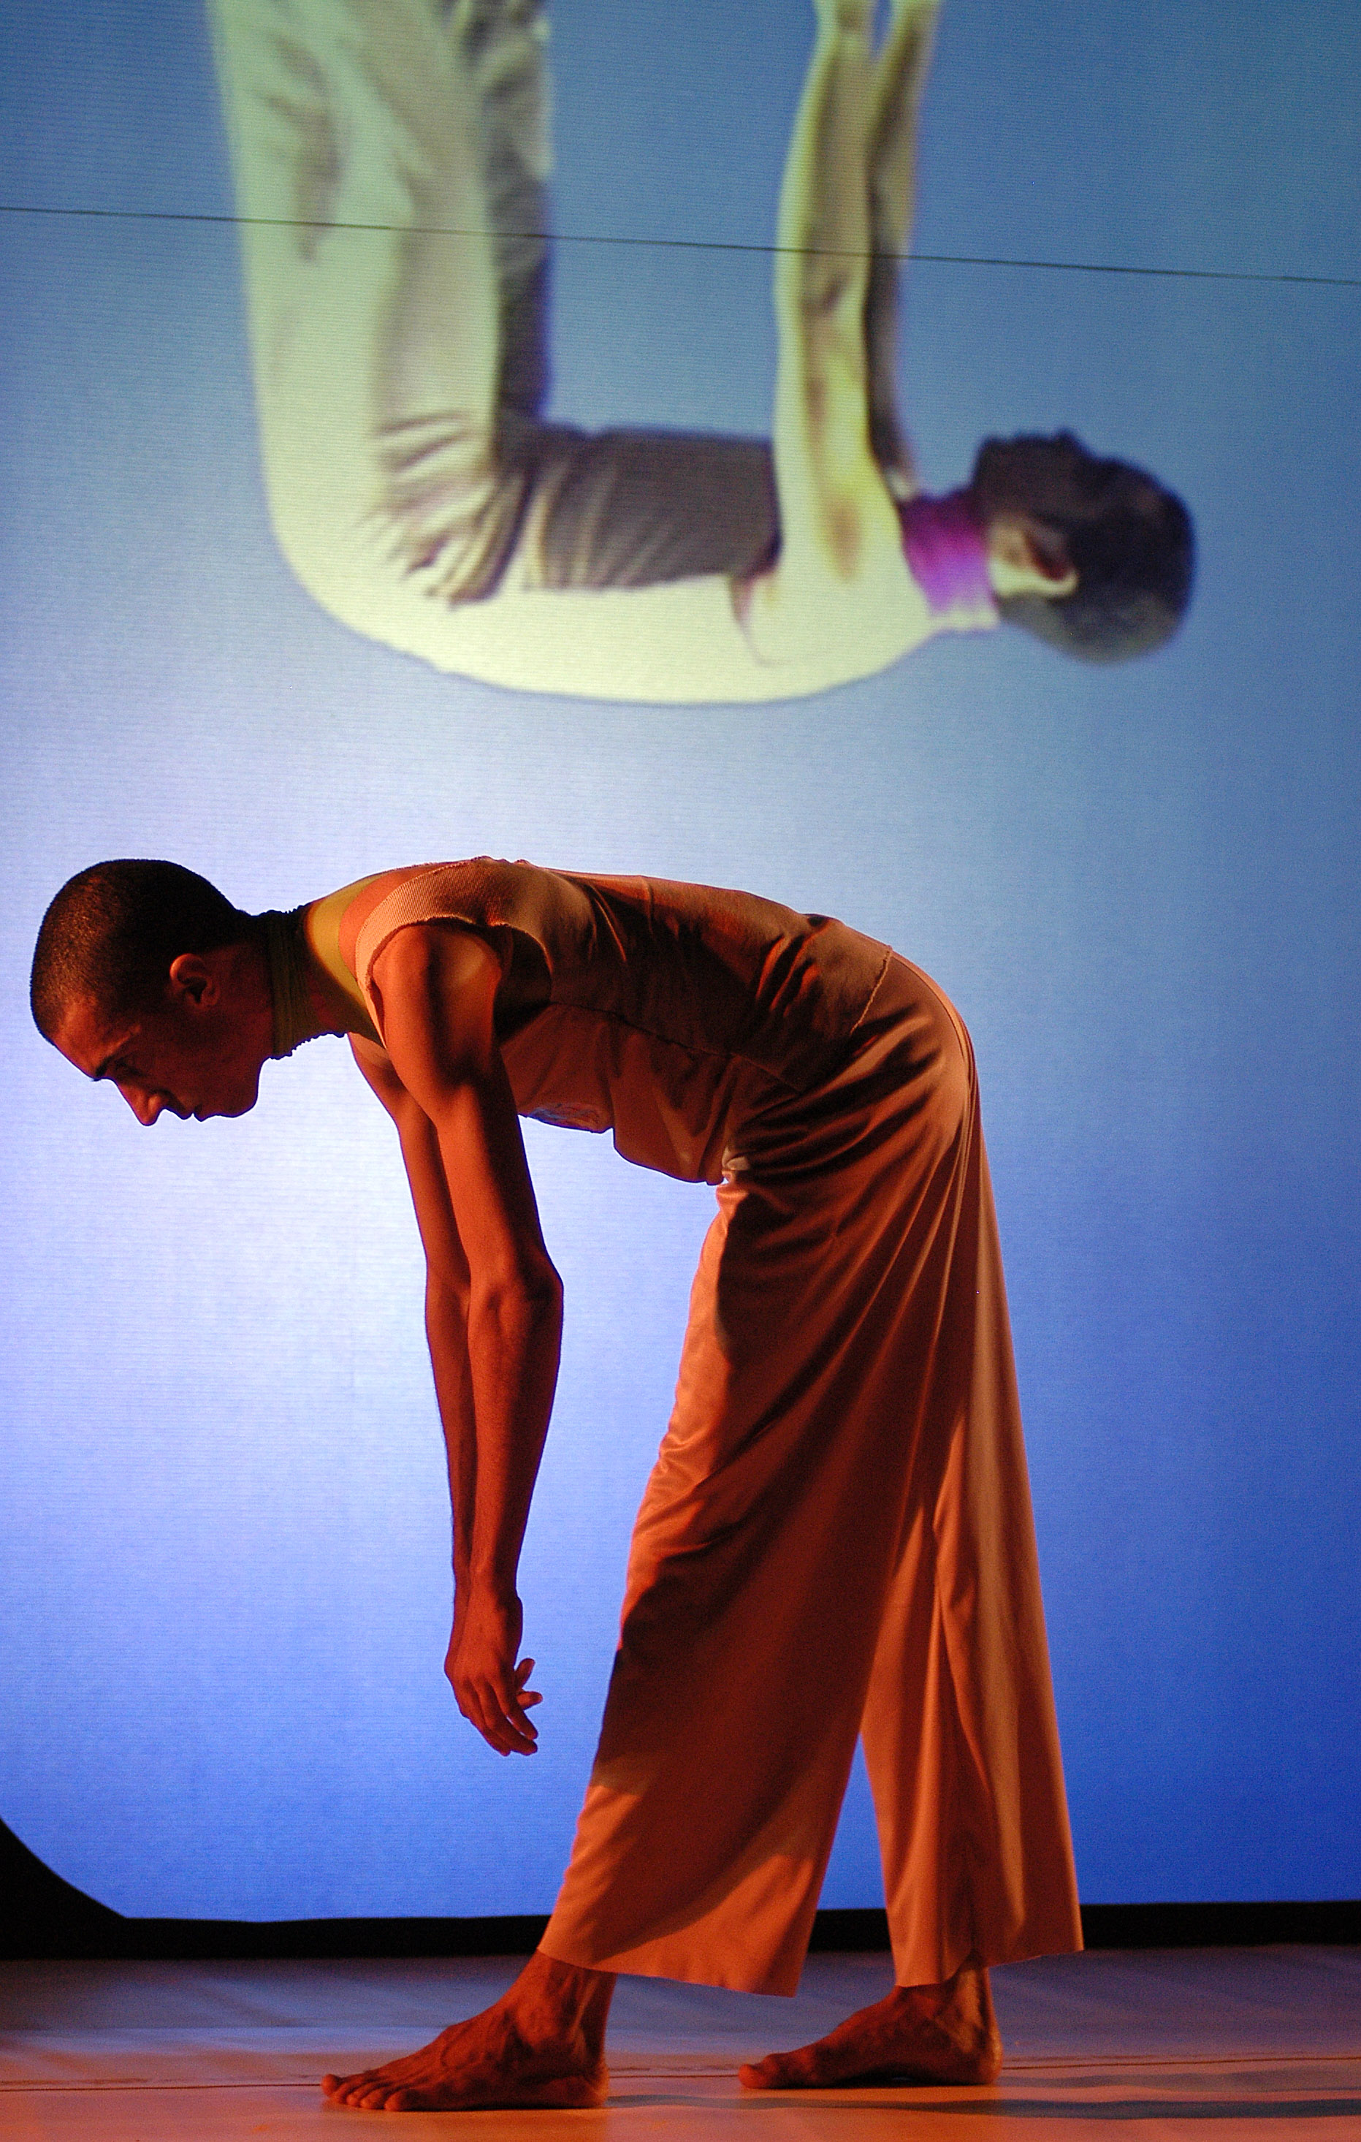
“A hole in space”. A “non-place” (network) to Performing Arts
Versus (2005)
Performing arts created since 2005 with support of RNP.
Versus

Slide 49
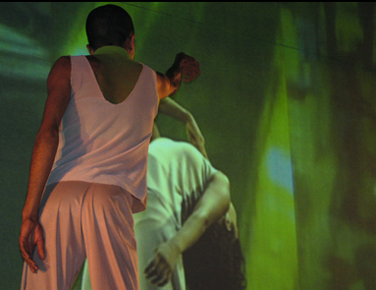
VERSUS (2005)
Salvador
StreamingHDTV
High Definition
Brasília
VERSUS - 2005

Slide 50
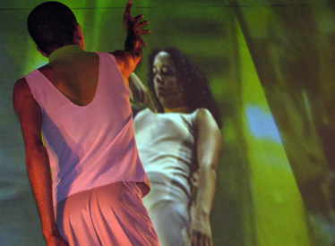
VERSUS (2005)
Salvador
StreamingHDTV
High Definition
Brasília
VERSUS - 2005

Slide 51
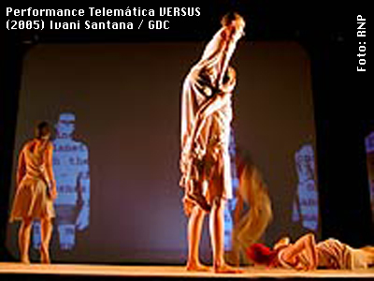
Versus (2005)
Performing arts created since 2005 with support of RNP.
Isadora software
Sensible environment

Slide 52
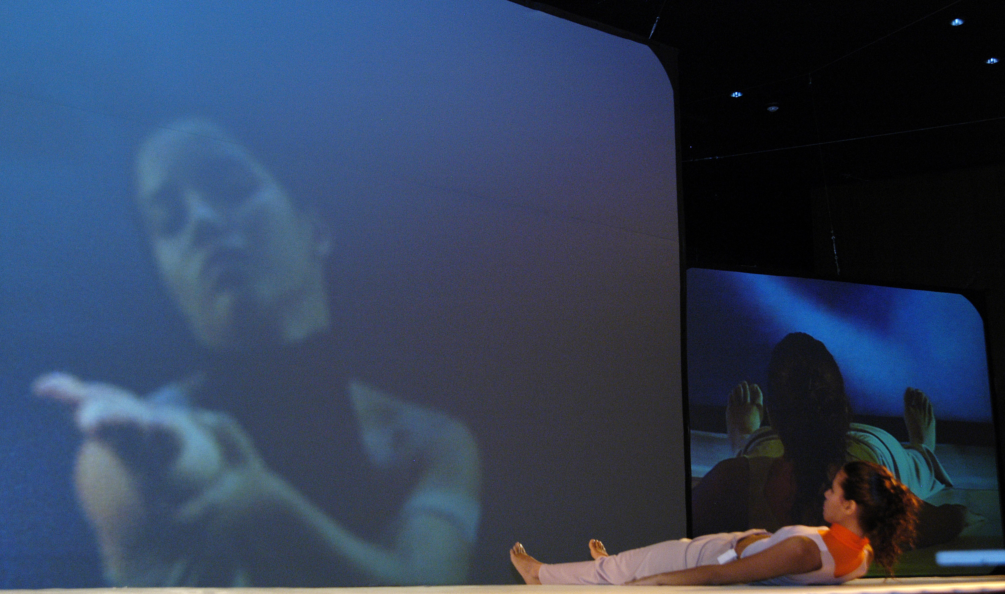
Versus (2005)

Slide 53
VERSUS - 2005

Slide 54
VERSUS (2005)
Video Stream to Brasília (space 2):
1 streming SDTV - músicos João Pessoa – 6 Mbps.
1 streming HDTV - dançarinos - Salvador – 20 Mbps.
Video Stream from Brasília (space 2):
1 streming SDTV to digital video RNP Network to PoP-RJ – 6 Mbps.
1 streming HDTV via GIGA Network to PoP-DF – 20 Mbps.
1 Internet streaming with audio (English and Spanish) and to PoP-RJ – 6 Mbps.

Slide 55
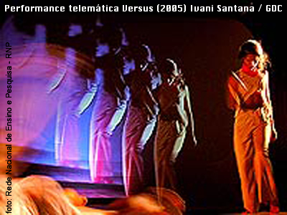

Slide 56
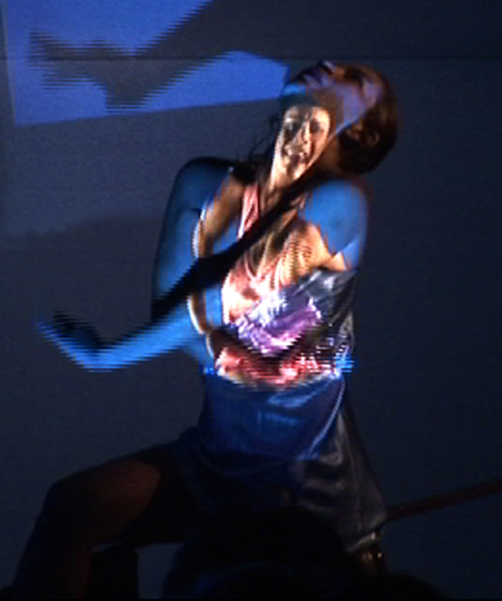
Por Onde Cruzam Alamedas
2006
(inspirado no livro “O Jardim das Veredas que se bifurcam” de Jorge Luis Borges)

Slide 57
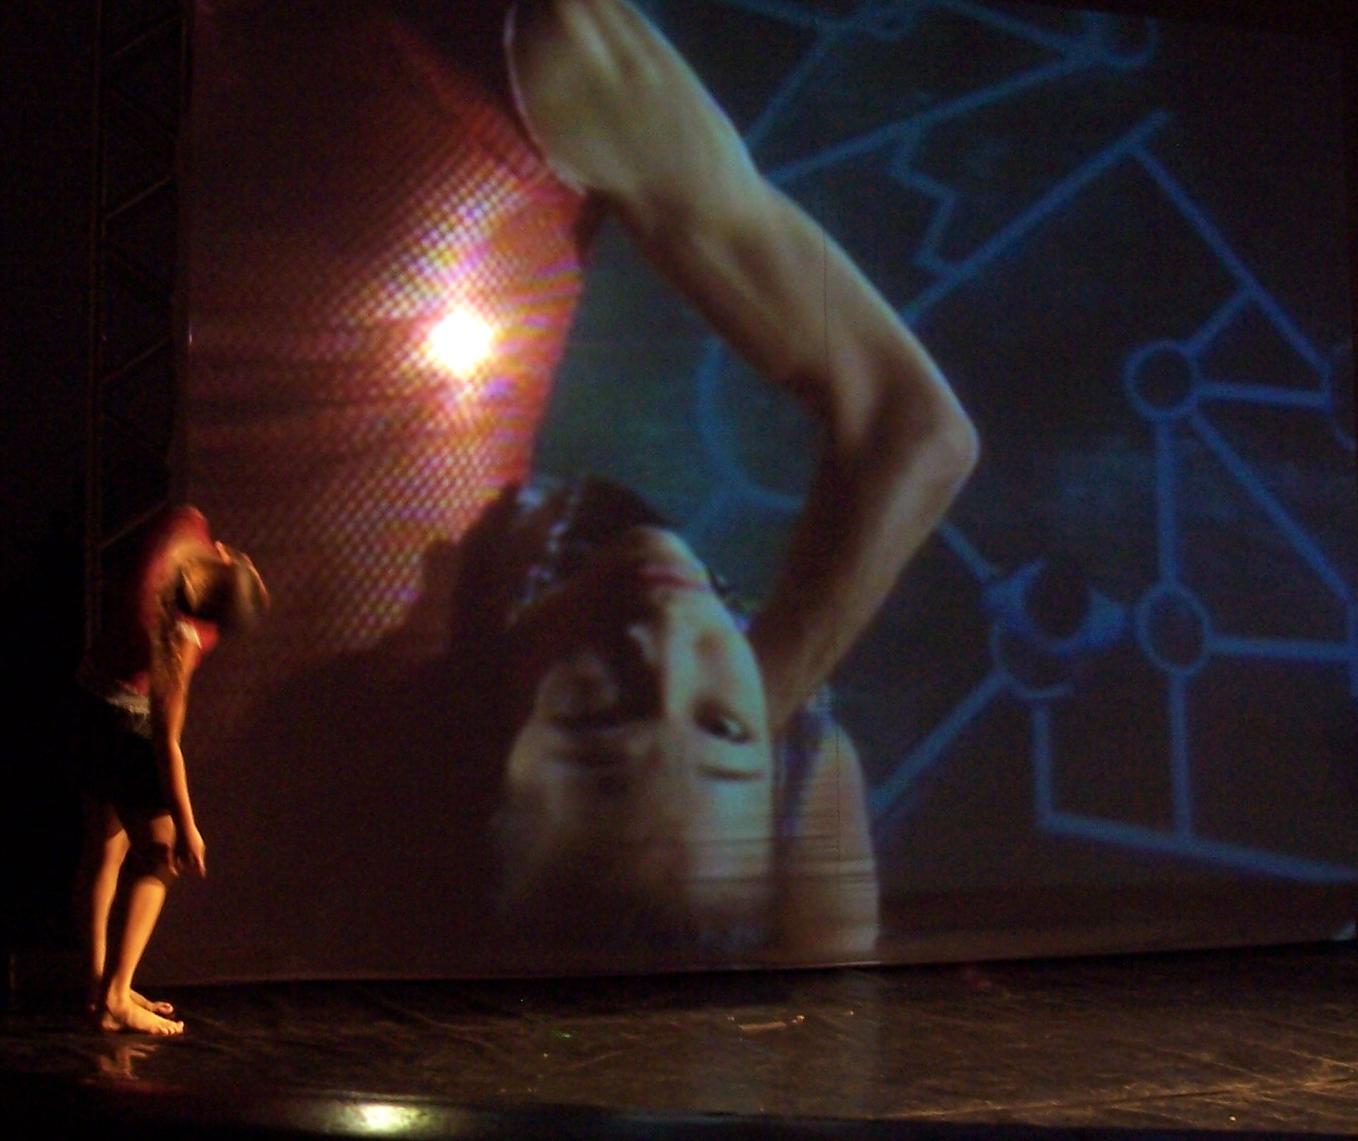
Por onde Cruzam Alamedas (2006) Ivani Santana
Remote space 1
layer 1 = dancers
layer 2
Videoscenography
Remote space 2
layer 1 = dancer
on stage
Por Onde Cruzam Alamedas

Slide 58
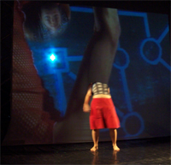
Remote space 1
layer 1 = dancers
layer 2
Videoscenography
Remote space 2
layer 1 = dancer
on stage
Espaço 2
Por Onde Cruzam Alamedas
Por onde Cruzam Alamedas (2006) Ivani Santana

Slide 59
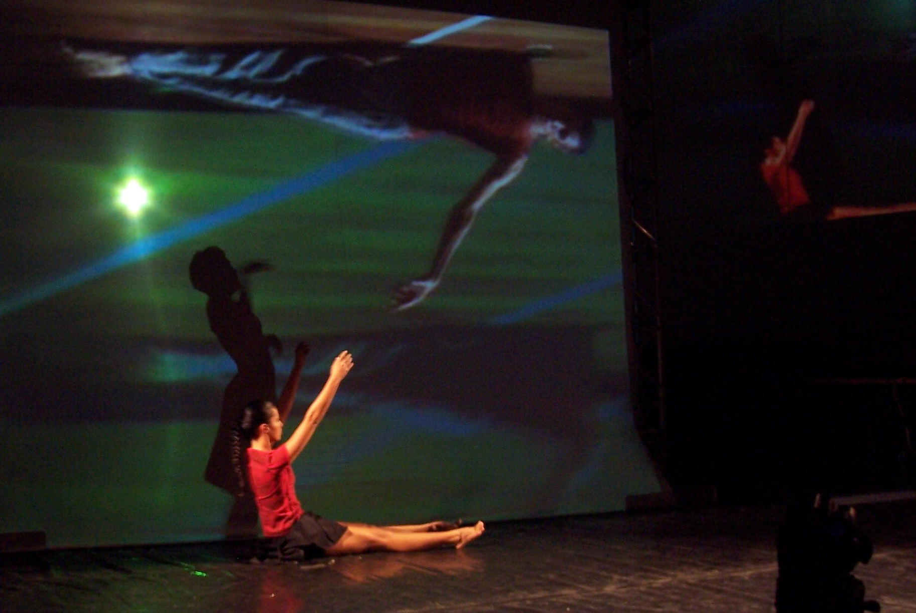
Por onde Cruzam Alamedas (2006) Ivani Santana
Space 1
Internet
Space 2
Por Onde Cruzam Alamedas

Slide 60
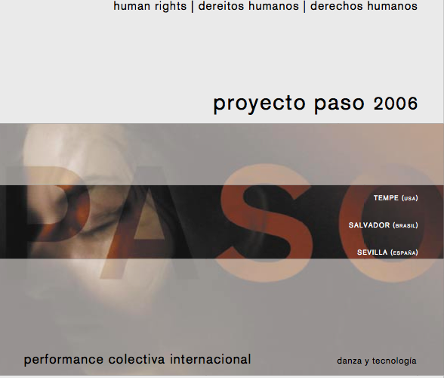

Slide 61
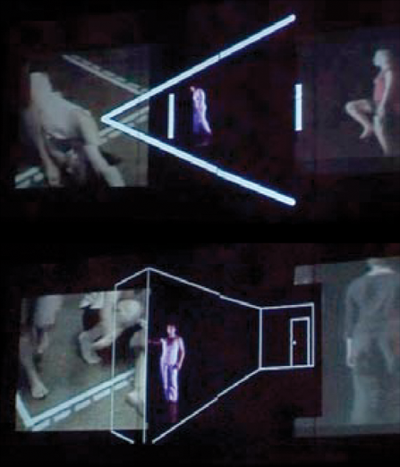
Proyecto Paso
(2006)
Ivani Santana
Brazil
Spain
EUA

Slide 62
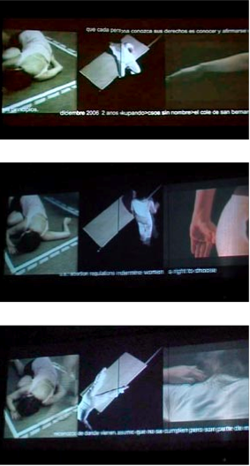
3 simultaneous images
USA
Spain
Brazil
Nukonen, Paso ao Chile
(2007)
Brazil, Chile, USA, Spain
Ivani Santana

Slide 63


Proyecto Paso
(2006)
Ivani Santana
Brazil
Spain
EUA

Slide 64


Proyecto Paso
(2006)
Ivani Santana
Brazil
Spain
EUA
2006/2007
Proyecto Paso
Nukonen, Paso ao Chile
Brazil, Chile, EUA, Spain

Slide 65


Proyecto Paso (2006) Brasil, USA, Spain , Ivani Santana

Slide 66

(In)TOQue
(2008)
Ivani Santana

Slide 67

(In)TOQue
(2008)
Ivani Santana

Slide 68
(In)TOQue
(2008)
Ivani Santana

Slide 69
(In)TOQue
(2008)
Ivani Santana

Slide 70

(In)TOQue
(2008)
Ivani Santana

Slide 71

(In)TOQue (2008) - Ivani Santana

Slide 72


Slide 73


Slide 74



Avatar = Euvira
e_Pormundos Afeto
(2010)
Ivani Santana/ Konic Thtr

Slide 75


Slide 76
e_Pormundos Afeto (2011) - Ivani Santana/ Konic Thtr Brasil/Spain

Slide 77
e_Pormundos Afeto (2011)
Ivani Santana/ Konic Thtr Brasil/Spain

Slide 78
e_Pormundos Afeto (2011) - Ivani Santana/ Konic Thtr Brasil/Spain

Slide 79
e_Pormundos Afeto (2011) - Ivani Santana/ Konic Thtr Brasil/Spain

Slide 80
e_Pormundos Afeto (2011)
Ivani Santana/ Konic Thtr Brasil/Spain

Slide 81
e_Pormundos Afeto (2011) - Ivani Santana/ Konic Thtr Brasil/Spain

Slide 82
e_Pormundos Afeto (2011) - Ivani Santana/ Konic Thtr Brasil/Spain

Slide 83
Next Project
Ecotelemedia = Brasil (Rio de Janeiro/Salvador), Dinamarca/China
CyberPerformance (2012)
Brasil/Korea/Thai
APAN (the Asia Pacific Advanced Network)

Slide 84

Why NETWORK PERFORMANCE TELEMATIC ART ?
Give new ideas;
Transgress, go beyond;
Create new demands to the network;
Integrate cultures;
It’s a reflex of our time;
It’s beautiful!!!!!!

Slide 85
Why not a Cultural Network to interchange Art Knowledge?

Slide 86

Do you know any culture, at any time, without art?

Slide 87

This is the ART of our time! DIGITAL CULTURE
Ivani Santana www.poeticatecnologica.ufba.br
ivani_santana@uol.com.br www.mapad2.ufba.br

