Slide 1
A
Bioinformatics
Allan Orozco
Training & Scientific Manager
Spanish National Bioinformatics Institute- CNIO- Madrid- Spain
Director Bioinformatics lab’s-UCR-Costa Rica
Director Bioinformatics Central America Net
Rio de Janeiro, 2011

Slide 2
¿Qué es la Bioinformática?
La bioinformática es el campo donde las ciencias biológicas, biomédicas, la ciencia de la computación, y la tecnología de información se funden en una disciplina.
El objetivo principal es el descubrimiento de nuevos indicios biológicos, como también crear una perspectiva global de la cual poder unificar principios de la biología.
(NCBI Education)on)

Slide 3

No solo tiene un camino visible…..
expression data …
Sometimes the Bioinformatics teaching and research paths shows us an apparent way but then we realize that there are other unknown ways that can give us answers that are not very clear at the time.

Slide 4

… sino varios y son diversos

Slide 5
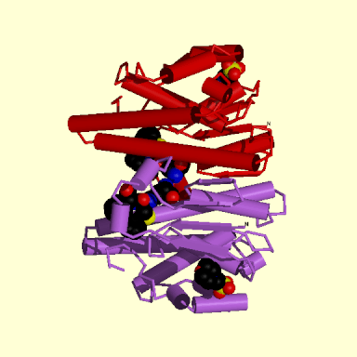
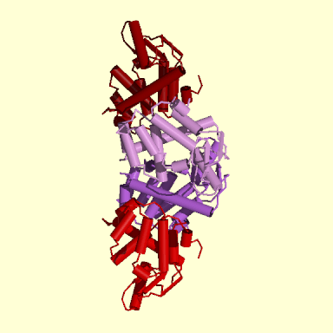
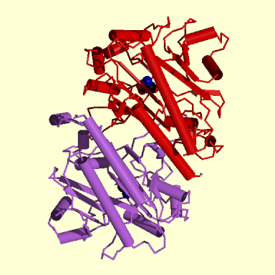
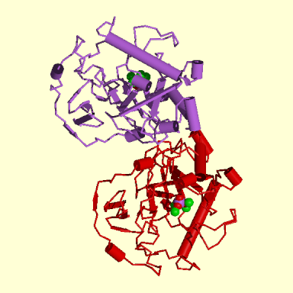
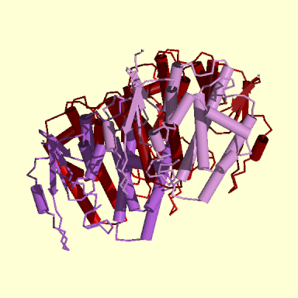
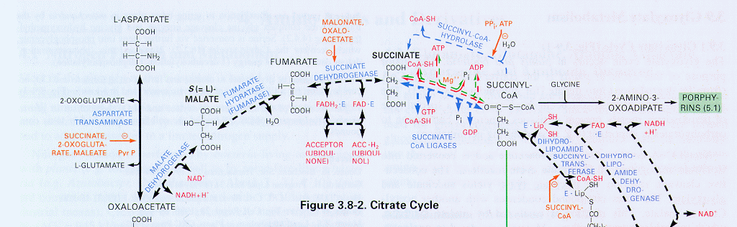
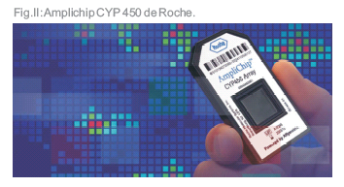
GENOMA
BIOINFORMATICS
relaciones gen-proteína
PROTEOMA
relaciones proteína-proteína
METABOLOMA
Relaciones metabólicas y celulares
Citrate Cycle

Slide 6

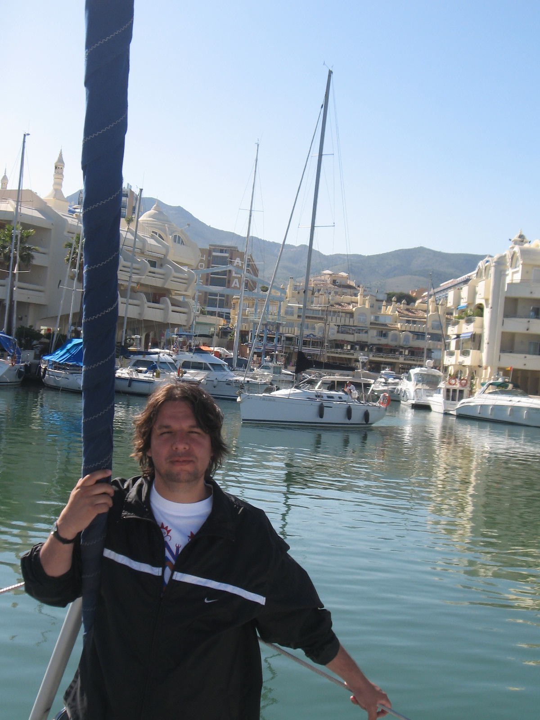
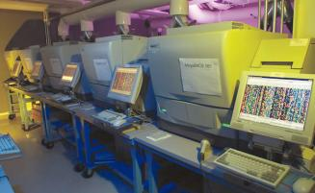
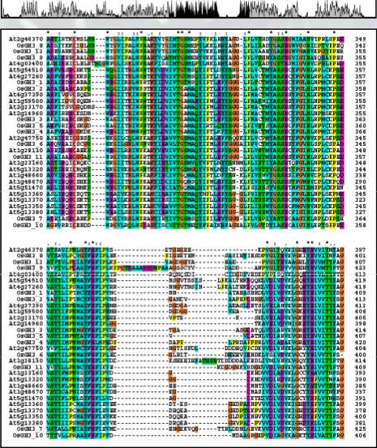


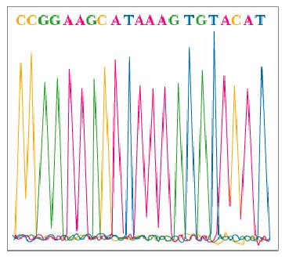
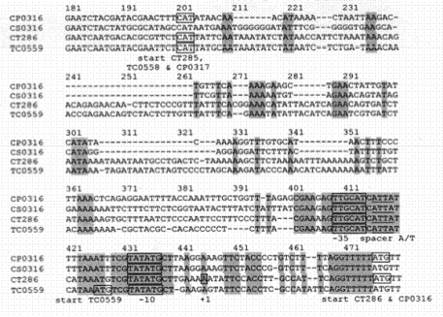
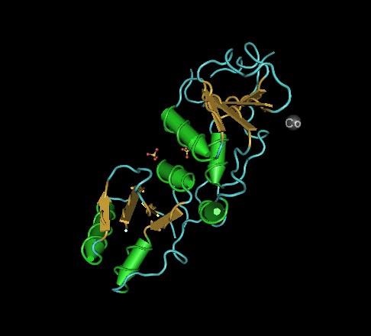
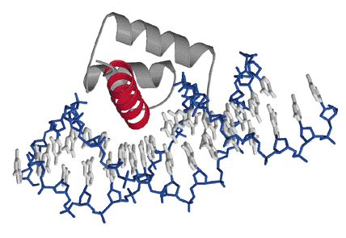
Aplicaciones bioinformáticas
Secuenciación ADN
Funcionalidad en estructura
Determinación de motivos

Slide 7
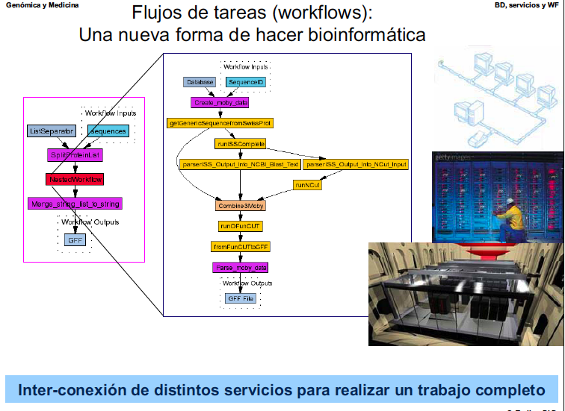
Workflows

Slide 8
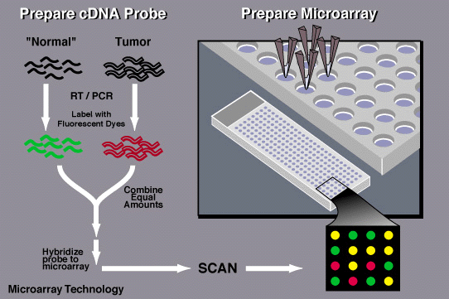
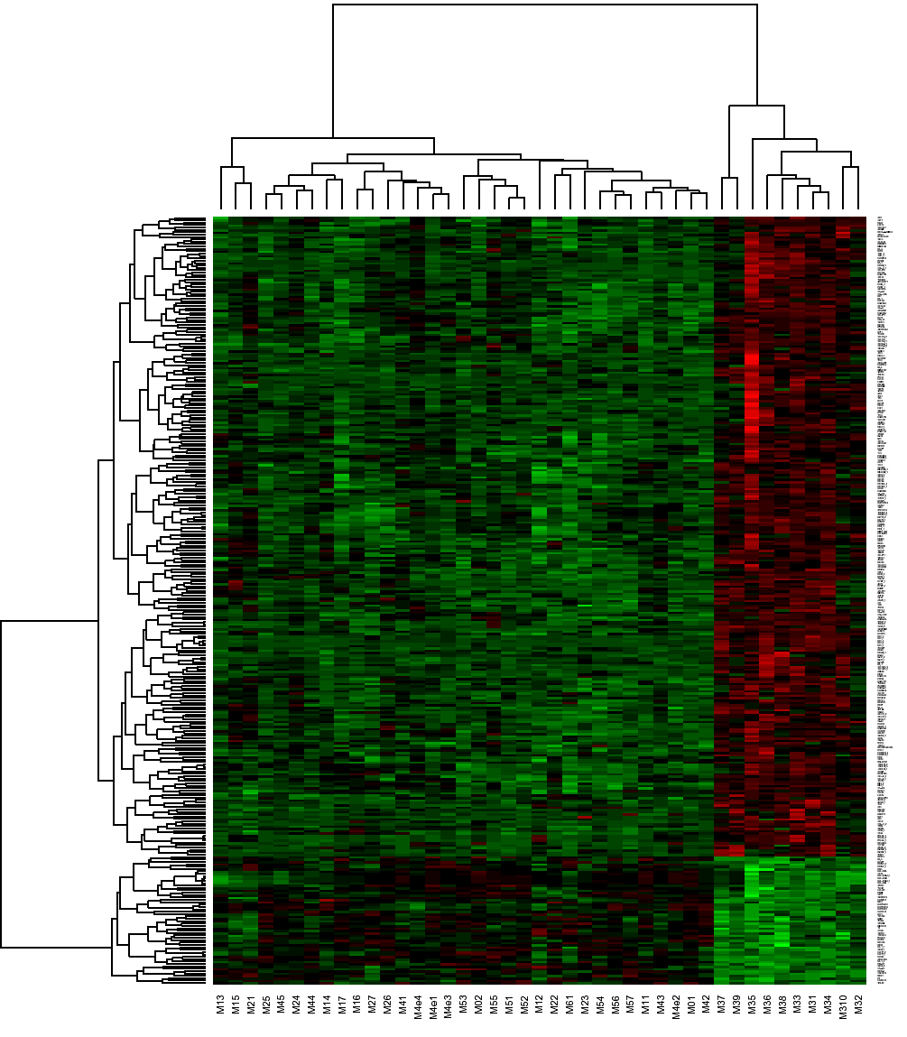
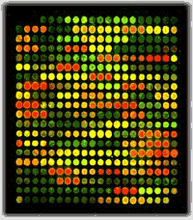
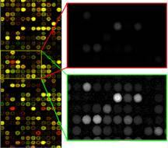
Farmacogenómica y Bioinformática en la medicina..
Para ello se amplifica el ADN obtenido a partir de una muestra de sangre o tejido de un paciente.
Fuente:
Estos fragmentos de material genético pueden ser secuencias
cortas llamadas oligonucleótidos, o de mayor tamaño,
cDNA (ADN complementario sintetizado a partir de mRNA),
o
bien productos de PCR (replicación in vitro de secuencias de ADN mediante la reacción en cadena de la Polimerasa).

Slide 9
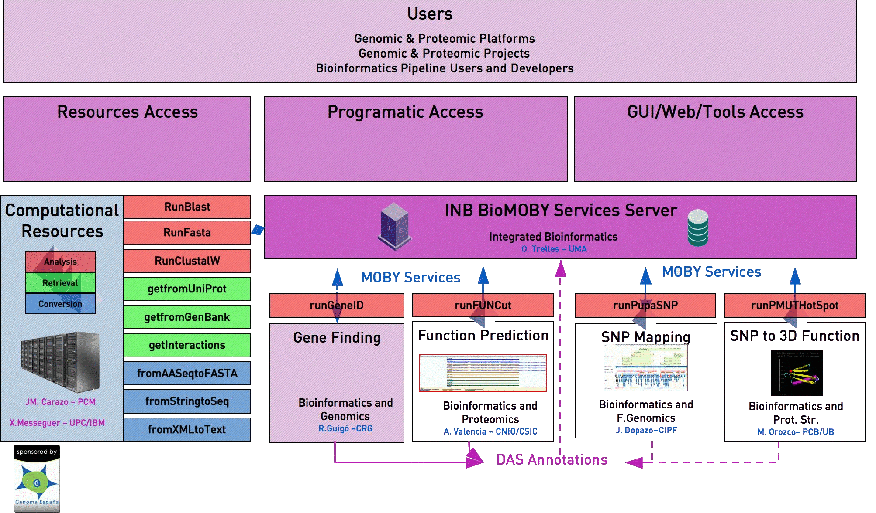
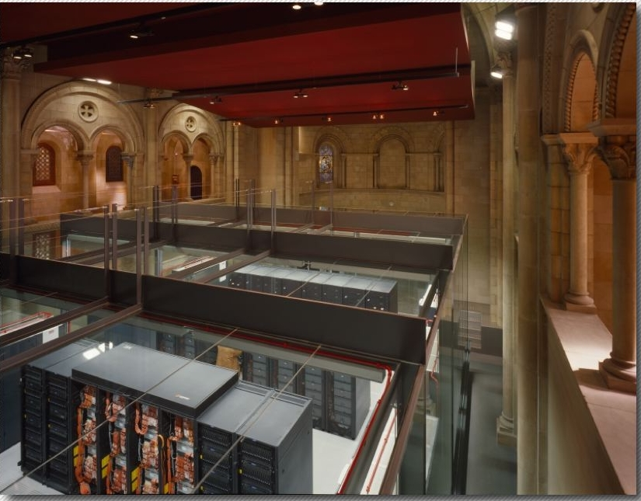
INB Technological Offer Implementation
CNIO
BSC
Fuente: David Pizano, CNIO

Slide 10
Web services INB
This is the collection of web services that
we have at the INB, to solve by using different methods,
problems of sequencing, prediction and functional gene annotation.

Slide 11
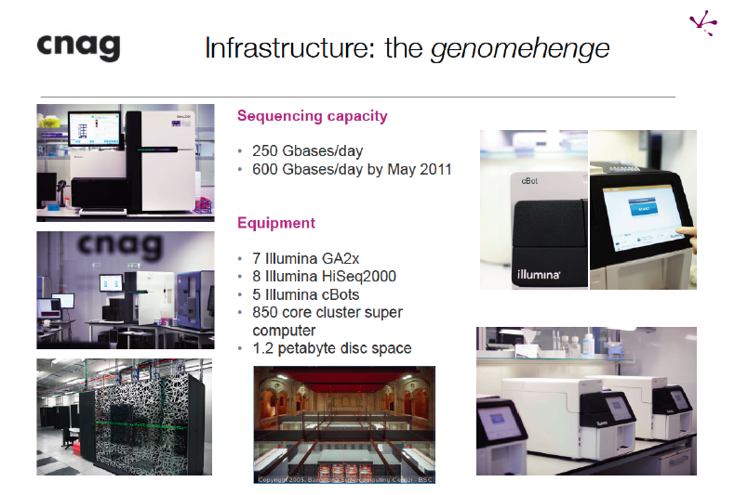

Slide 12
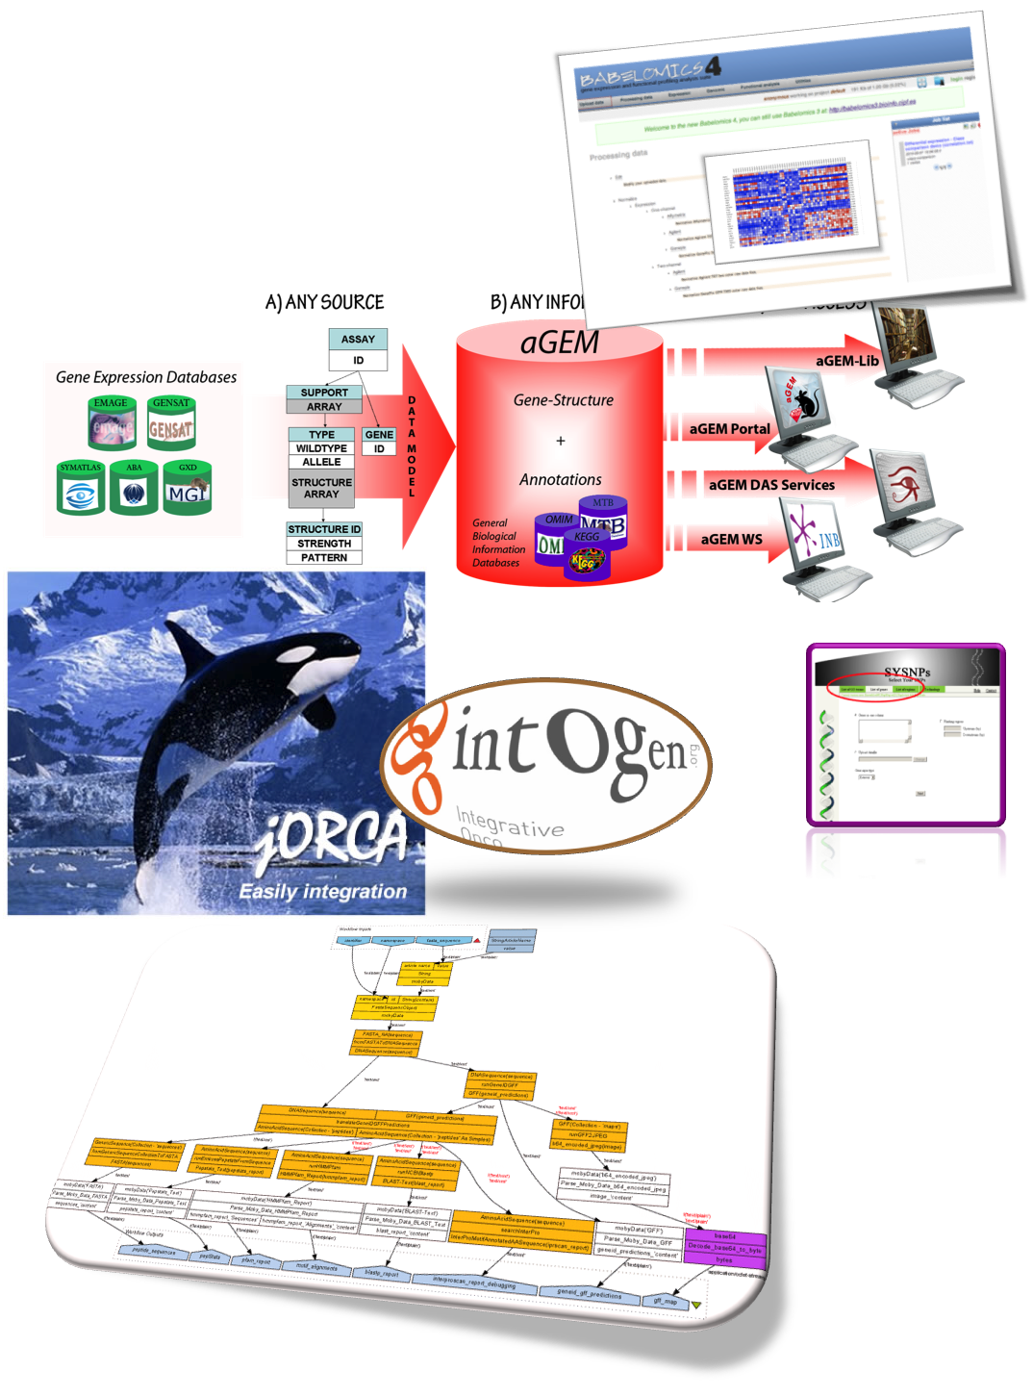
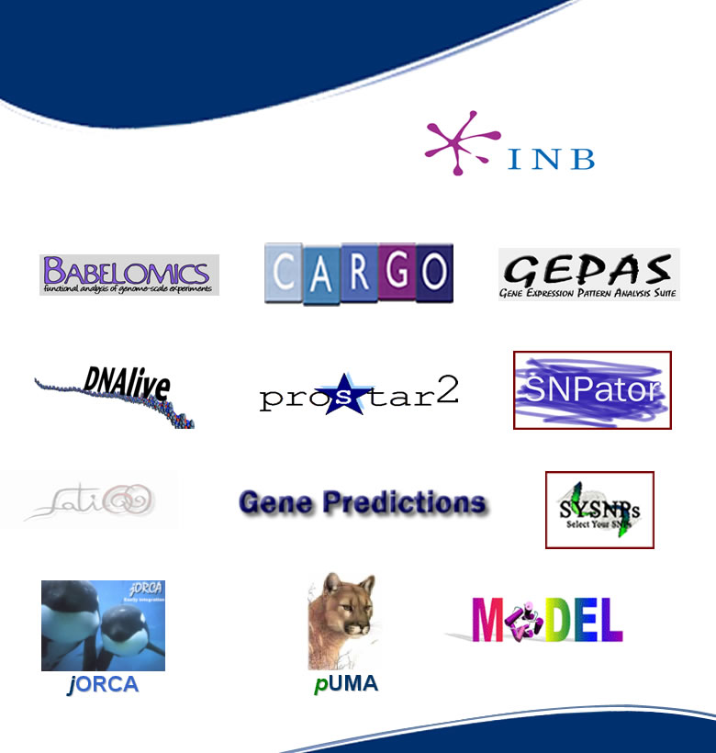
Tools Software

Slide 13
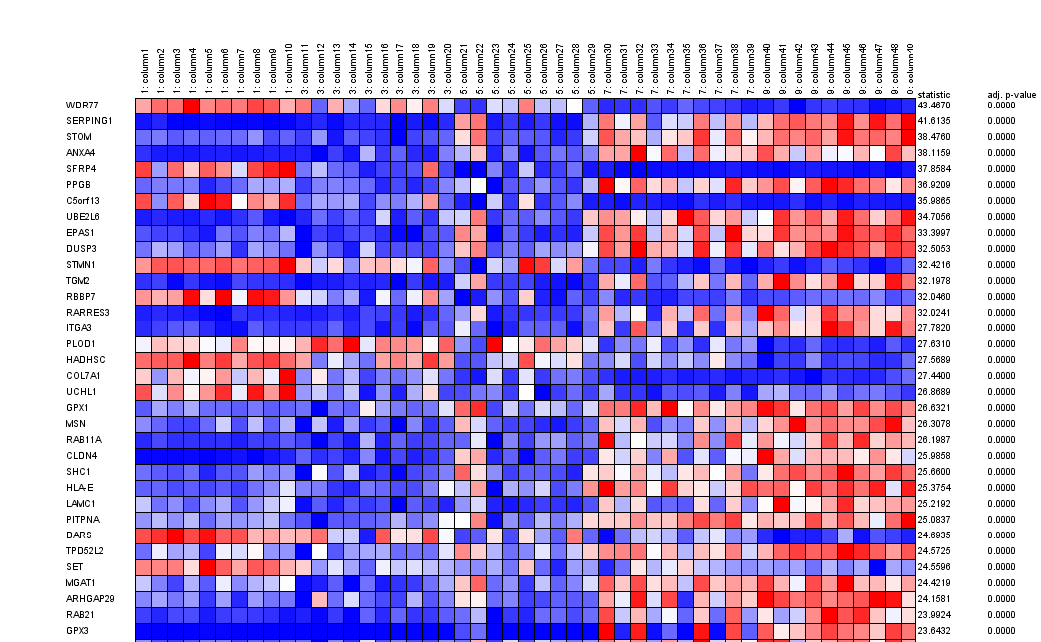
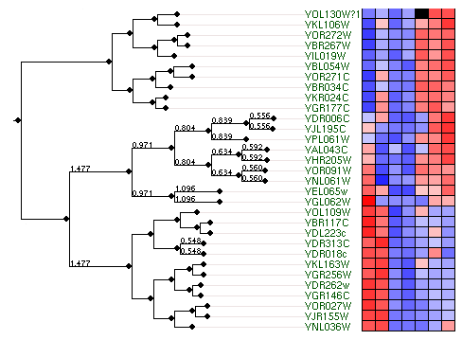

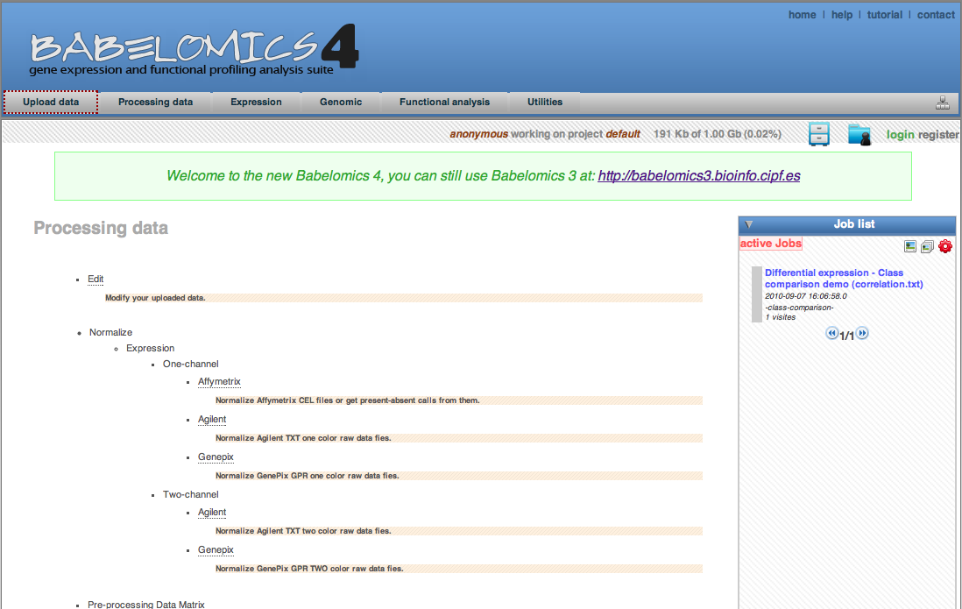
Microarrays

Slide 14

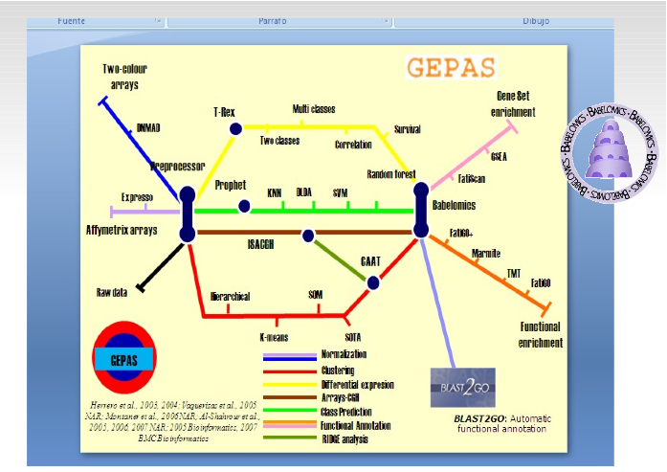
Clustering (Microarrays)
Babelomics 4 is an integrative platform for the analysis of transcriptomics, proteomics and genomic data with advanced functional profiling. This new version of Babelomics integrates primary (normalization, calls, etc.) and secondary (signatures, predictors, associations, TDTs, clustering, etc.) analysis tools within an environment that allows relating genomic data and/or interpreting them by means of different functional enrichment or gene set methods.

Slide 15

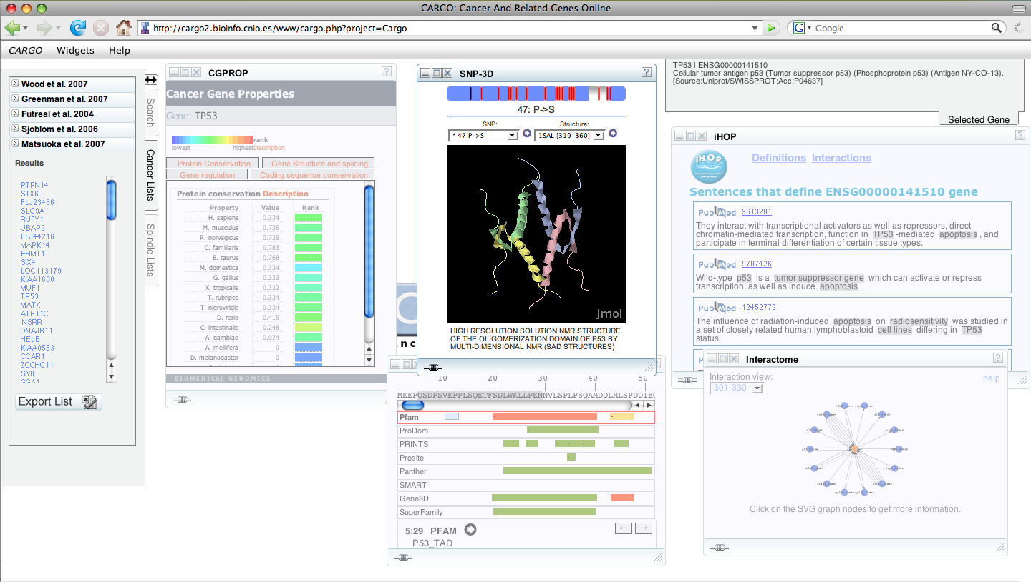
Cargo is a configurable biological web system designed to facilitate, integrate, and
visualize functional information associated to human gene lists using user-friendly interface,
where information is dynamically extracted from distributed databases and web services
using a technology similar to the one of the popular Google Bio-widgets (small
agents supported by Rich Internet Application-RIA- based on Ajax).

Slide 16

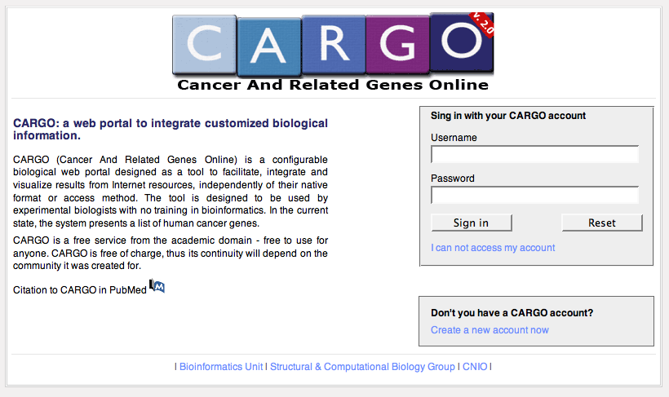
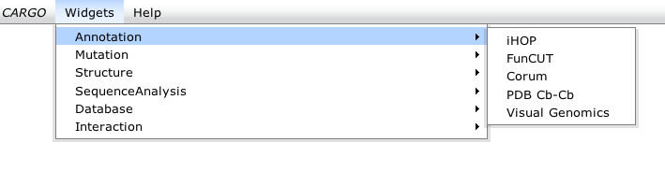
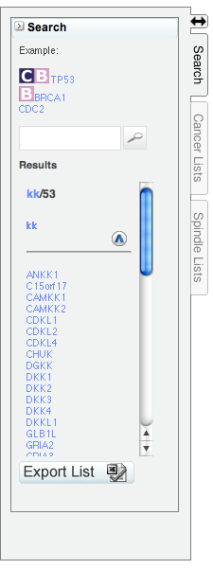
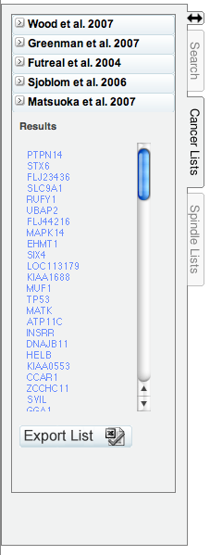
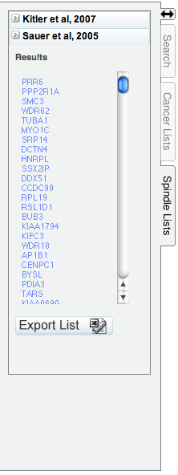
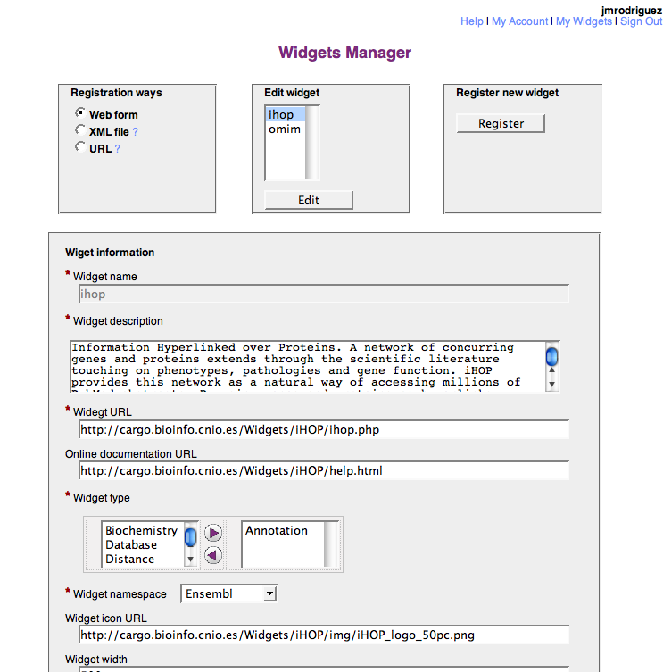
A web portal to integrate customized
biological information
Cargo provides pieces of minimal, relevant and descriptive biological information over lists of interesting genes. The tool is designed for usage by experimental biologists with no training in bioinformatics

Slide 17
Herramientas bioinformáticas www.inab.org
The bio-Widgets are the functional elements of CARGO. Control
and visualization elements, which can be individually selected by
users and which organize themselves to form a web control
panel via the user interface.

Slide 18
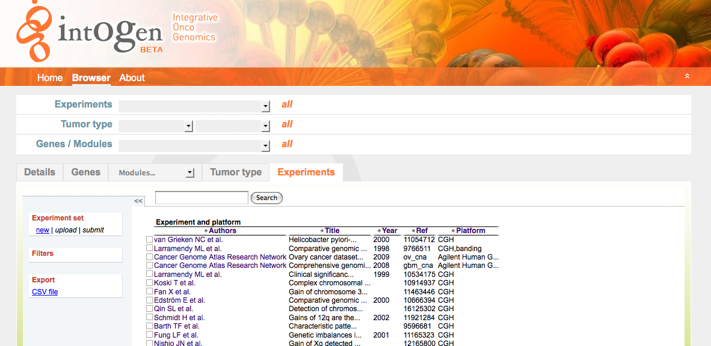
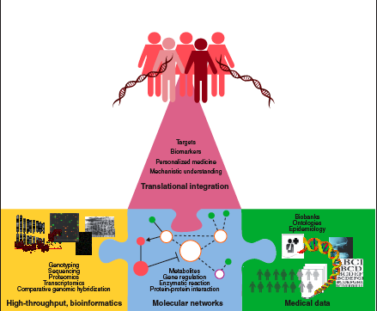
Intogen
;

Slide 19
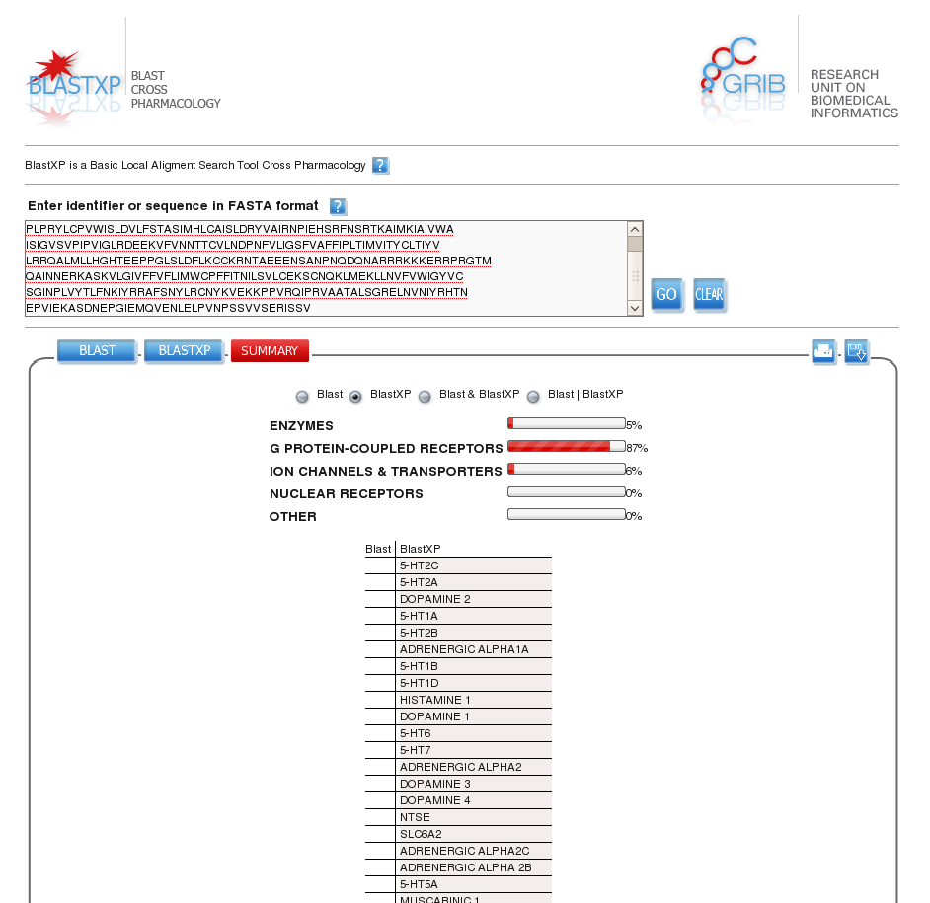
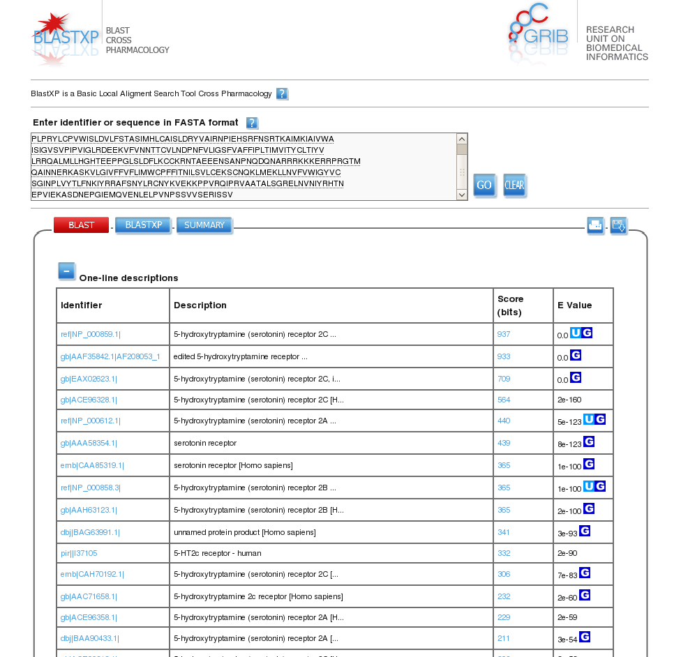
BlastXP

Slide 20
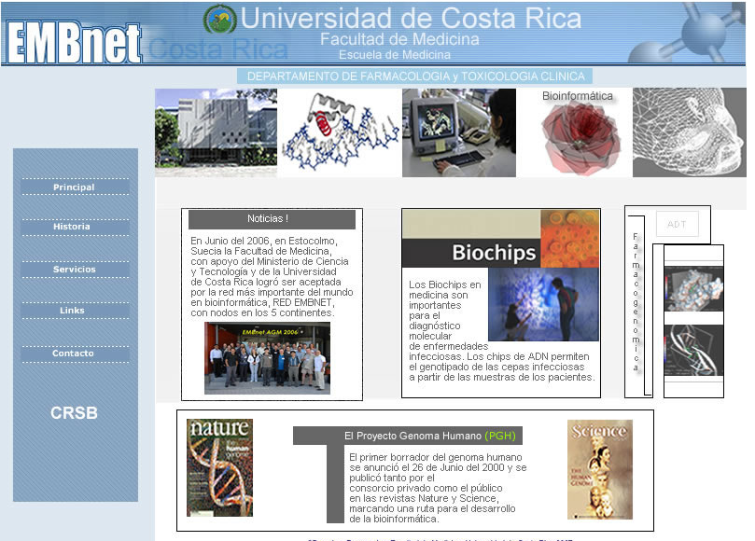
Grupo de Bioinformática- Escuela de Medicina- Universidad de Costa Rica

Slide 21
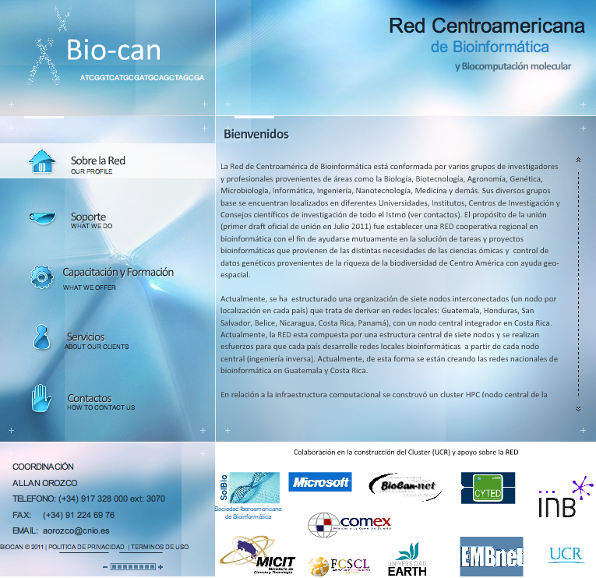
Creación de Red de Bioinformática en Centroamérica, 2011

Slide 22
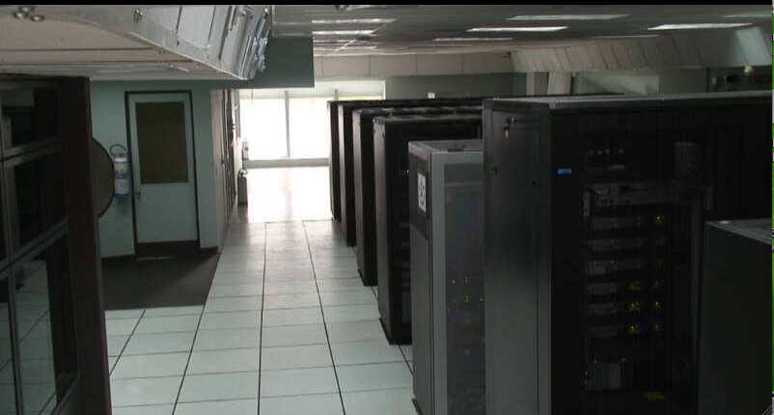
Creación del cluster de Bioinformática Centroamericano
- NELLY-Costa Rica. Apoyado por Microsoft research y
Universidad de Washington EEUU. 2011
Central American net of Bioinformatics with a computational cluster named Nelly,
The cluster was built thanks to the contributions of institutions such as
Microsoft Research and the University of Washington.

Slide 23
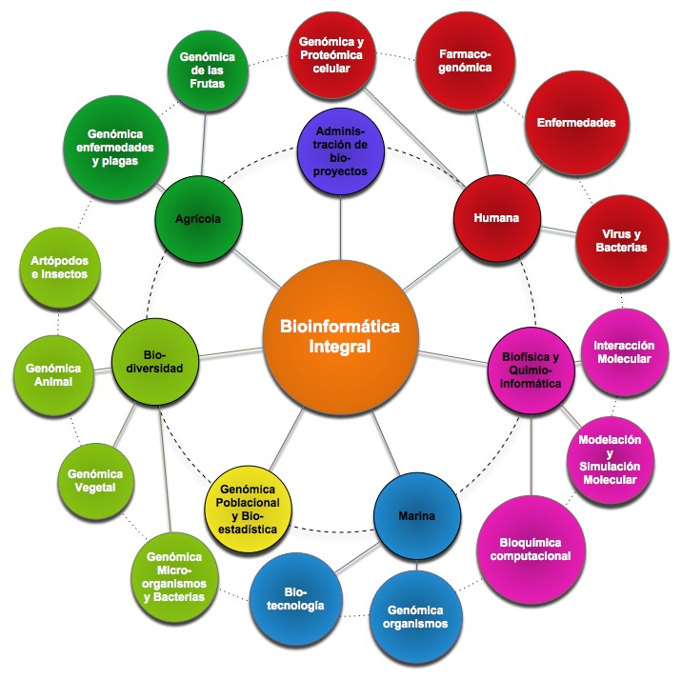
PROJECTS
This is a distribution map of projects that we implement in Spain to put
in order the bioinformatics activities. More details can be seen on the web site.

Slide 24
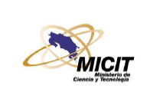
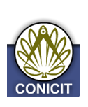

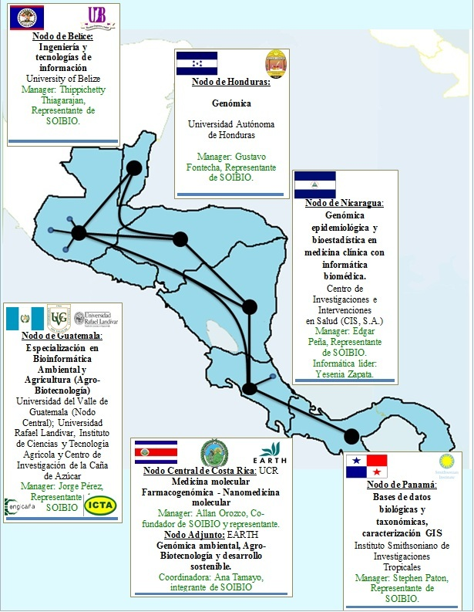
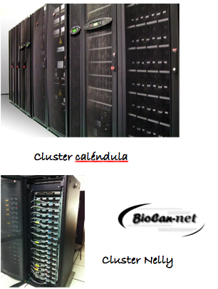
Red Centroamericana de Bioinformática
Red Clara
Director de RED: Allan Orozco, Costa Rica

Slide 25
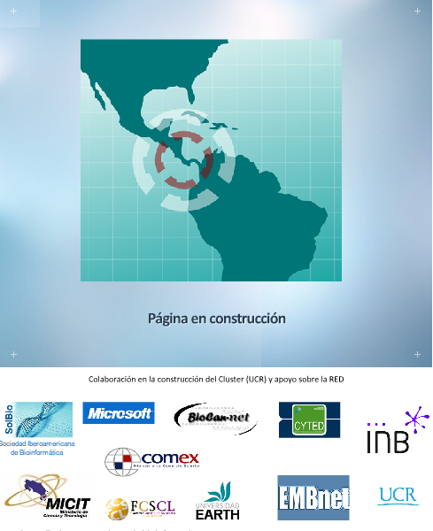
Also we have built a Central American net of Bioinformatics with a computational cluster named Nelly,
in honor to my mother that struggled with me to find out what my field of interest was.
The cluster was built thanks to the contributions of institutions such as Microsoft Research and
the University of Washington.
North America and South America
Bioinformatics Net
Red Clara
GISELA
Others
We must remember that Central America has
one of the most extraordinary biodiversity areas of the world.

Slide 26
Ejes verticales: Servicios y Desarrollo tecnológico
Ciencias de la vida
ELIXIR
Plataformas ISC III
Bioinformática estructural
Comité científico
especializado
ISC III
Chile
Argentina
Web Services, Sistemas, Workflows
Bioinformática médica
American Net
Ejes transversales :
formación, calidad,
Transferencia conocimiento,
innovación
Bioinformática
Integral
Proteómica
GN6-BSC
Bioinformática integral
Costa Rica
Brasil
Bioinformática y Genómica
Nuevos recursos
computacionales
Genómica Bacterial
Uruguay
Mexico
Mow-Server
Diversidad Genómica
y Genómica Poblacional
Bioinformática y proteómica
Bioinformática
y genómica funcional
Métodos y catálogos de servicios
Nodo Central
Director General/
Gestión científico/formación
Gestión técnica
Filogenética
Bioinformática
computacional

Slide 27
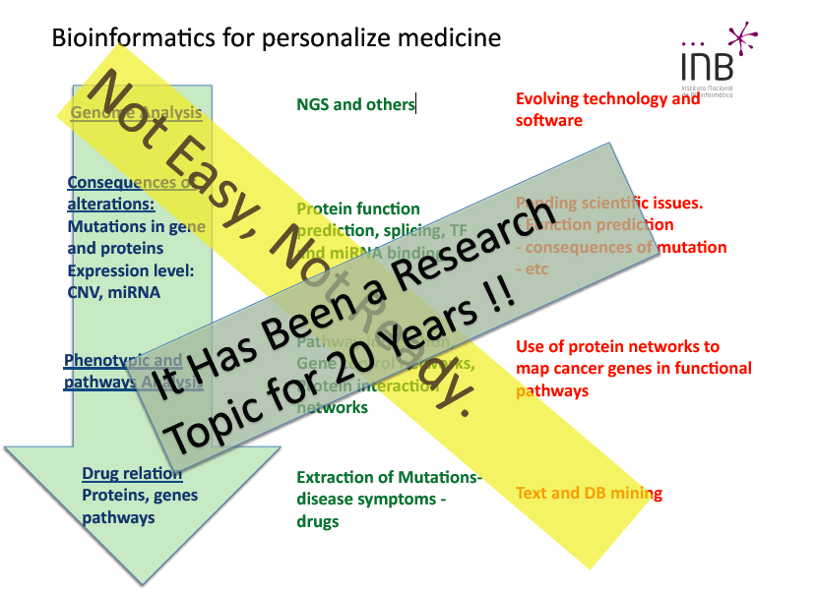
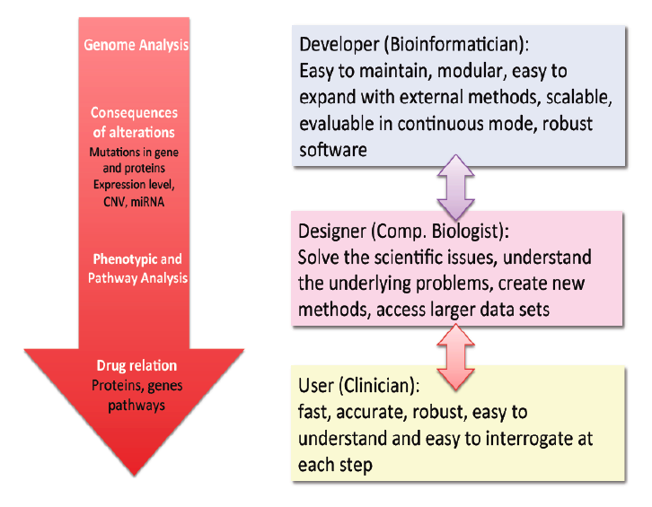
Time For Change?

Slide 28





Nanorobots……
and Bioinformatics operating system
As a central idea we could imagine the organization of development projects by thematic. But one of the greater bets would be to focus on a parallel way the development and research on nanotecnologies and biomedicine..

Slide 29






Nanogenomics bioinformatics
Leonardo Da Vinci
Nuevos campos de aplicación en medicina genómica

Slide 30

Omics (Bioinformatics, Genomics, Proteomics, Metagenomics, Metabolomics, etc) and Nanotechnology
American Networking Nanomics
User OMICS- Nanotechnology
Resources
Access
GUI/Web/Tools
Computational resources
Web Services
genes
anotacion
proteinas
redes
perfiles
atomica

Slide 31


This particular situation may extend
bridges in the future for ELIXIR
and other Latin American nets if we think
about an American Bioinformatics Net.

Slide 32

For example, in Europe actually there is a bioinformatics infrastructure building going on,
coordinated by the European Bioinformatics Institute. In Spain, the institute where I work
is in charge of providing all the technology related with web services of it.
This particular situation may extend bridges in the future for ELIXIR and other Latin
American nets if we think about an American Bioinformatics Net.

Slide 33


Propose: Bioinformatics American Network ?
RED CLARA
For example, in Europe actually there is a bioinformatics infrastructure building going on, coordinated by the European Bioinformatics Institute.
In Spain, the institute where I work is in charge of providing all the technology
related with web services of it. This particular situation may extend bridges in the future for
ELIXIR and other Latin American nets if we think about an American Bioinformatics Net.
The INB is member of the steering committee of the
ELIXIR project for the construction of the European Infrastructure for Bioinformatics.
Window of opportunity: ELLA?

Slide 34






Stable
Services
(INAB)
Unstable
Services
(MOBY-DEV)
INB MOBY Services
(+600)
INBmassRegistry
(473 without duplications)
getMOBYWSDL
(used by EMBRACE)
Tester
Database
INBmassTester
(periodically launched)

Slide 35




iHOP (Text Mining)
Fuente: Jose Maria Fernandez, CNIO-INB

Slide 36

Text Mining: Medical Ontologies

Slide 37


CursosINB
This is the education program about the activities that we have been doing in Spain. We have implemented control tools for the Ips entrance. The particular thing about these courses is that the students are Ips and their final task is a study case.
This is one of the best examples of translational projects with education in bioinformatics on Spain´s medical field.

Slide 38

Temática curso 2010-2011

Slide 39


Presencial y virtual servidores: ( BSc y INAB)

Slide 40


Students of several hospitals in
Barcelona educating in our platforms
located in BSC and the INB.

Slide 41


Creación del primer Master de Bioinformática en
Centroamérica-2011
Also, we have created the first Master’s Degree
on Bioinformatics on the Central American isthmus.

Slide 42




Caso Pionero en europa

Slide 43



Free software: Augmented reality and molecular visor
Use AR
Programming
Speaker: Allan Orozco,
International Society for Computational Biology, Mali, Africa. 2009

Slide 44

?

Slide 45
THANKS !!!

