Slide 1
ELLA
Europe Links with Latin America
A feasibility Study

Slide 2
e-Infrastructures
Did start as local or national initiatives
Are being strongly supported at the regional level
Need to become global
The existence of a pervasive physical communication infrastructure is assumed

Slide 3
GEANT2 2009

Slide 4
Research Infrastructure
Europe has made a very large effort:
NRENs at the national level
GEANT backbone at the regional level
Latin America and Europe have jointly made an effort in Latin America to create RedCLARA
What is in between?

Slide 5
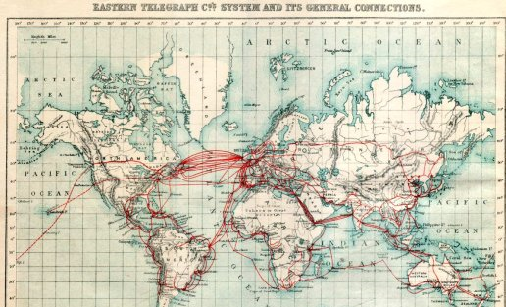
In 1901

Slide 6
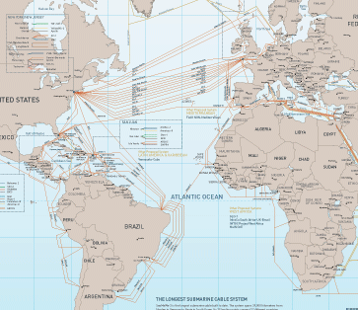
Today
Columbus III
Atlantis 2

Slide 7
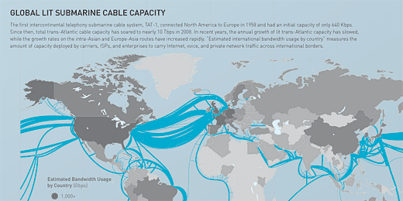
In terms of capacity

Slide 8
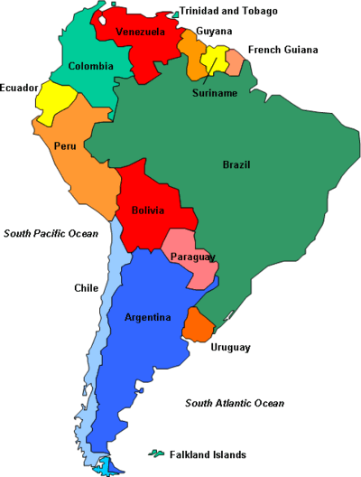
From Telegeography
NA route (532 Gbps)
EU direct route (5 Gbps)
It is estimated that more than 30% of the traffic on the NA route has Europe as final destination !

Slide 9
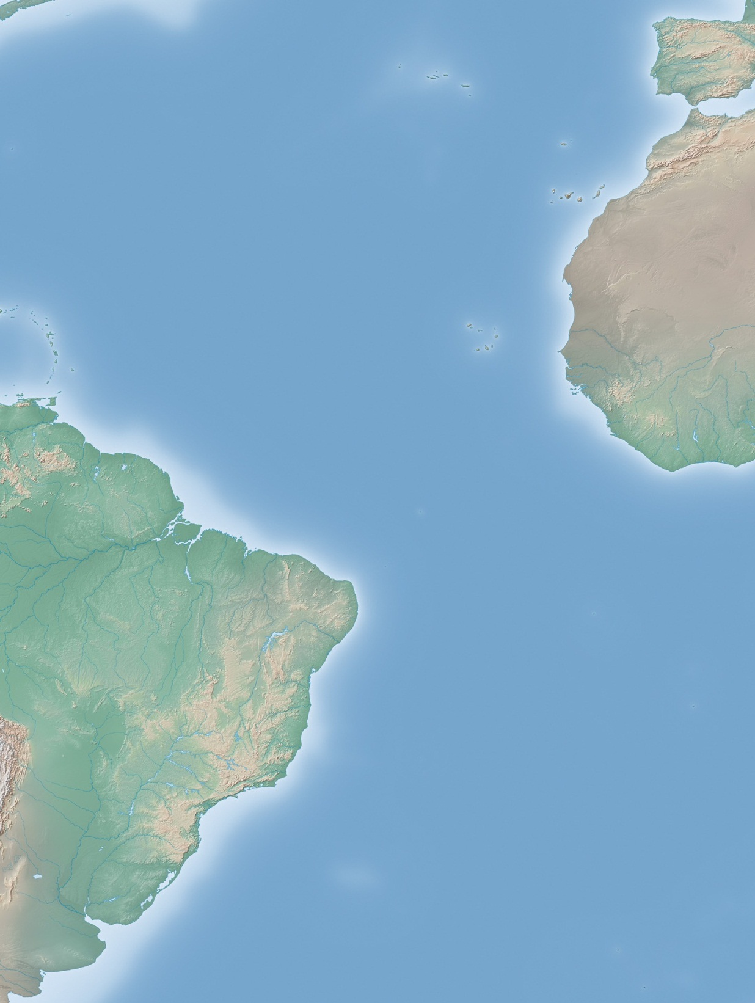
ATLANTIS 2 Submarine Cable System
Lisbon
(Portugal)
RFS Date: 29 December 1999
Cable Length: 12,253 Km.
Number of fibre pairs: 2
Design Capacity: 8 x 2.5 Gbps per fp
No express fibre
Designed for telephony
Difficult to upgrade (but not impossible)
From the e-Infrastructures point of view has an advantage in terms of latency
El Medano
(Spain)
Praia
(Cape Verde)
Dakar
(Senegal)
Fortaleza
(Brazil)
Las Tonina
(Argentina)

Slide 10
Why a New Cable
Today the cost of bandwidth between LA and EU is nearly ten times higher then between NA and EU
A Strategic Objective
To have all the data communication channels to go through the North America North Europe route is a global risk
Increase of competition will create big advantages to the users
A Commercial Opportunity
There are the conditions for a rapid ROI and commercial advantages
A Social Necessity
The close social and cultural links between Europe and LA make the need of strict interaction a necessity in a worldwide social environment

Slide 11
Window of Opportunity
Political Willingness
For the first time there is a political interest at creating alternatives to the US centered internet model
Possibility of a short-term return of investment
The recent soccer World Cup in South Africa has shown that large sport events can be a large income opportunity:
2016 – Olympics in Brazil set the time window
Market Potential
Latin America and China are the most attractive data communication markets in the short to medium period
Africa will be the next one

Slide 12
Synergies
West Africa cables being deployed now create a unique opportunity for synergies
The most logical route for a LA to Europe cable fits perfectly with the existing and planned Europe to Africa cables
Africa to LA cables could become a reality soon
Trans-Africa equatorial fibres could be well integrated in the scheme and be an alternative to LA to Asia cables

Slide 13
Project Consortium Members & Partners
The Project Consortium members cannot fulfill alone the objectives of the work.
Commercial partners are essential for the successful outcome, however it has been chosen not to have them as Project Consortium members
Avoid a bias that could have endangered the final outcome
Avoid an a-priori selection
Guarantee the confidentiality of the information
A number of Non Disclosure Agreements have been already negotiated, others will be added soon.

Slide 14
ELLA objectives
Reassess the political willingness
Study the technical options
Estimate the budget required
Evaluate the market development and the impact of the new infrastructure
Consider the financial options
Secure seed funds from public sources
Trigger the creation of a Consortium

Slide 15
Project Timeframe
Started on May, 1st 2011
Expected end on July, 31st 2012
Intermediate results in January 2012
But the commercial partners are pushing us to accelerate the process as much as possible!

