Slide 1

The project
The e-Infrastrucrures available at CRIA
Sidnei de Souza
Centro de Referência em Informação Ambiental, CRIA
(Reference Center on Environmental Information)
Conference on Europe-Latin America e-Infrastructures
Rio de Janeiro, October 2011
•

Slide 2
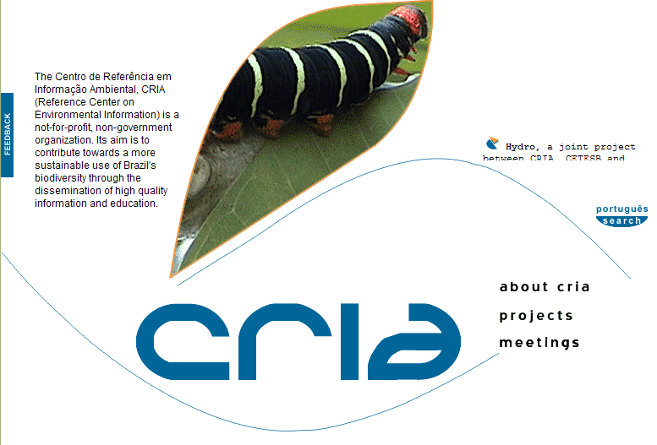
The Centro de Referência em Informação Ambiental, CRIA
(Reference Center on Environmental Information) is a
not-for-profit, non-government organization
created in 2000
Its aim is to contribute towards a more sustainable use of Brazil's biodiversity through the dissemination of high quality information and education.
Through
…
research projects in partnership with the scientific community,
dissemination of data and information generated by the scientific community,
…
•
•
•
•

Slide 3
agenda
speciesLink
INCT-HVFF
networks
The List of Brazilian Flora and Fungi
The OpenBio project
The openModeller framework
•
•
•

Slide 4
objectives
the openbio project
“Deploy an e-Infrastructure of open access resources (data, tools and services) supporting the needs of the biodiversity scientific community. This e-Infrastructure will result from the federation and integration of existing EU and Brazilian developed infrastructures and resources.”
Interoperation of existing Brazilian and European e-Infrastructures in the distributed computing, scientific data and portals & platform layers
Focus on the integration of data and software platforms running through all of infrastructures
Identification of further future EU-Brazil collaboration in support to the biodiversity area in all types of infrastructures
•
•
•
•
Notes:
Unfortunately the right people to be here and talk about the project were not able to attend as they are in Brussels right now for the kick-off meeting of OpenBio.
There is not much in a concrete basis that I can tell you about the project as it is a very exploratory project.
So I’ll tell you a little bit of its objectives and some of the resources we have available at CRIA that should be used by OpenBio.
As described in the proposal, the main objective of the project is…

Slide 5
use cases
the openbio project
Use Case I – Integration between Regional & Global Taxonomies
Focus on taxonomical information
A pilot study to analyse and cross-map the regional List of Species of Brazilian Flora served by CRIA with the Global Catalog of Life served by Sp2000
Use of two tools under development in the i4Life project – the CoL Cross-mapping Tool, and the CoL Piping Tool.
The activity should enhance the gCube Search developed in the existing D4Science-II project
Use Case II - Data usability and the use of ecological niche modelling
Focus on plants data (accepted names, synonyms and distribution)
Determine the number of usable occurrence points each species
Run ecological niche modelling with automatically selection of algorithms
Use of openModeller in a distributed environment to run the models
The resulting models will be saved to be checked and validated by specialists
•
•
•
•
•
Notes:
There are two use cases defined in the project.
The first one is related to taxonomy information and intends to cross-mapping different catalogs of scientific names.
Mainly the Species List of Brazilian Flora and the Species2000 Catalog of Life.
The second one relates to the use of an ecological niche modeling tool, the openModeller, in a cloud environment, to produce
potencial distribution models of plants in large scale.
The species list of brazilian flora and the openModeller framework were both developed and maintained by CRIA

Slide 6
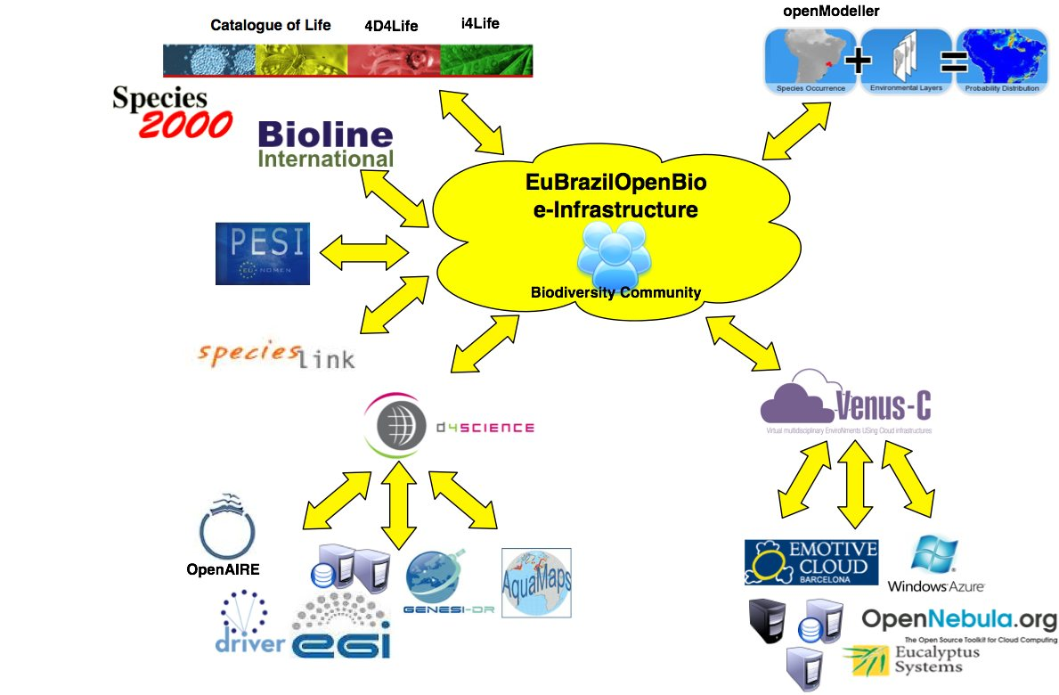


objectives
the openbio project
study
analyze
explore
propose
•
•
•
•
•
•
Notes:
So, the basic idea of OpenBio is that there are a lot of resources (software and data infrastructures) available out there.
Also there is a lot of new technologies that can be used to put these parts together to generate biodiversity knowledge.
So, the idea is to study, analyze and explore these parts and propose new and more efficient ways of using them for the common good.

Slide 7






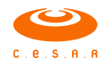


stakeholders
the openbio project
Centro Nacional de Supercomputación de Barcelona Barcelona Supercomputing Center | BSC | Spain
Consiglio Nazionale delle Ricerche National Research Council | CNR | Italy
Trust IT Services Ltd | TRUST-IT | UK
Species 2000 | SP2000 | UK
Universitat Politècnica de València Valencia Polytechnic University | UPVLC | Spain
Centro de Referência em Informação Ambiental Reference Center on Environmental Information | CRIA | Brazil
Centro de Estudos e Sistemas Avançados do Recife Recife Center for Advanced Studies and Systems | C.E.S.A.R | Brazil
Universidade Federal Fluminense Fluminense Federal University | UFF | Brazil
Rede Nacional de Pesquisas National Education and Research Network | RNP | Brazil
•
•
•
•
•
•
•
Notes:
The project has a strong list of partners.
Each of them with a well recognized competence in its knowledge area.
So, we expect to have a very successful project.
There are five from Europe and four from Brazil.
Two from Spain, two from UK and one from Italy.

Slide 8
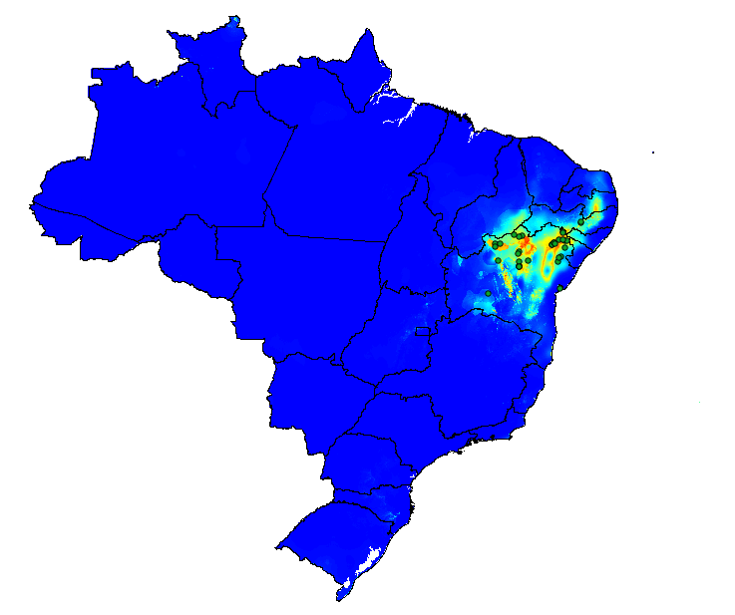
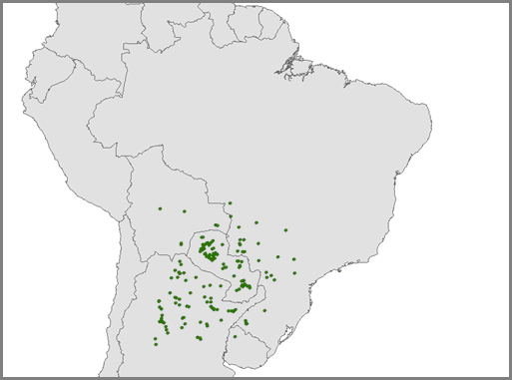
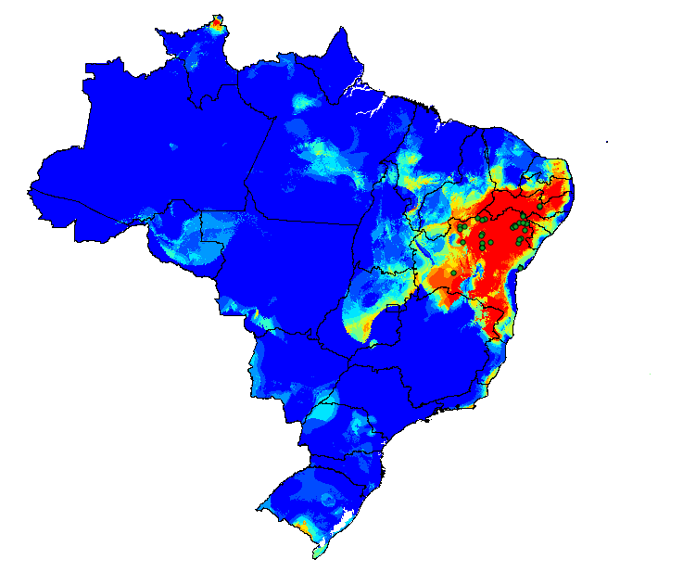
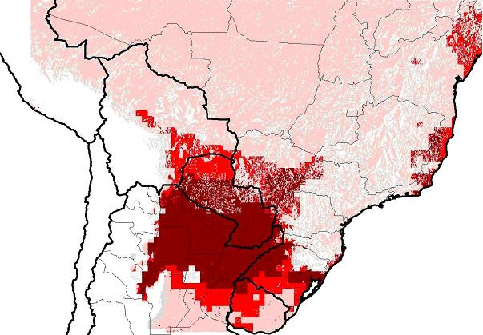

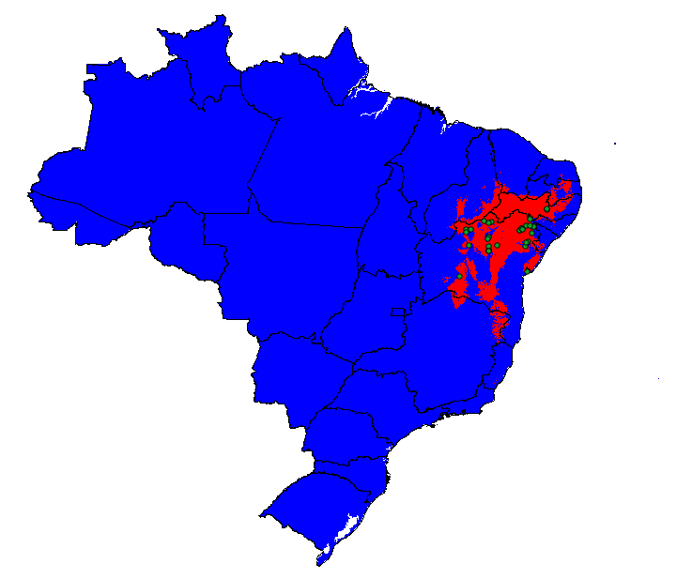
agenda
speciesLink
INCT-HVFF
networks
The List of Brazilian Flora and Fungi
The openBio project
The openModeller framework
•
•
•
•
•
•
•
•
Notes:
Now I’ll talk a little bit about three of the resources that will available to the project as the CRIA’s contribution.
The first one is the openModeller framework.

Slide 9




what is it?
the openmodeller framework
openModeller is an open source C++ library dedicated to static spatial distribution modelling developed to facilitate and speed up modelling tasks, offering an homogeneous environment to carry out experiments with different algorithms.
openModeller is platform independent, has multiple interfaces, multiple algorithms implemented and is open to new developers
Available at openmodeller.sourceforge.net
Developed by National Institute of Spacial Researches (INPE), the Polytechnic School (Poli-USP) and CRIA
Collaboration of the University of Kansas and the University of Reading
Project financed by Fapesp
•
•
•
•
•
•
•
•
•

Slide 10

ecological niche modelling tool
the openmodeller framework
Species occurrence points
Environmental variables
Environmental conditions where species occurs
Temperature
Precipitation
Potential distribution
model
algorithm
Temperature
projection
Precipitation
•
•
•
•
•
•
•
•
•
•

Slide 11
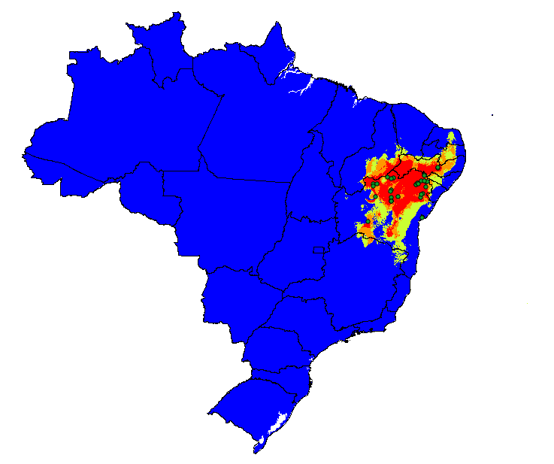
possible uses
the openmodeller framework
Guide field work
Provide information for new research
Improve data quality
Prioritize data entry and geo-referencing
Prioritize species for conservation
Value biological collections
Invasive species studies
…
•
•
•
•
•
•
•
•
•
•
•

Slide 12
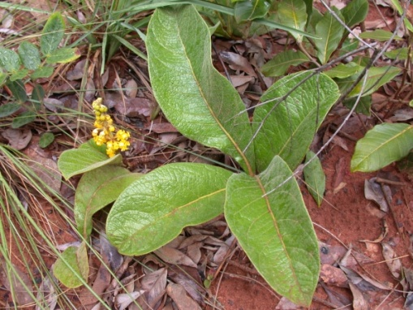
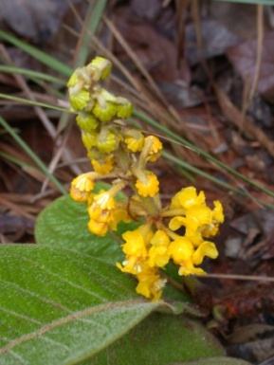
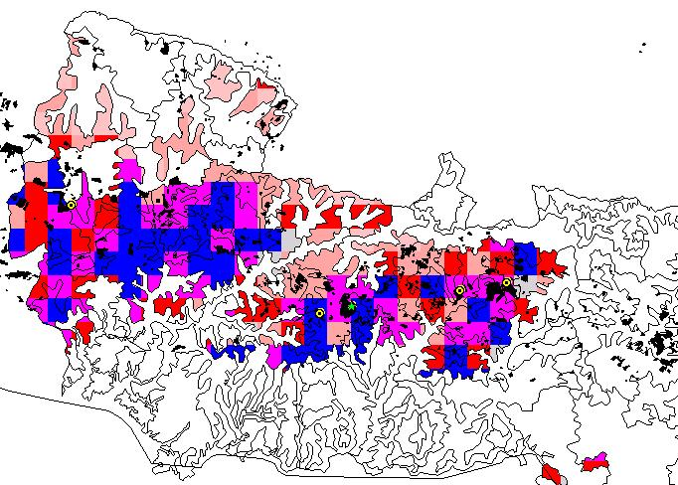
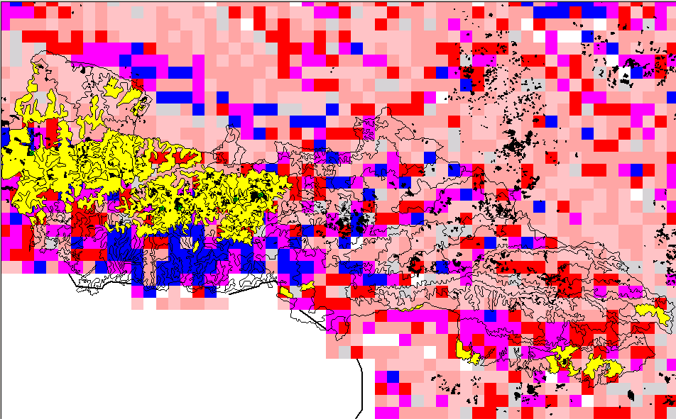
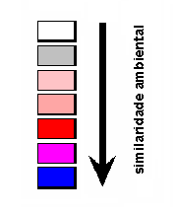
Byrsonima subterranea Brad. & Markgr.
the openmodeller framework
= original point
= 4 new points
•
•
•
•
•
•
•
•
•
•
•
•

Slide 13
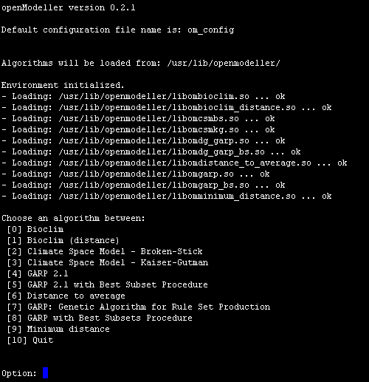
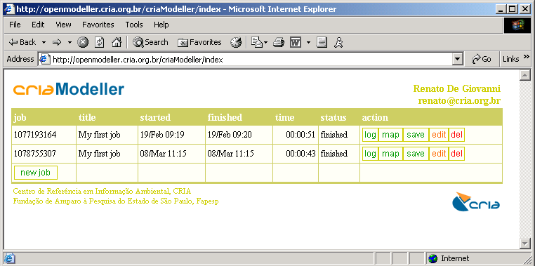
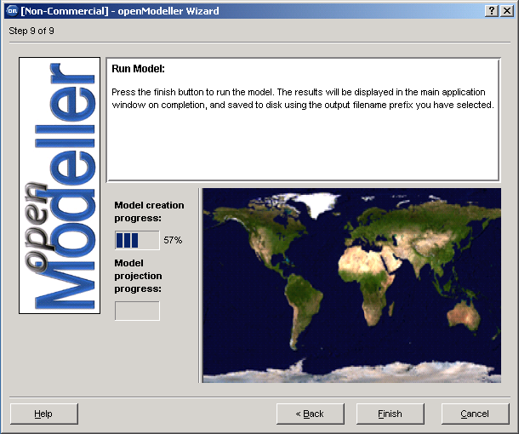
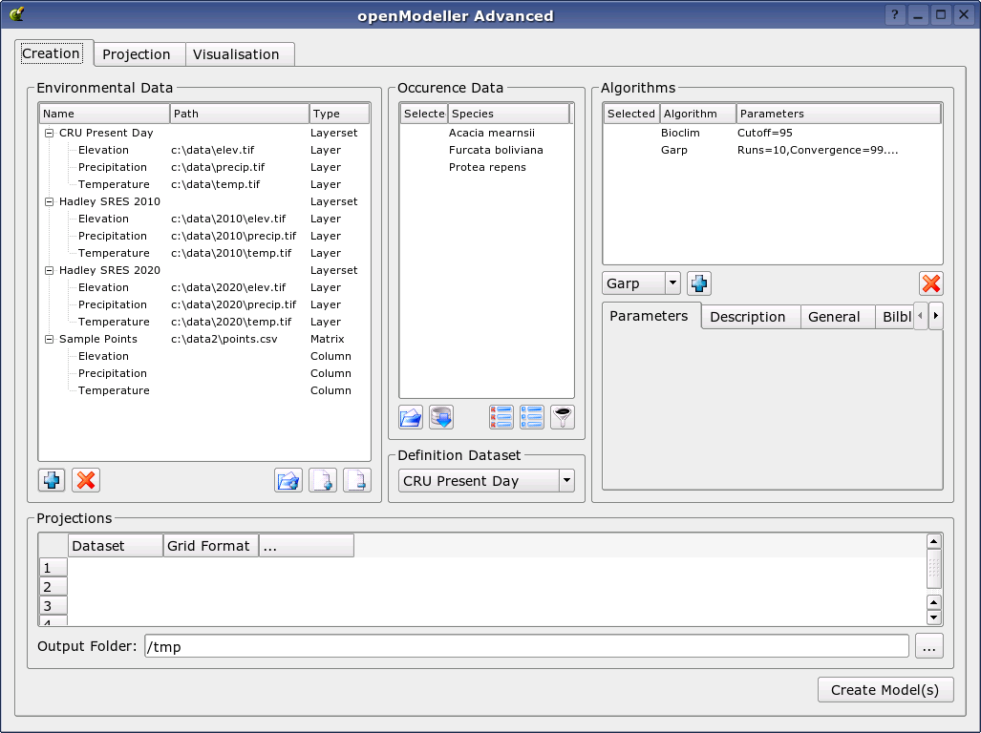
available interfaces
the openmodeller framework
•
•
•
•
•
•
•
•
•
•
•
•
•

Slide 14










agenda
speciesLink
INCT-HVFF
networks
The List of Brazilian Flora and Fungi
The openBio project
The openModeller framework
•
•
•
•
•
•
•
•
•
•
•
•
•
•

Slide 15
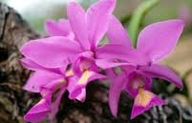
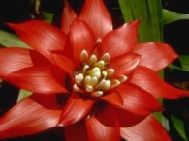
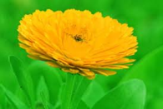
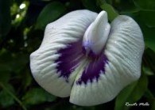
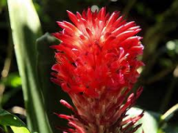
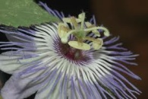
context
the species list of brazilian flora
Brazil, as party to the Convention on Biological Diversity (CBD), has assumed a number of commitments before the international community.
Among these commitments is the implementation of the Global Strategy for Plant Conservation (GSPC), that aims to facilitate consensus and synergy at the global, national, regional and local levels to promote knowledge and conservation of plants.
Of the 16 global targets set by the GSPC for 2010, the first is the development of "a widely accessible working list of known plant species, as a step towards a complete world flora".
In order to reach that target, the Instituto de Pesquisas Jardim Botânico do Rio de Janeiro was designated by the Ministry of Environment through the Centro Nacional de Conservação da Flora (CNCFlora) to coordinate and organize Brazil’s working list of known plant species "Lista de Espécies da Flora do Brasil".
CRIA is responsible for the development, maintenance and on-line publication of the administrative and public systems since 2009.
•
•
•
•
•
•
•
•
•
•
•
•
•
•
•

Slide 16

Hepaticas
Briófitas da Mata Atlântica
Pteridófitas
Annonaceae
Burmanniaceae
Cannaceae
Costaceae
Haemodoraceae
Thismiaceae
Triuridaceae
Zingiberaceae
Fungos (12)
integration of more than 40 existing species lists
Angiospermas da Mata Atlântica
Fabaceae da Mata Atlântica
Flora do Nordeste
Flora do Acre
Flora do Semi-Árido
Flora do Cerrado
Kew Gardens
Typus RB
Mike Hopkins
Algas (Várias)
Musgos
Antoceros
the species list of brazilian flora
Lista de Angiospermas da Mata Atlântica (MS-Excel)
Lista de Fabaceae da Mata Atlântica (MS-Excel)
Flora do Nordeste (MS-Word)
Flora do Acre (MS-Word)
Flora do Semi-Árido (MS-Excel)
Flora do Cerrado (MS-Word);
Lista de Kew Gardens (Texto tab-delimited)
Lista de Typus do RB (MS-Excel)
Lista do Mike Hopkins (MS-Excel)
Várias listas de Algas (MS-Word)
Lista de Musgos (MS-Excel, MS-Word)
Lista de Antoceros (MS-Excel)
Lista de Hepaticas (MS-Excel)
Lista de Briófitas da Mata Atlântica (MS-Excel)
Lista de Pteridófitas (MS-Excel)
Lista de Annonaceae (MS-Excel)
Lista de Burmanniaceae (MS-Excel)
Lista de Cannaceae (MS-Excel)
Lista de Costaceae (MS-Excel)
Lista de Haemodoraceae (MS-Excel)
Lista de Thismiaceae (MS-Excel)
Lista de Triuridaceae (MS-Excel)
Lista de Zingiberaceae (MS-Excel)
Doze Listas de Fungos (MS-Excel)
Famílias do sistema Flora brasiliensis revisitada:
Cactaceae (Daniela Zappi)
Rutaceae (José Rubens Pirani);
Simaroubaceae (José Rubens Pirani)
Bignoniaceae (Lucia G Lohman)
Onagraceae (Ana Odete Santos Vieira)
Clusiaceae (Volker Bittrich)
Hypericaceae Volker Bittrich)
Fbr - Cactaceae
Fbr - Rutaceae
Fbr - Simaroubaceae
Fbr - Bignoniaceae
Fbr - Onagraceae
Fbr - Clusiaceae
Fbr - Hypericacea
•
•
•
•
•
•
•
•
•
•
•
•
•
•
•
•

Slide 17
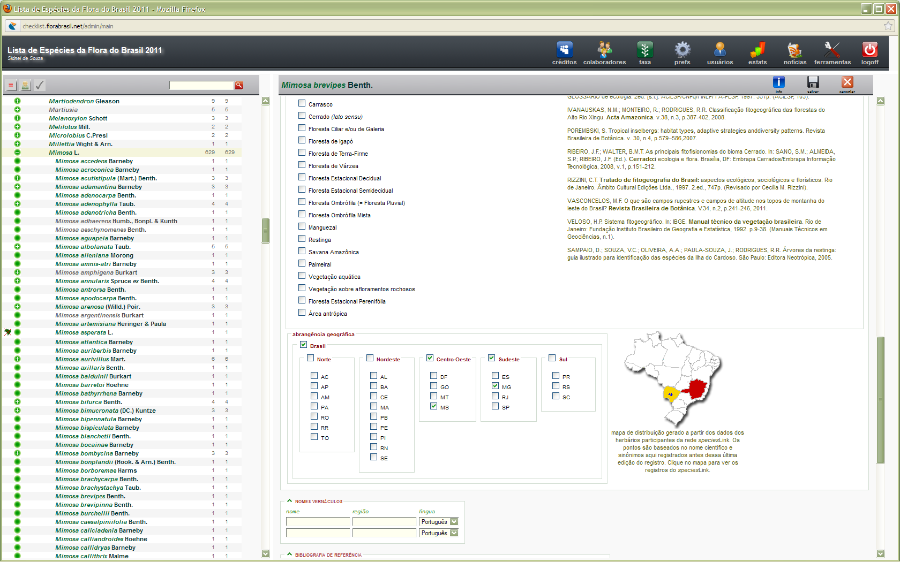
web interface for data management
the species list of brazilian flora
speciesLink data supports the species distribution knowledge
•
•
•
•
•
•
•
•
•
•
•
•
•
•
•
•
•

Slide 18
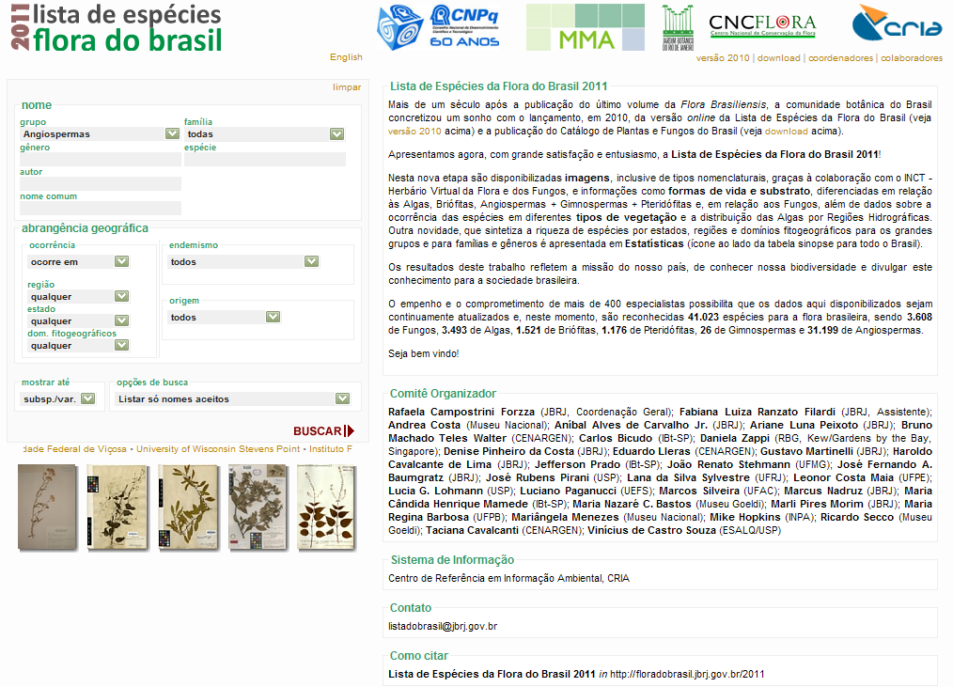
public access web interface
the species list of brazilian flora
•
•
•
•
•
•
•
•
•
•
•
•
•
•
•
•
•
•

Slide 19
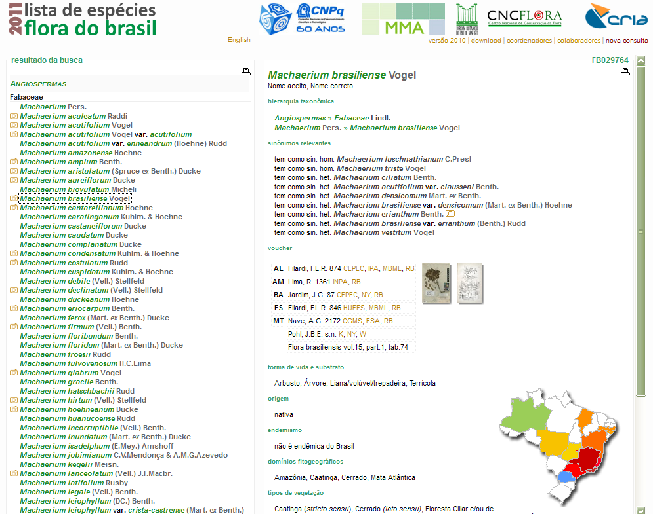
taxonomic lists produced on-the-fly
the species list of brazilian flora
•
•
•
•
•
•
•
•
•
•
•
•
•
•
•
•
•
•
•

Slide 20
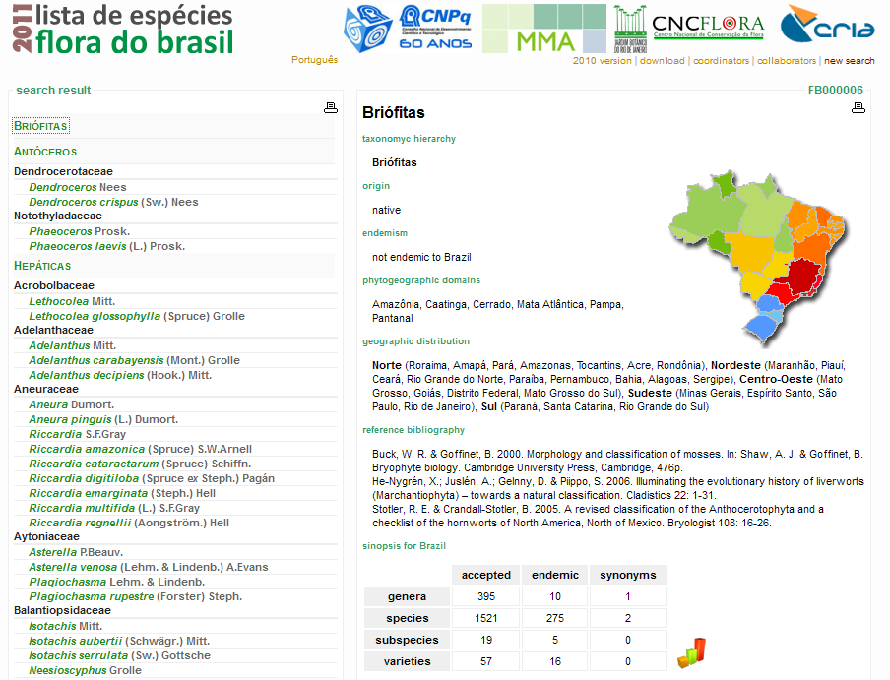
regional lists produced on-the-fly
the species list of brazilian flora
•
•
•
•
•
•
•
•
•
•
•
•
•
•
•
•
•
•
•
•

Slide 21
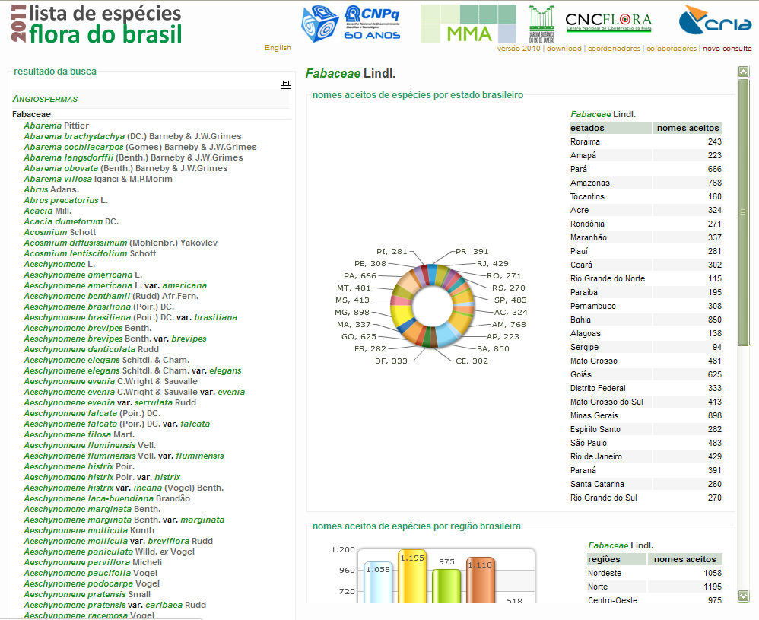
statistics pages available
the species list of brazilian flora
•
•
•
•
•
•
•
•
•
•
•
•
•
•
•
•
•
•
•
•
•

Slide 22





some figures
the species list of brazilian flora
104,215 | records
94,535 | species names
46,517 | accepted species names
388 | family names
481 | specialists involved
•
•
•
•
•
•
•
•
•
•
•
•
•
•
•
•
•
•
•
•
•
•

Slide 23

agenda
speciesLink
INCT-HVFF
networks
The List of Brazilian Flora and Fungi
The openBio project
The openModeller framework
•
•
•
•
•
•
•
•
•
•
•
•
•
•
•
•
•
•
•
•
•
•
•

Slide 24
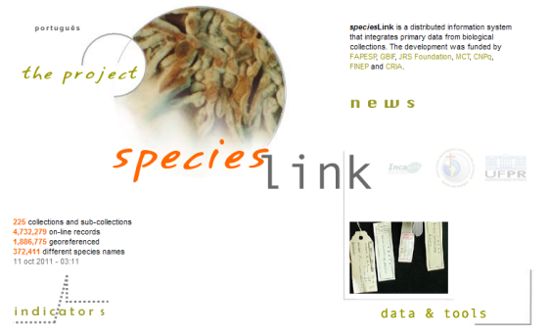
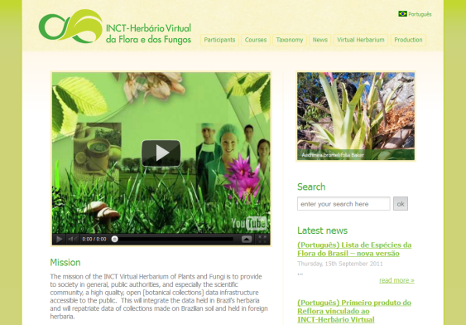
global networks
the speciesLink and inct-virtual herbarium of flora and fungi
The speciesLink network is a distributed information system that integrates primary data from biological collections. The development was funded by FAPESP, GBIF, JRS Foundation, MCT, CNPq, FINEP and CRIA. It uses Tapir and DiGIR as Information Retrieval Protocol and DarwinCore2 as its data model.
225 collections partipating
4,733,478 on-line records of all taxonomic groups being served (as of Oct 13)
INCT-HVFF – The Virtual Herbarium of Flora and Fungi uses the same technology developed for the speciesLink network and has its focus on herbaria records. The development is being funded by MCT and CRIA.
88 herbaria participating
3,363,422 on-line records being served
(as of Oct 13)
•
•
•
•
•
•
•
•
•
•
•
•
•
•
•
•
•
•
•
•
•
•
•
•

Slide 25
architecture
the speciesLink and inct-virtual herbarium of flora and fungi
user
indicators
images
Collections data
Data cleaning reports
maps
data
tools
Web Services
Data analysis
External
requests
indicators
mapCRIA
collection profile
TAPIR Provider
data cleaning
manager
Images
Central Repository
Indexing
Collections with providers
Collections without providers
TAPIR
TAPIR/DiGIR
Cache nodes
spLinker
Cache nodes
NYBG
MNHN
Smithsonian
Mobot
….
JBRJ
•
•
•
•
•
•
•
•
•
•
•
•
•
•
•
•
•
•
•
•
•
•
•
•
•
Notes:
10 regional servers
each collection has a collection profile page
datacleaning reports are generated for each collection
indicators are generated for each collection, groups of collections or the entire network
no data is changed by CRIA
the collections have total control of the data they make available
web services are available for external partners

Slide 26
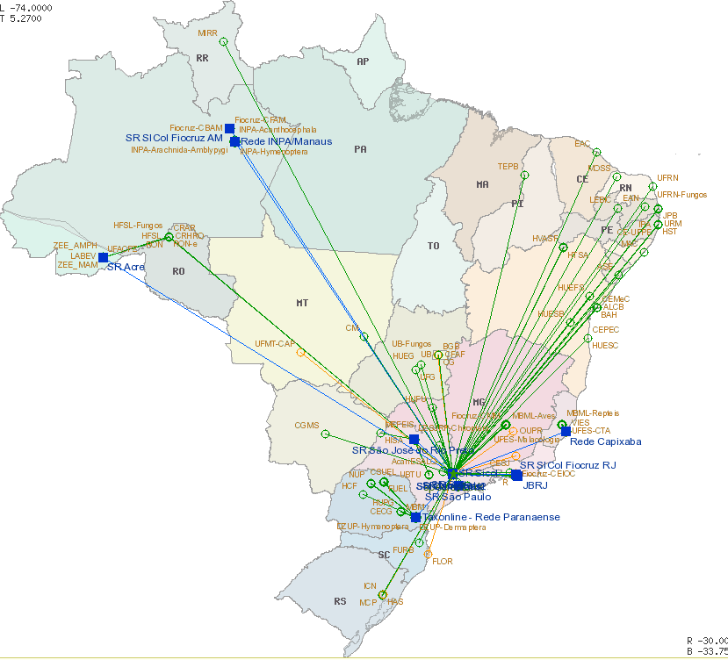
geographic scope
the speciesLink and inct-virtual herbarium of flora and fungi
24 Brazilian States
(out of 27)
represented
Data Repatriation
NYBG
MOBOT
Smithsonian
MVZ Berkeley
MNHN Paris
•
•
•
•
•
•
•
•
•
•
•
•
•
•
•
•
•
•
•
•
•
•
•
•
•
•

Slide 27
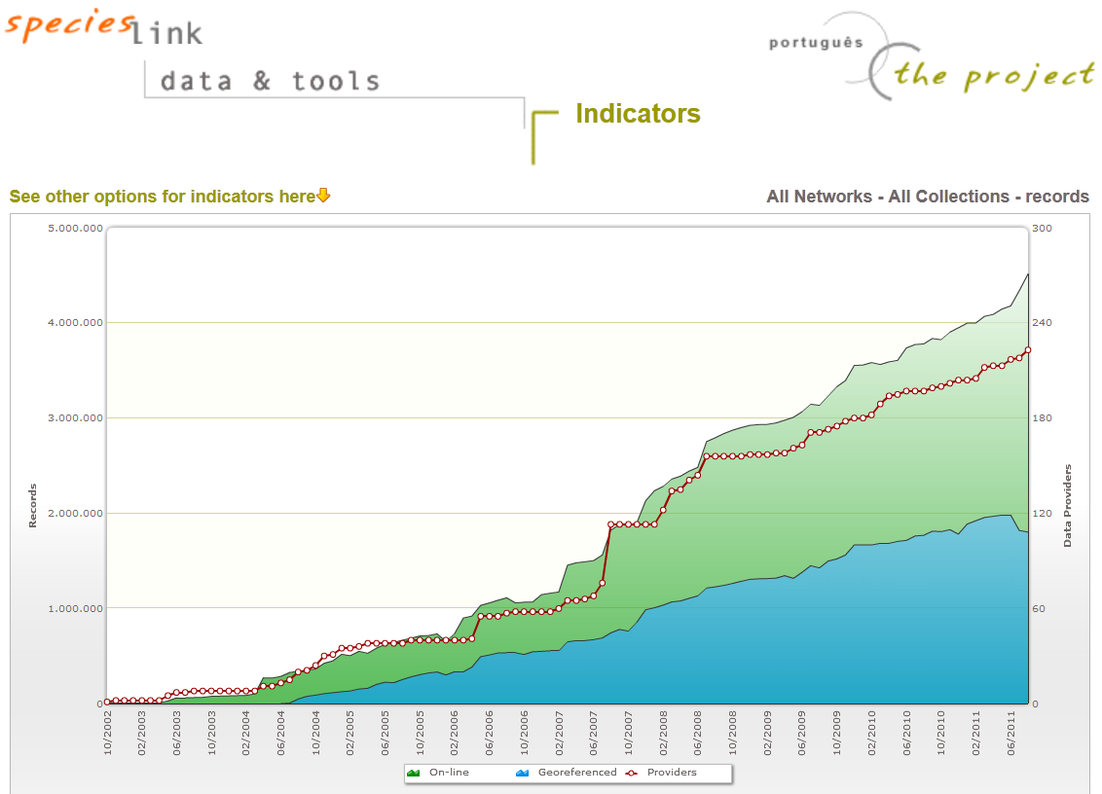
content growth
the speciesLink and inct-virtual herbarium of flora and fungi
225 collections connected, > 4.7 Million records in 10 years
•
•
•
•
•
•
•
•
•
•
•
•
•
•
•
•
•
•
•
•
•
•
•
•
•
•
•

Slide 28
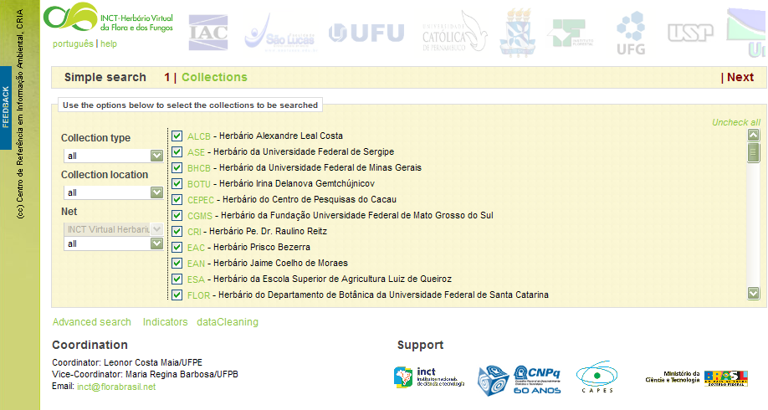
search interface • where to search
the speciesLink and inct-virtual herbarium of flora and fungi
•
•
•
•
•
•
•
•
•
•
•
•
•
•
•
•
•
•
•
•
•
•
•
•
•
•
•
•

Slide 29
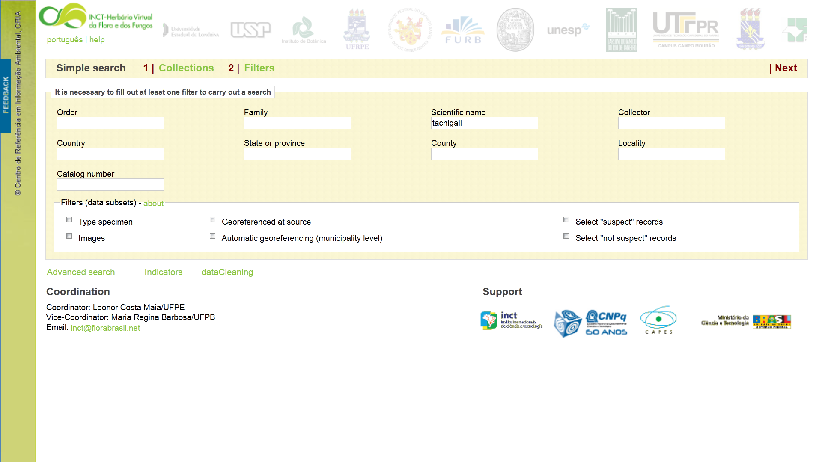
search interface • what to search
the speciesLink and inct-virtual herbarium of flora and fungi
•
•
•
•
•
•
•
•
•
•
•
•
•
•
•
•
•
•
•
•
•
•
•
•
•
•
•
•
•

Slide 30
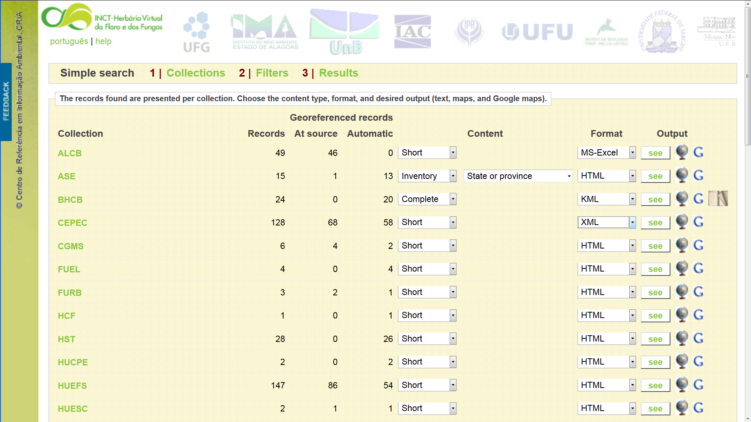
search interface • results summary
the speciesLink and inct-virtual herbarium of flora and fungi
•
•
•
•
•
•
•
•
•
•
•
•
•
•
•
•
•
•
•
•
•
•
•
•
•
•
•
•
•
•

Slide 31
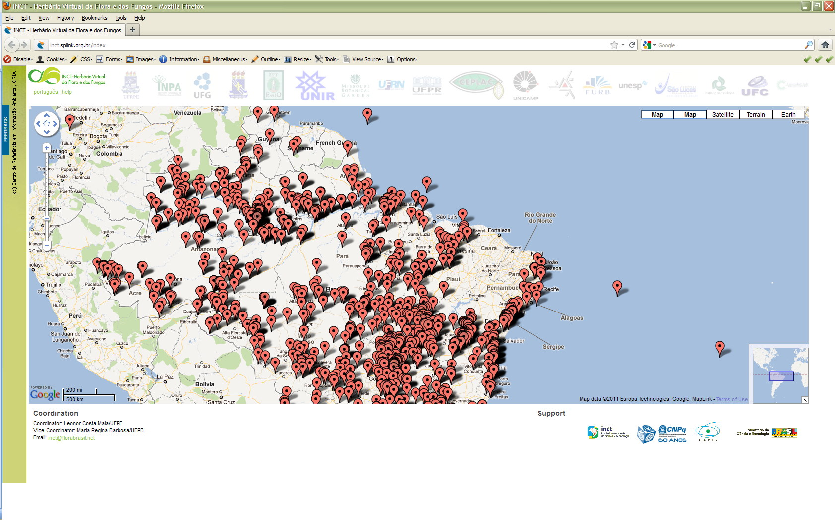
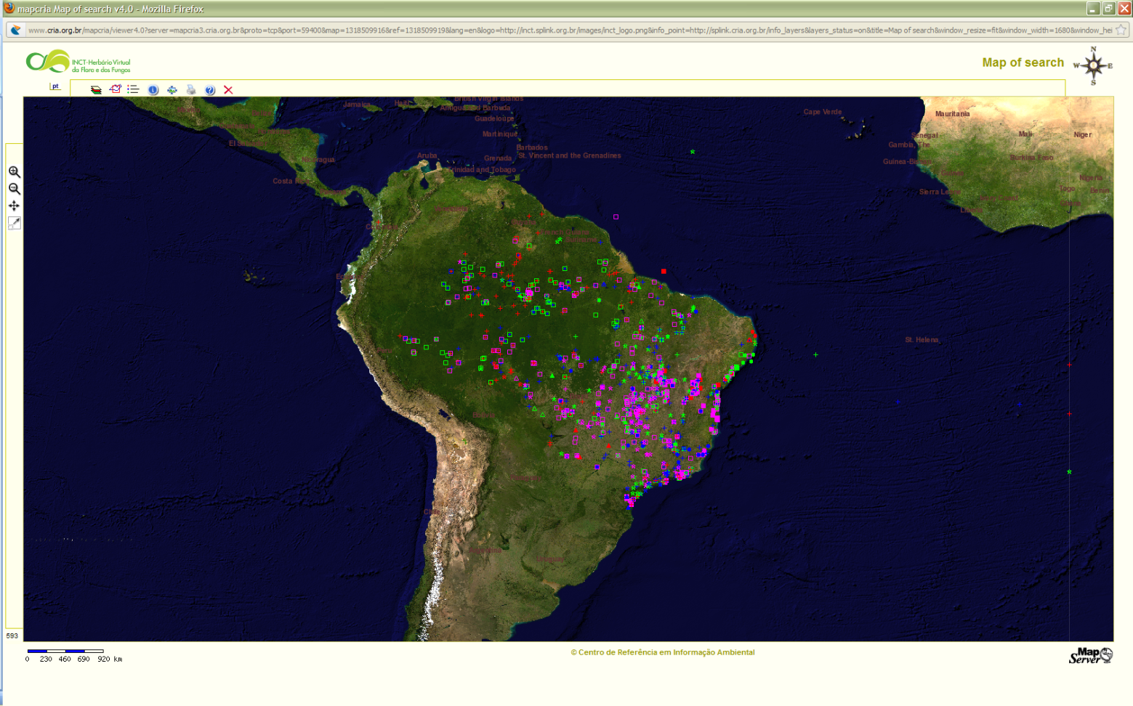
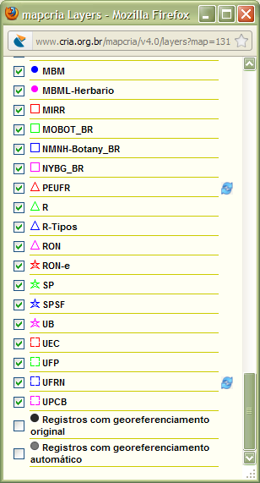
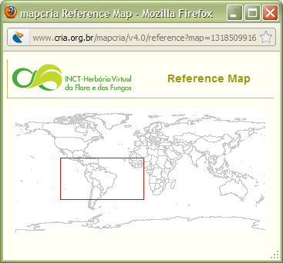
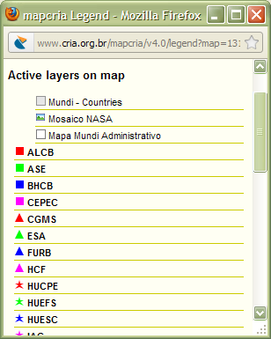
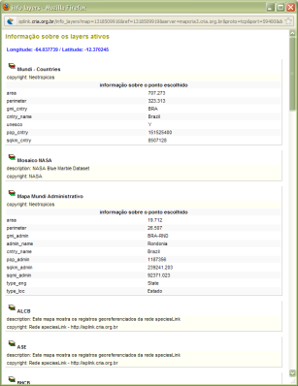
search results • maps
the speciesLink and inct-virtual herbarium of flora and fungi
•
•
•
•
•
•
•
•
•
•
•
•
•
•
•
•
•
•
•
•
•
•
•
•
•
•
•
•
•
•
•

Slide 32
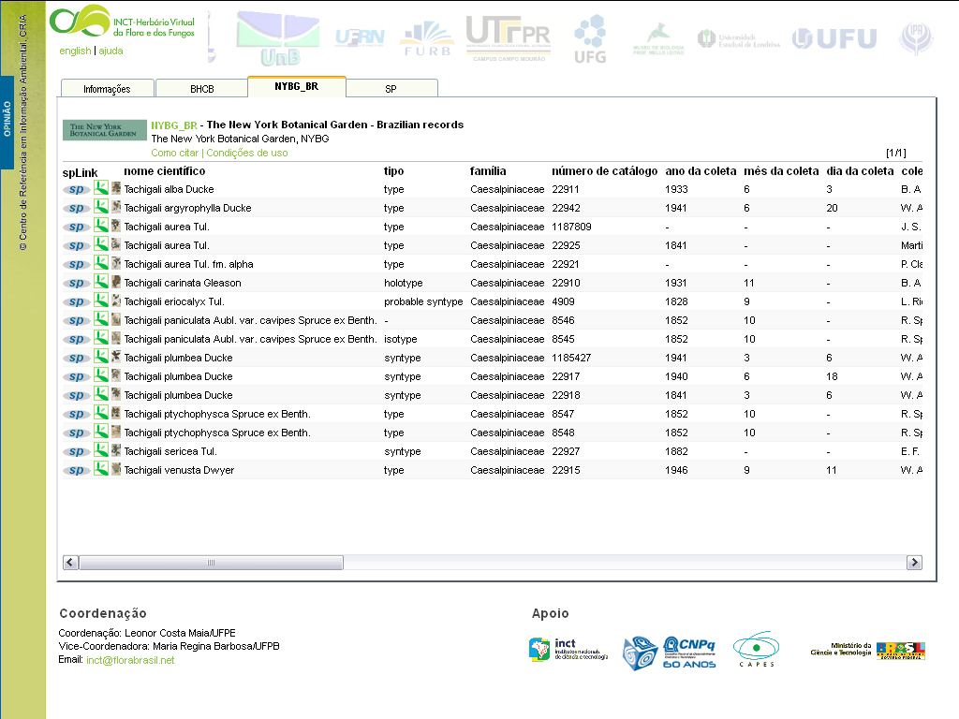
search results • detailed
the speciesLink and inct-virtual herbarium of flora and fungi
•
•
•
•
•
•
•
•
•
•
•
•
•
•
•
•
•
•
•
•
•
•
•
•
•
•
•
•
•
•
•
•

Slide 33
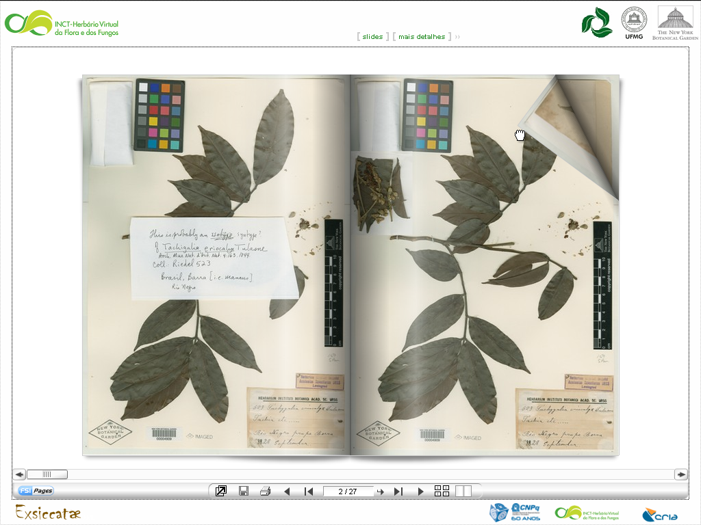
high resolution images integration
the speciesLink and inct-virtual herbarium of flora and fungi
•
•
•
•
•
•
•
•
•
•
•
•
•
•
•
•
•
•
•
•
•
•
•
•
•
•
•
•
•
•
•
•
•

Slide 34
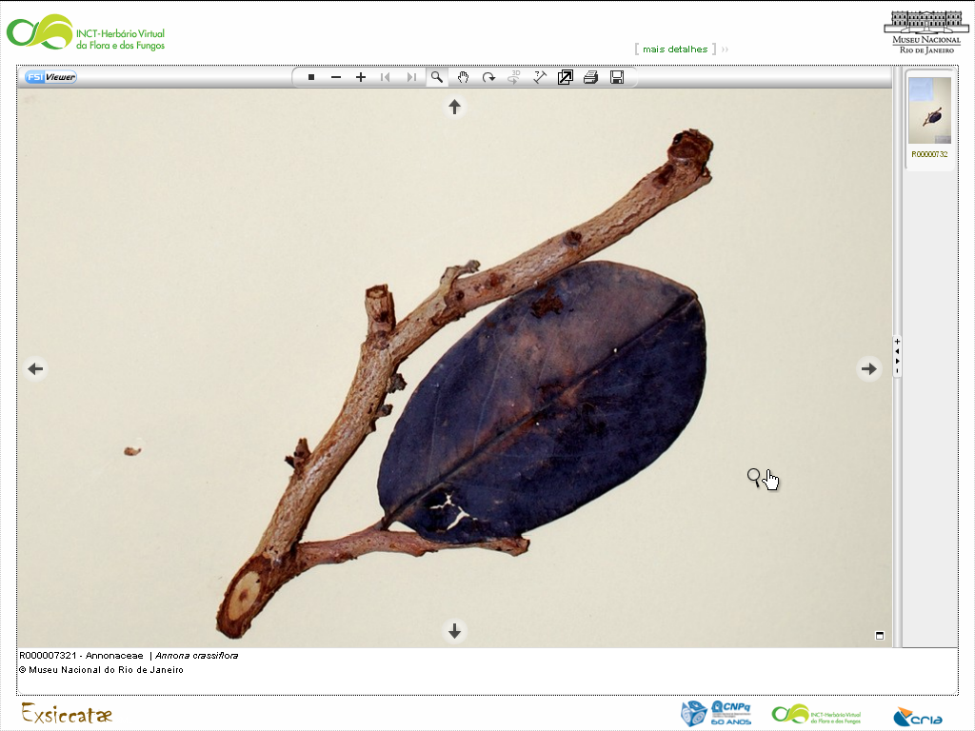
high resolution images integration
the speciesLink and inct-virtual herbarium of flora and fungi
•
•
•
•
•
•
•
•
•
•
•
•
•
•
•
•
•
•
•
•
•
•
•
•
•
•
•
•
•
•
•
•
•
•

Slide 35
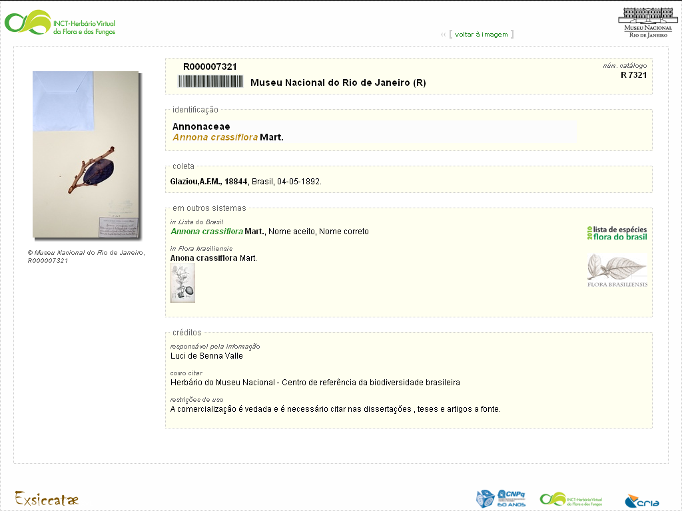
search results • integration with other systems
the speciesLink and inct-virtual herbarium of flora and fungi
•
•
•
•
•
•
•
•
•
•
•
•
•
•
•
•
•
•
•
•
•
•
•
•
•
•
•
•
•
•
•
•
•
•
•

Slide 36
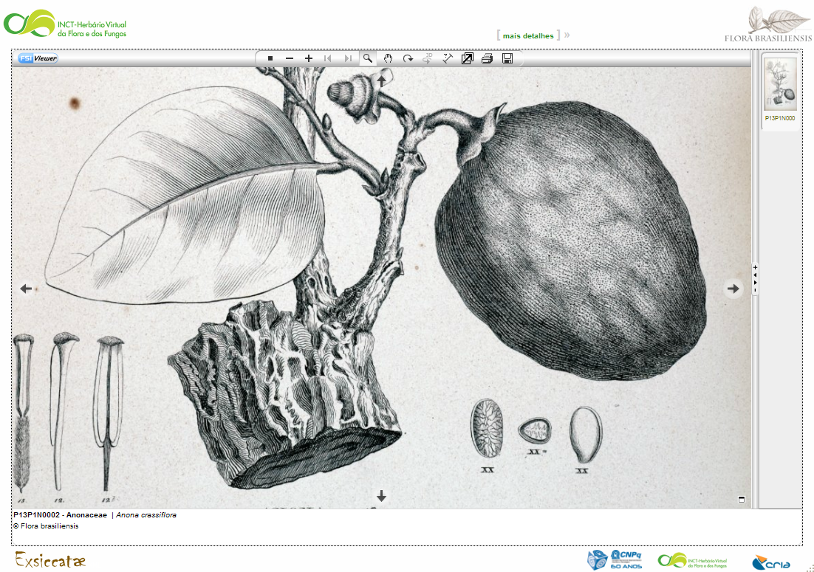
search results • integration with other systems
the speciesLink and inct-virtual herbarium of flora and fungi
Martius Flora brasiliensis
•
•
•
•
•
•
•
•
•
•
•
•
•
•
•
•
•
•
•
•
•
•
•
•
•
•
•
•
•
•
•
•
•
•
•
•

Slide 37
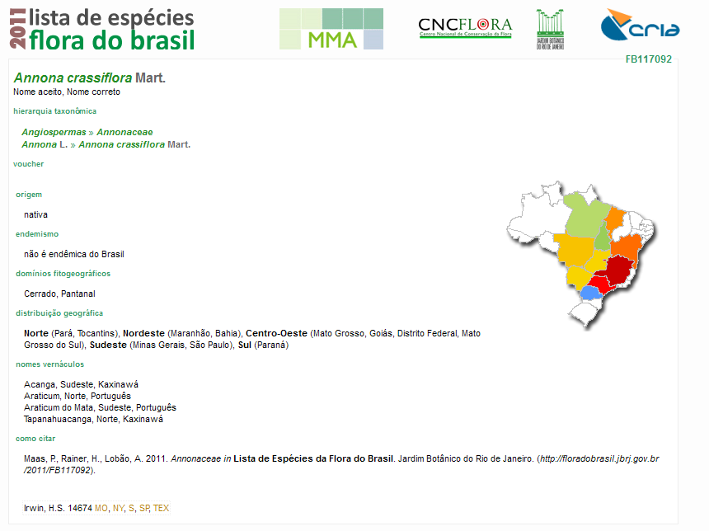
search results • integration with other systems
the speciesLink and inct-virtual herbarium of flora and fungi
•
•
•
•
•
•
•
•
•
•
•
•
•
•
•
•
•
•
•
•
•
•
•
•
•
•
•
•
•
•
•
•
•
•
•
•
•

Slide 38
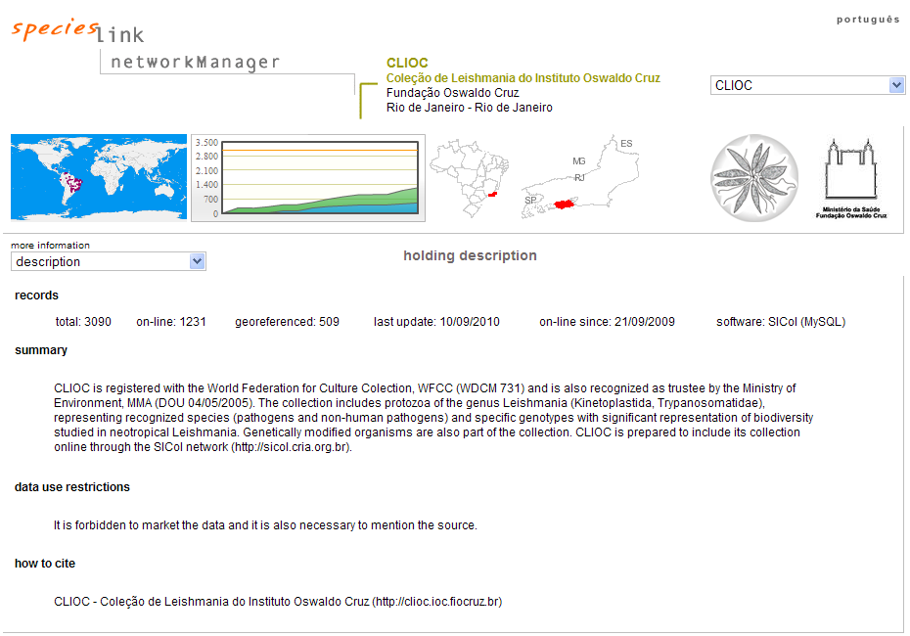
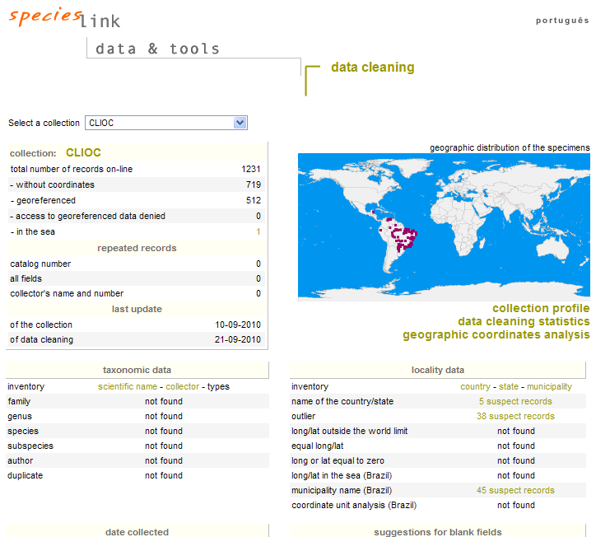



other services
the speciesLink and inct-virtual herbarium of flora and fungi
information about the collection
datacleaning reports
data analysis, indicators reports, georeferencing suggestions
•
•
•
•
•
•
•
•
•
•
•
•
•
•
•
•
•
•
•
•
•
•
•
•
•
•
•
•
•
•
•
•
•
•
•
•
•
•

Slide 39




































































partners and sponsors
the speciesLink and inct-virtual herbarium of flora and fungi
•
•
•
•
•
•
•
•
•
•
•
•
•
•
•
•
•
•
•
•
•
•
•
•
•
•
•
•
•
•
•
•
•
•
•
•
•
•
•

Slide 40

Thank you, obrigado!
Sidnei de Souza
sidnei@cria.org.br
Centro de Referência em Informação Ambiental, CRIA
www.cria.org.br
•
•
•
•
•
•
•
•
•
•
•
•
•
•
•
•
•
•
•
•
•
•
•
•
•
•
•
•
•
•
•
•
•
•
•
•
•
•
•
•

