Slide 1
FÍSICA NO LHC
RNP –EVALSO – ELLA REDE CLARA Conference
October 17 - 18
Alberto Santoro
UERJ – Tier2
Outline
I – HEP → CERN → LHC
II – LHC – Experiments
ALICE – LHCb – ATLAS – CMS
III- Physics
IV - Conclusion
25 minutos

Slide 2
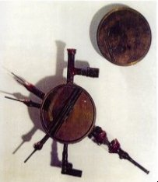
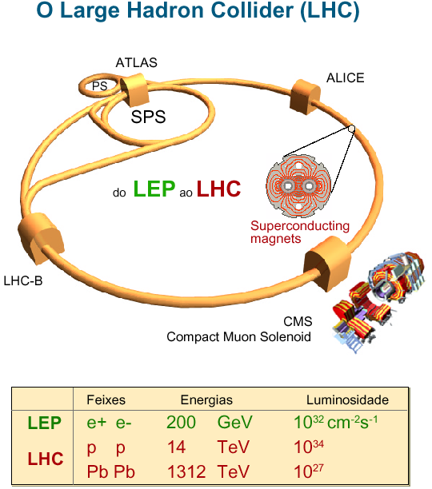
I – HEP → CERN → LHC
An Introduction
Particle physics is the Science that seeks to understand the evolution of the
Universe. HEP is dedicated to the study of the Fundamental Interactions of
Nature and its first bricks. (Fundamental interactions: gravitational,
electromagnetic, weak and strong)
The dinamic created by curiosity, makes modern world work. The study of particle physics challenges our preconceptions.
The history of the Particle Physics is part of the history of the Curiosity.
Philosophy – Quantum Mechanics – Cosmic Rays – Particle Accelerator Physics
They make part of the evolution of the Science with a big success.
E. O. Lawrence 1930
80 KeV

Slide 3
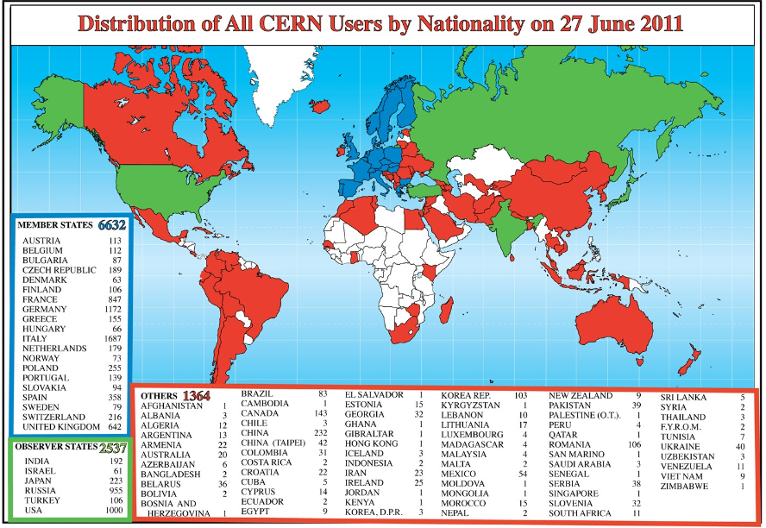
Cern World

Slide 4
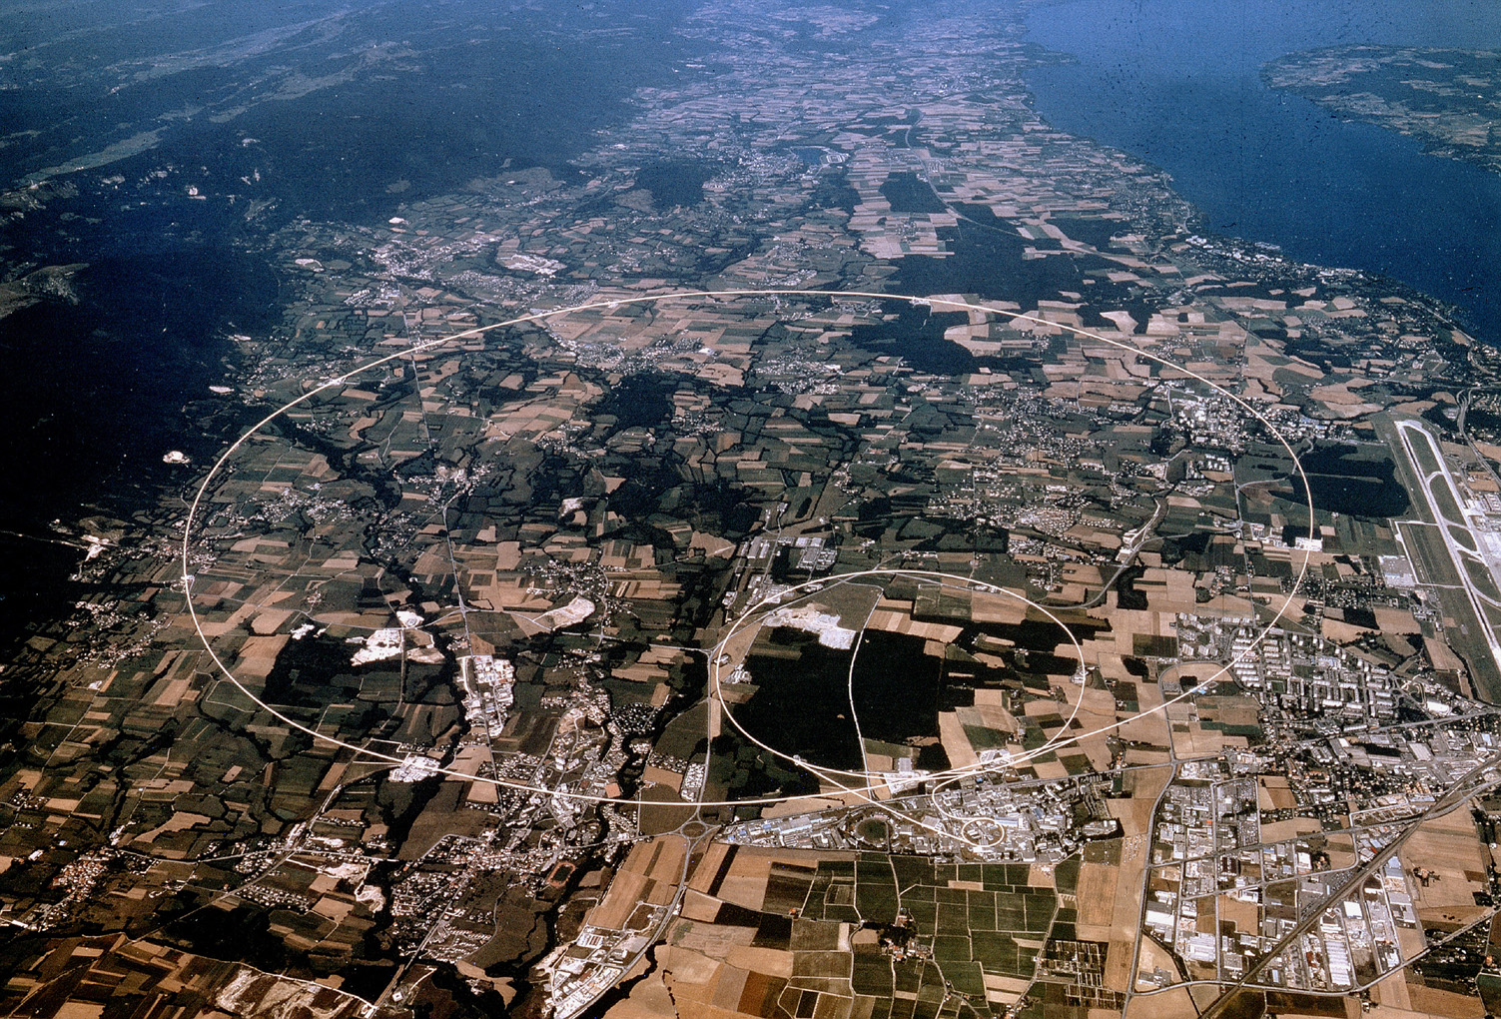

CERN: SCIENCE –EDUCATION – COLLABORATION - TECHNOLOGY

Slide 5

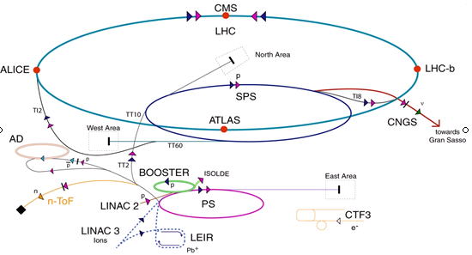



What is the LHC?
The LHC is the biggest Particle Accelerator of the World.
The Construction starts in 2000 with the following Characteristics:
27 Km of Circunference, an 100 m below the earth, is a collider of protons with
Maximum of 7 TeV/beam.
There are 1800 Superconducters magnets 7000 Km of superconduct wires,
120 T of Helium (700 thousands of Litters)at 1,9 K
1,15 x 10¹¹ Particulas/bunch

Slide 6
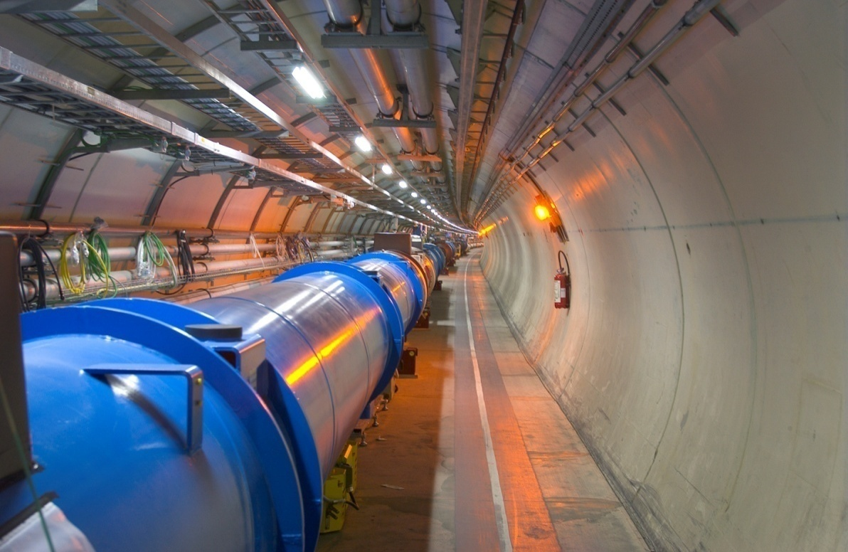
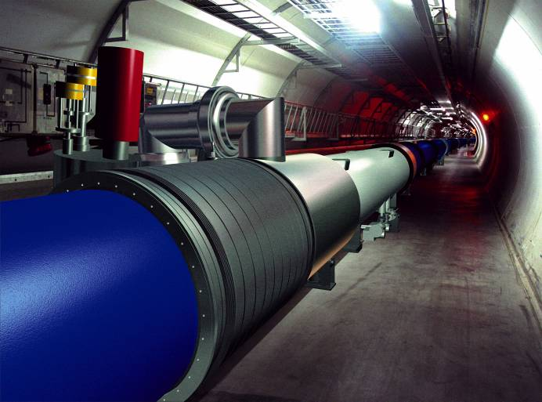
6
Notes:
6

Slide 7
II – LHC – Experiments
ALICE – LHCb – ATLAS – CMS
The activities in High Energy –Experimental- Physics are:
-- The Accelerator ( where we produce the beam and
Initial Conditions to the experiment
-- The detector ( where we take data which will be the
seed of the Physics to be done.
-- The computing (where we do everything and without
we could not do all these activities.
-- The Analysis ( where we do the physics)
Let us now talk a bit about the detectors itself on LHC.

Slide 8
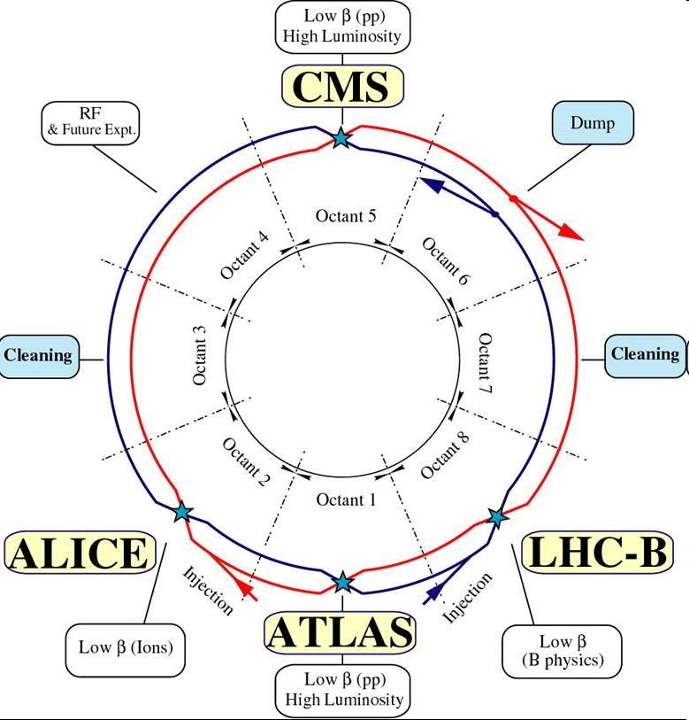
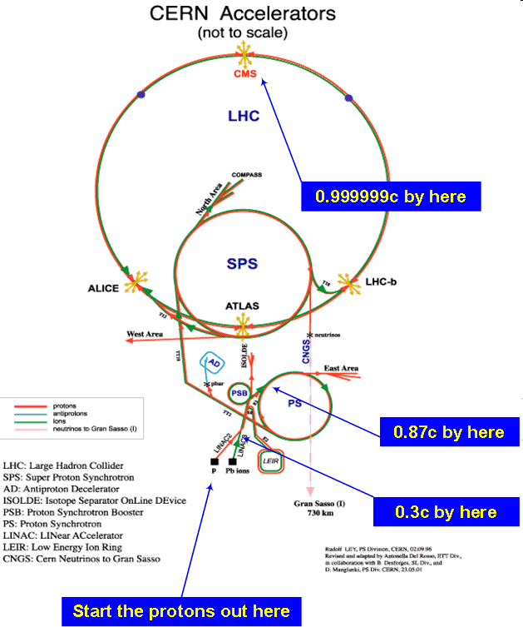
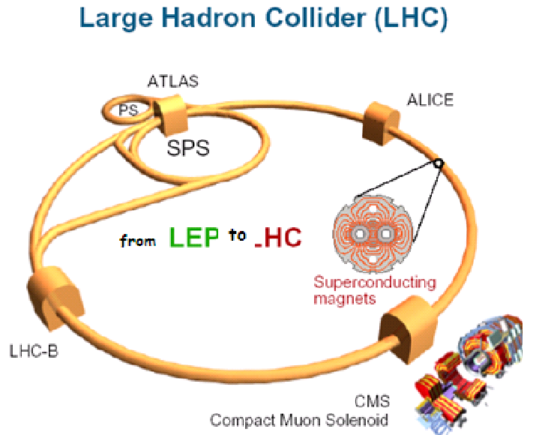

Slide 9
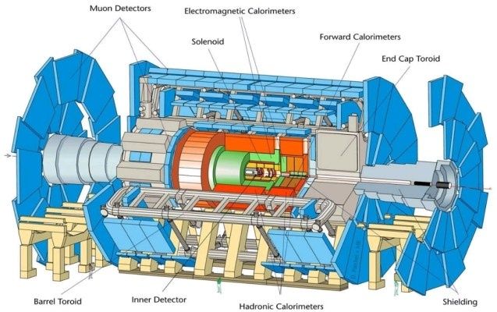
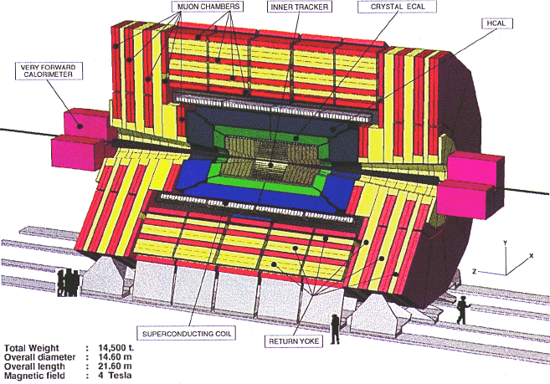
II - The LHC Experiments
ALICE – LHCb – ATLAS - CMS
ATLAS and CMS are two detectors of General Purpose.
From Brazil 4 Institutions:
UFRJ – USP – UFSJ - UFJF
7 Institutions: CBPF, CEFET,
UABC,UERJ, UFRGS,UNESP,
UNICAMP
45 meters long and 25 meters
of height and weighs 7.000 T.
21 [m] long 15 [m] of diameter
15 [m] of height and weighs
12.000 T.
ATLAS – A Toroidal LHC Apparatus
CMS – Compact Muon Solenoid
Notes:
9

Slide 10
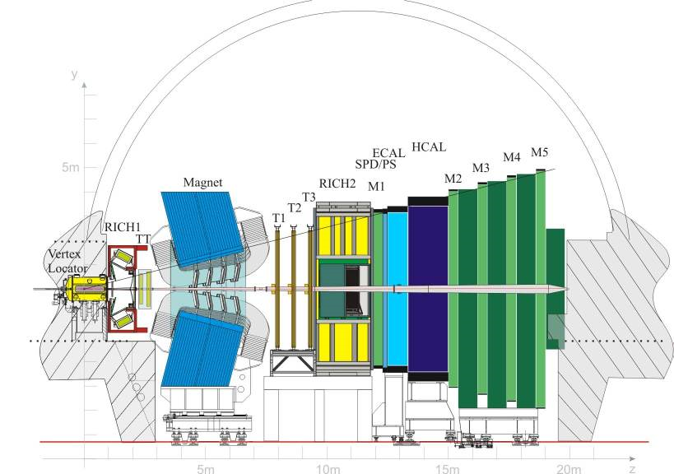
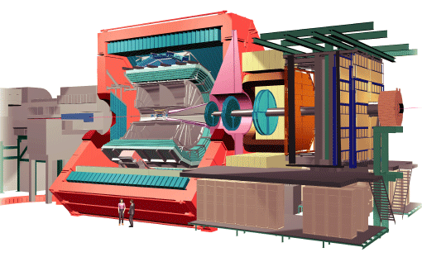
ALICE is dedicated to the Plasma Physics –Quarks and Gluons
Working mainling with Heavy Ions.
While the LHCb is dedicated to the studies of quark b
CP violation, and the problem Mater x Antimater.
From Brazil 2 Institutions: USP e UNICAMP
26 [m] long, 16 [m] height,16 m wide
And weighs 10.000 T.
3 Institutions – CBPF – UFRJ – PUC/Rio
21 [m] long, 10 meters height and weighs 5600 T.
LHCb
ALICE – A Large Ion Collider Experiment

Slide 11
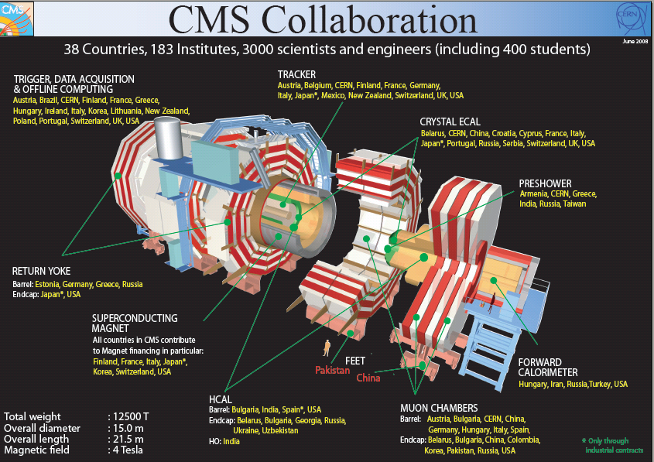
I will talk more about CMS which is a general purpose Detector. This is important for us. Open opportunity for much more people.

Slide 12
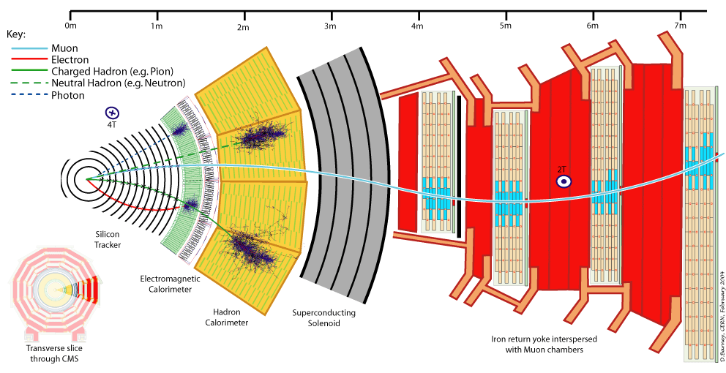
The particles detected in CMS: electron, muon,
Charged Hadron, Neutral Hadron, Photon

Slide 13
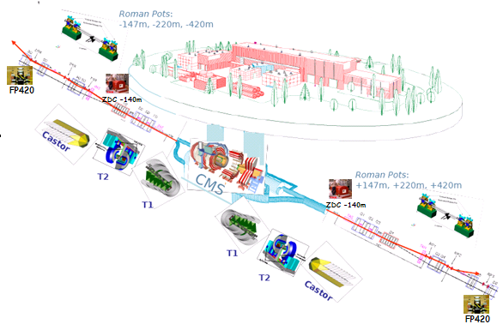
Forward Detectors: CASTOR, FP420, ZDC

Slide 14
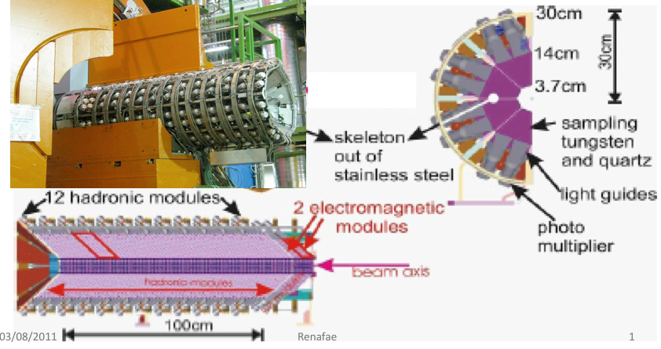
CASTOR
Centauro And STrange Object Research
Calorímetro de Tungstênio e Quartzo
Situado a 14.3 m do centro do CMS
Partially financed by FAPERJ

Slide 15
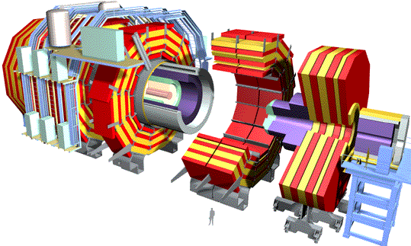
Computing – Hardware and Software
The International treatment of data - GRID/CMS
CMS Experiment
10s of Petabytes/yr for~2008
1000 Petabytes in < 10 ayears?
> 50% of CPUs are in Tier2s
Online System
0.2 - 1.5 GB/s
CERN Computer Center
Tier 0
10 Gb/s
10+ Gb/s
Tier 1
Korea
UK
Russia
FNAL
~10 Gb/s
Tier 2
DISUN
Caltech
UCSD
UERJ
Sprace
~10 Gb/s
Tier 3
UCLA
UCR
….
…
Tier 4
Physics caches
PCs

Slide 16
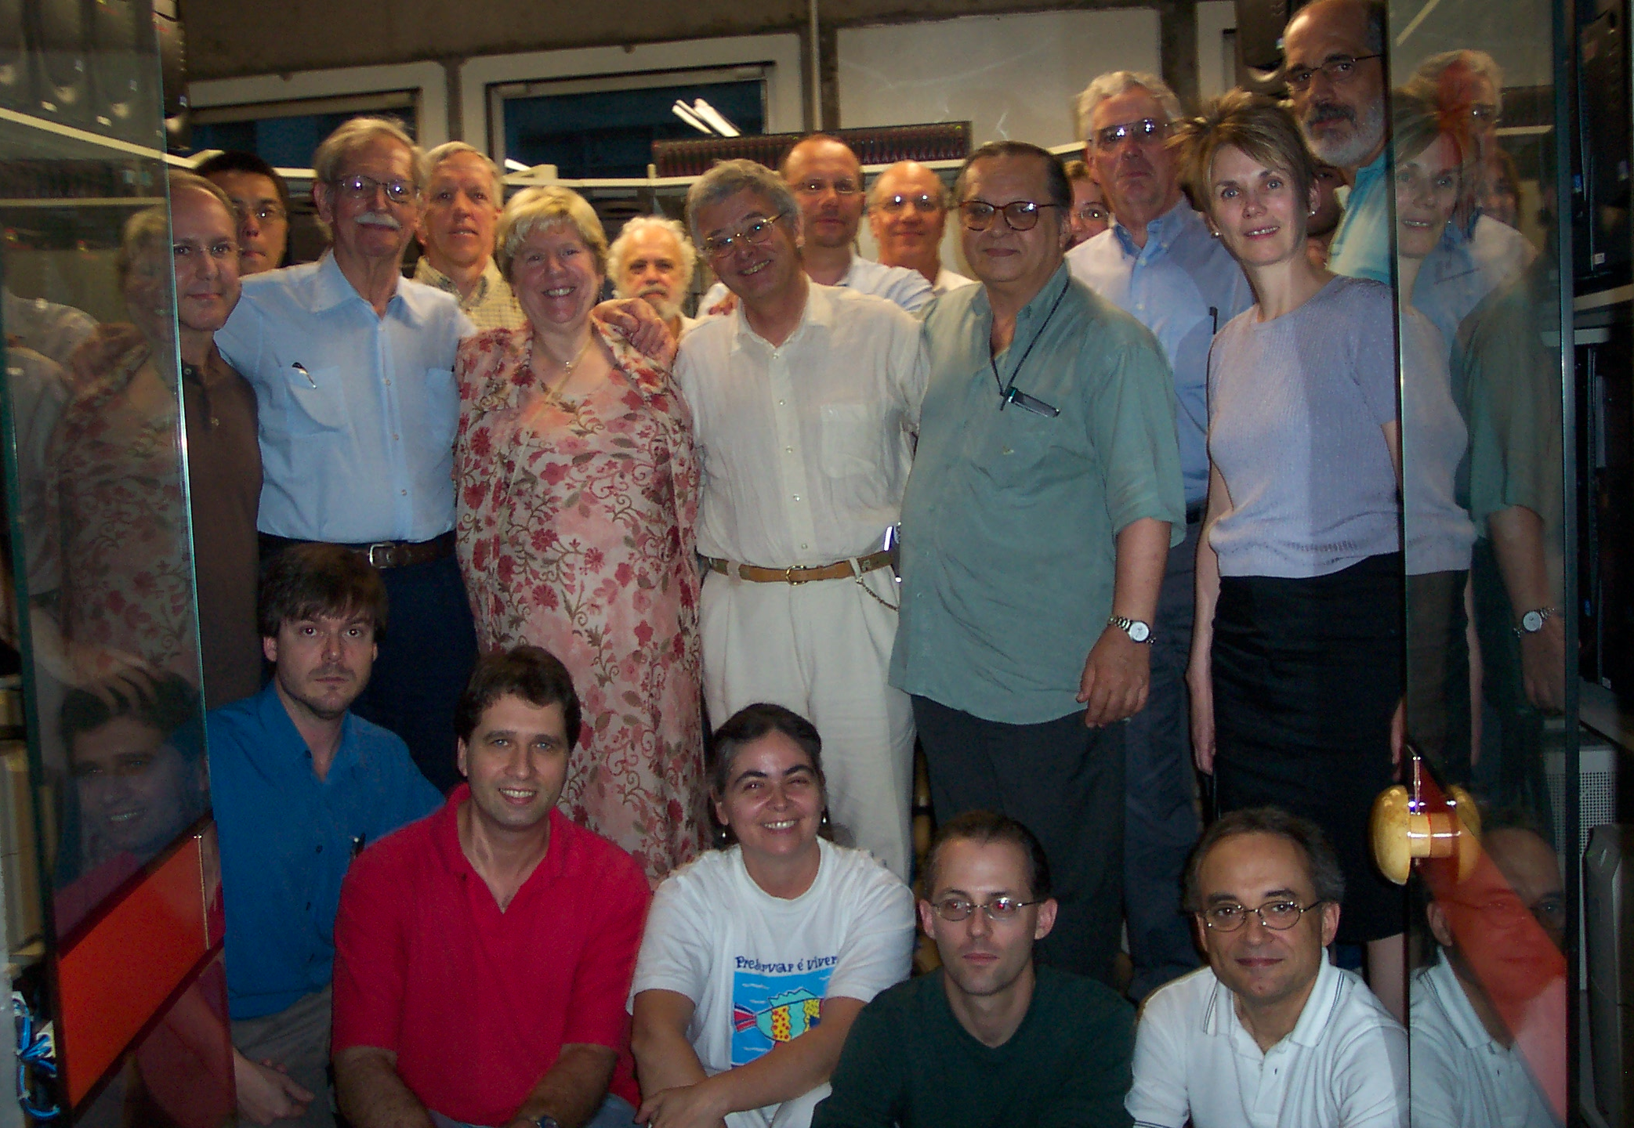

Slide 17
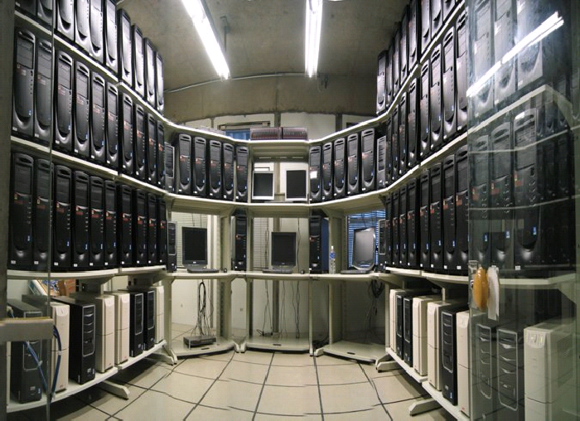
T2 – HEPGRID BRAZIL

Slide 18
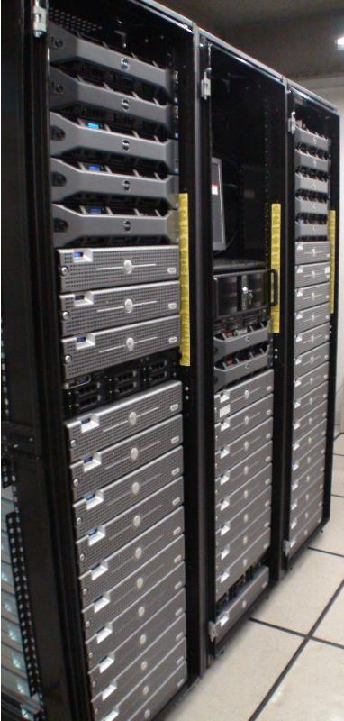
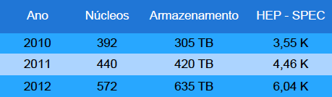
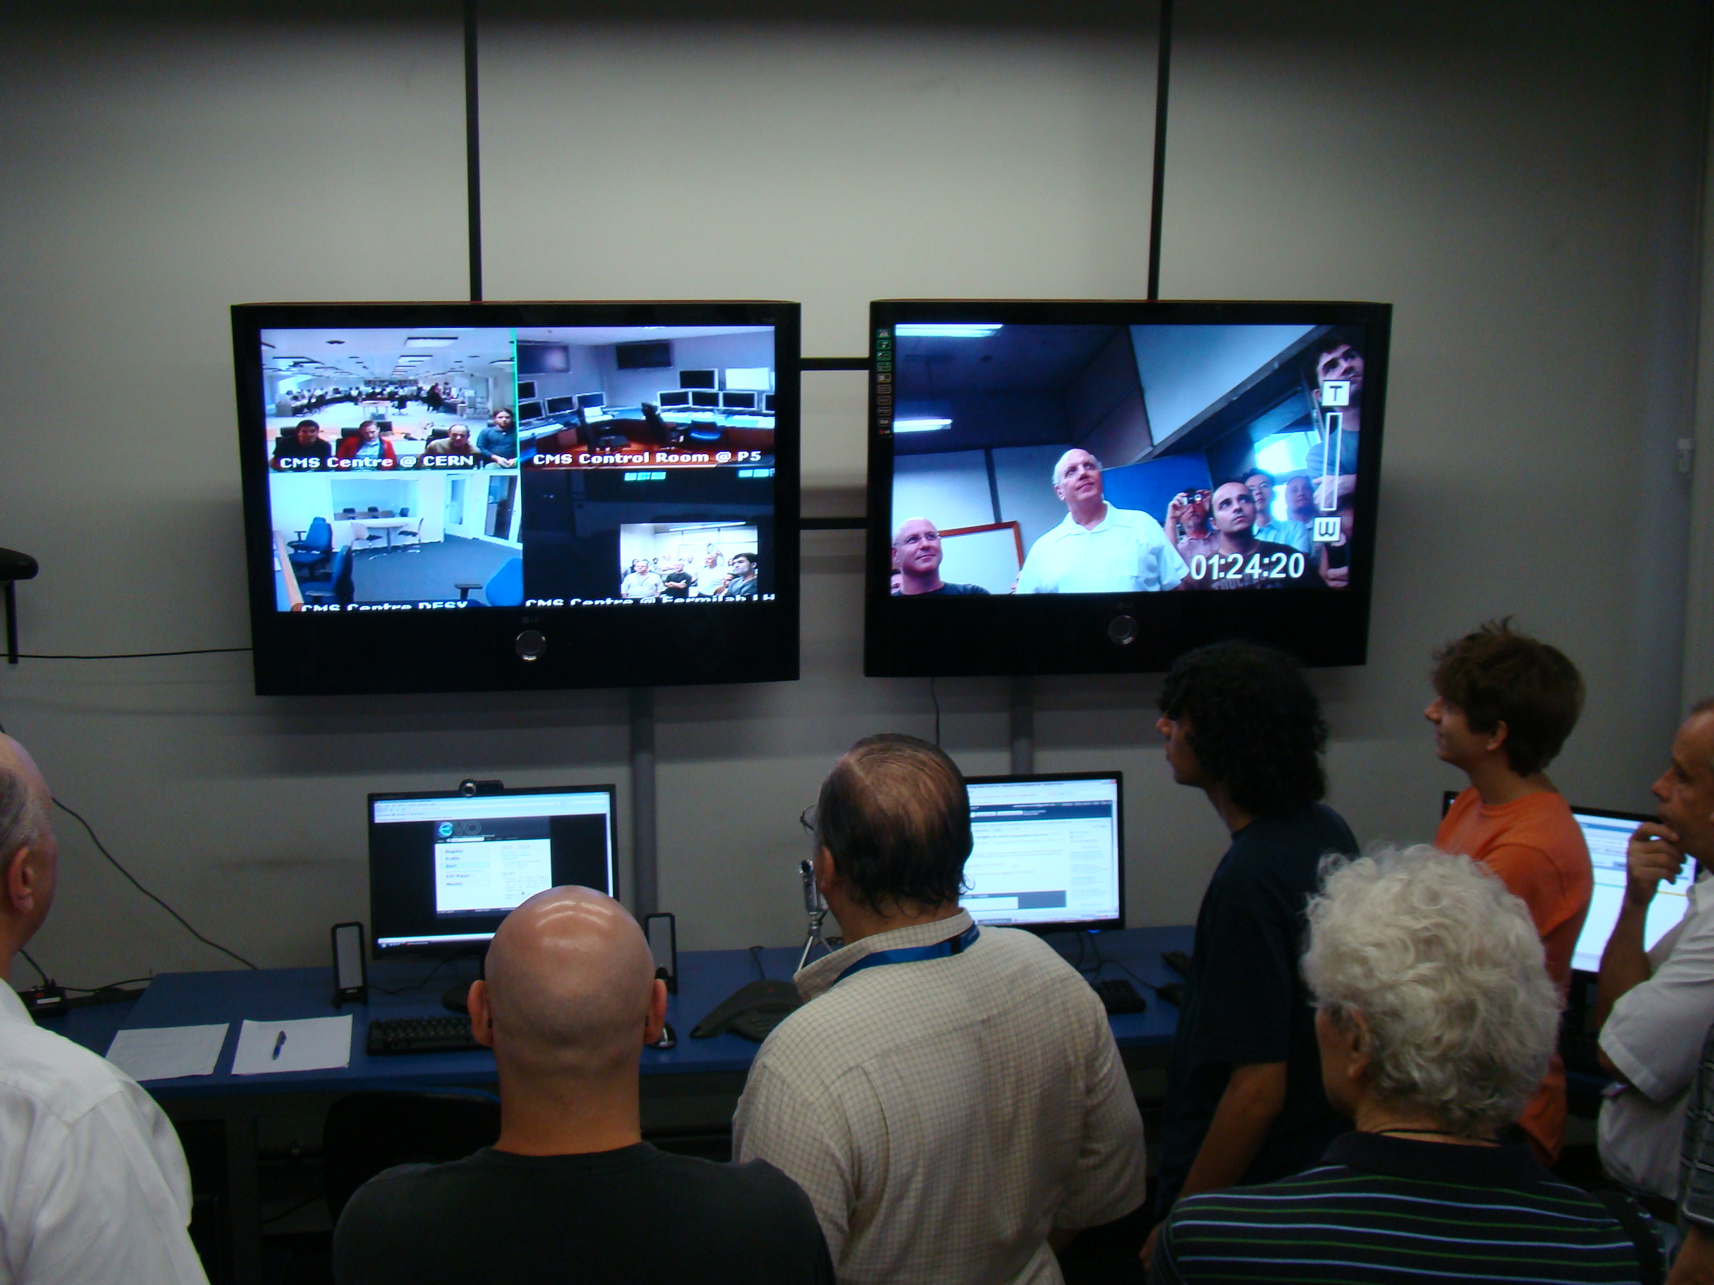
Processing Infraestruture at UERJ:
Cluster
Control Room:
Year Cores Storage HEP-SPEC
LINK Last Mile conection: VERY BAD!!!!!!

Slide 19
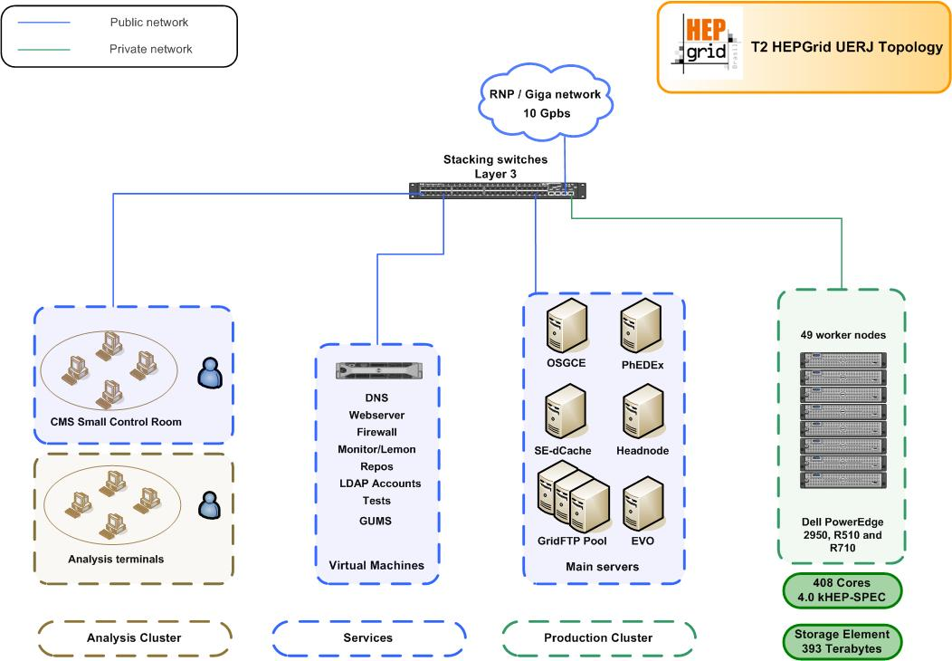

Slide 20

III- Physics
The LHC will stablish the future of the Particle
Physics independent of the new discoveries.
All Standard Model was re-discovered
Higgs Bosons
Dark Matter
Physics of Heavy Ions - Plasma
Matter x Antimatter
Supersimetry
Extra Dimensions
Jets and Multijets (QCD)
Leptoquarks
Centauros
Forward Physics
New Physics…..
………………………………………

Slide 21
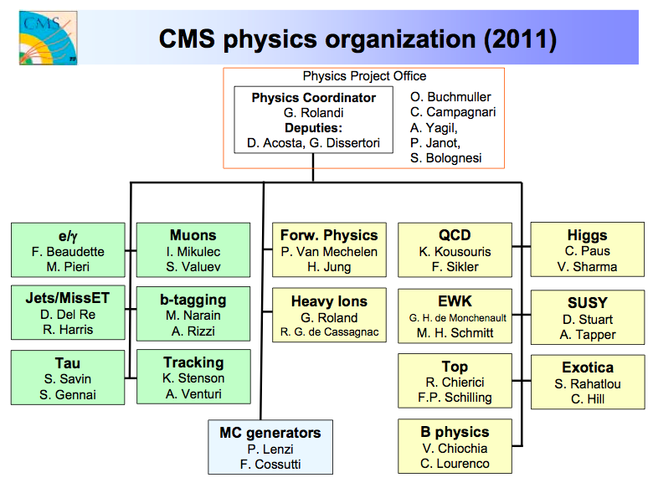

Slide 22
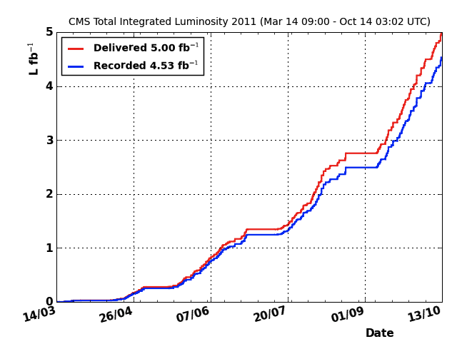

Slide 23
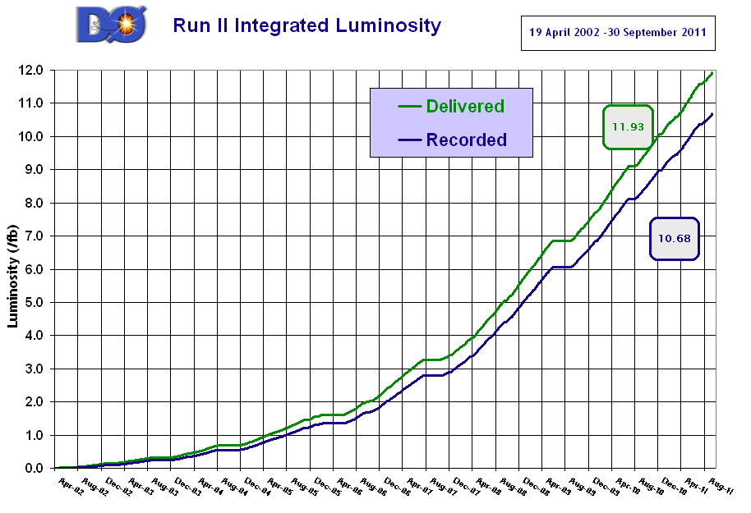

Slide 24

LHC Status
7 TeV!!!
O LHC is working very well as we shown by luminosity delivered.
First Collisions at 900 GeV in 23/11/09
Record Mundial in Energy 1.18 TeV/beam in 30/11/09
Collisions now proton x proton are at 7 TeV
Luminosity integrated go to 5 fb up to end of the year
Collisions with Pb x Pb at 2.76 TeV/per nucleon
As tomadas de dados tem sido um grande sucesso alcançado
pela máquina LHC, pelos detectores que estão conseguindo
gravar um número de dados muito grande.

Slide 25
CMS Brasil
Composed by :
7 Institutions in 3 Bras. States
48 members:
18 professors and researchers
30 Students and Engineers
Analisis:
Diffraction Physics
Exotic Physics
Higgs
Electroweak
Heavy Ion Physics
Detector R &D:
Castor
HPS (FP420)
Computing Infrastructure:
Tier2 UERJ
Tier2 SPRACE
Software Development:
Alpgen
FastSim
Services:
Monte Carlo Production
Shifts

Slide 26
IV - Conclusion
What can we expect from LHC Experiments?
Always surprises.
- Higgs if exists.
-Extra Dimensions?
-Supersimetry?
…………………….
HEP is an area of frontier of Research and one
Local plentiful of Inovation.
We are in the Energy, and the Data production, then,
in Computing to take in account of this all complex system.

Slide 27
Visitas Ilustres

Slide 28
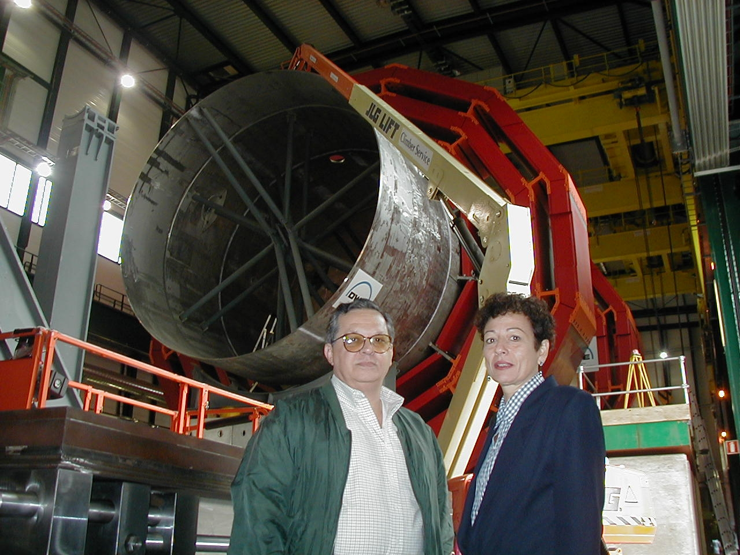
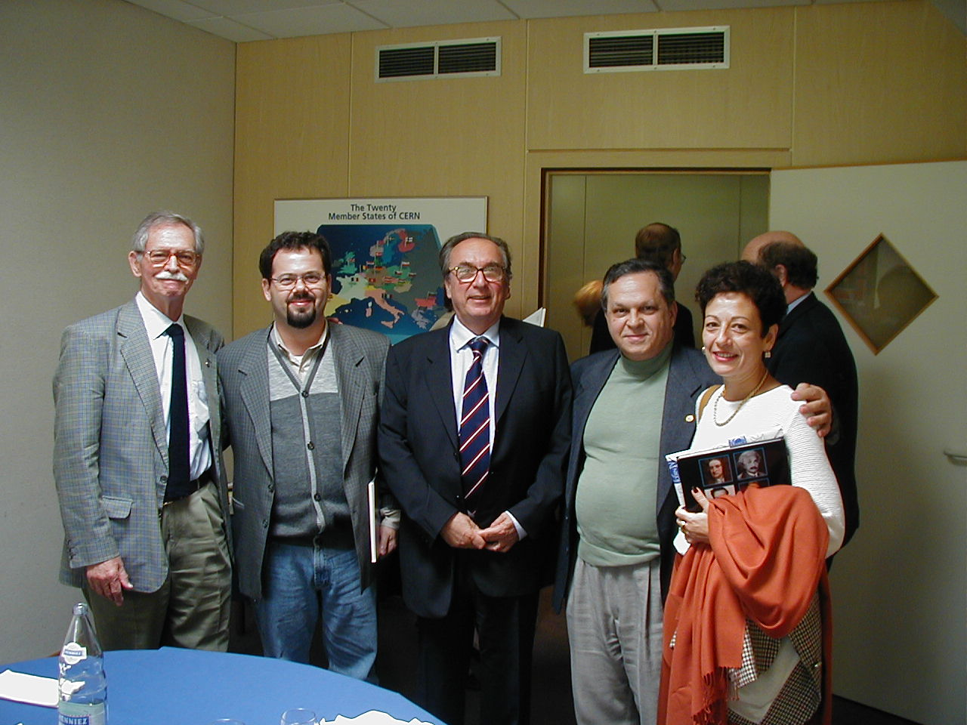
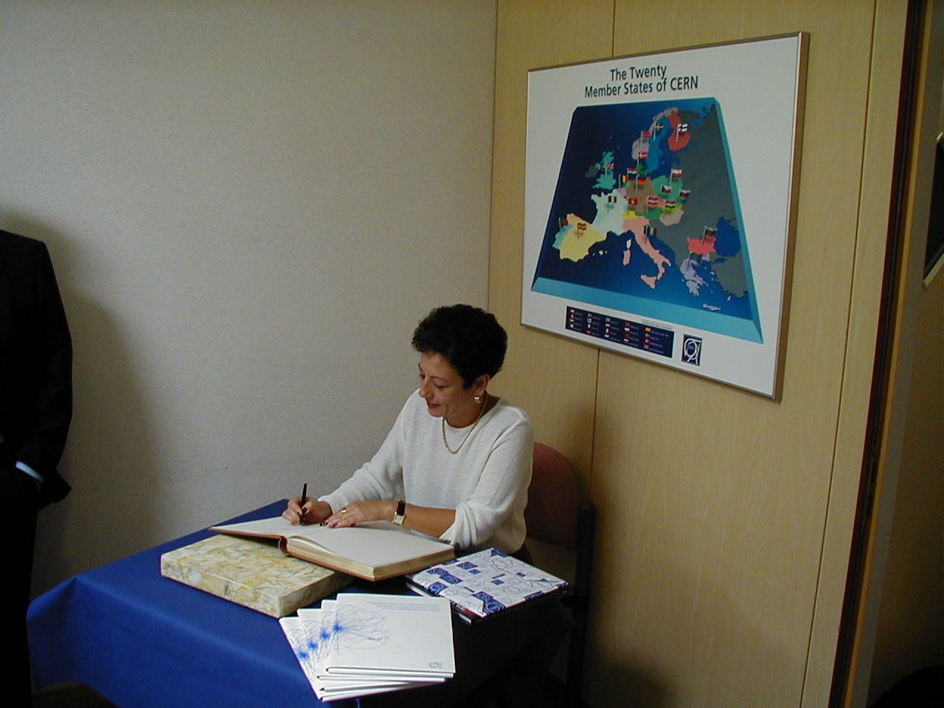

Slide 29
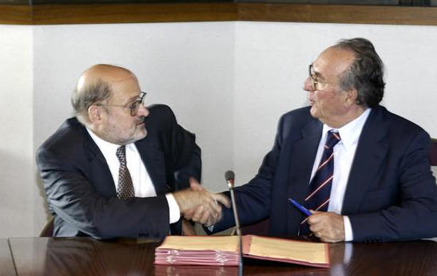

Slide 30
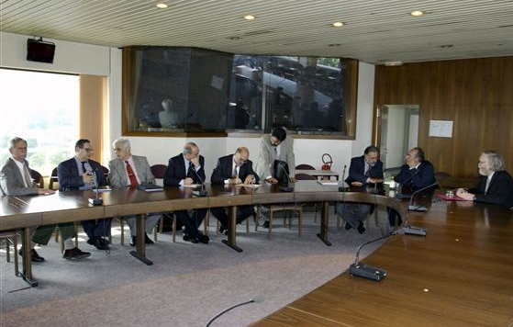

Slide 31
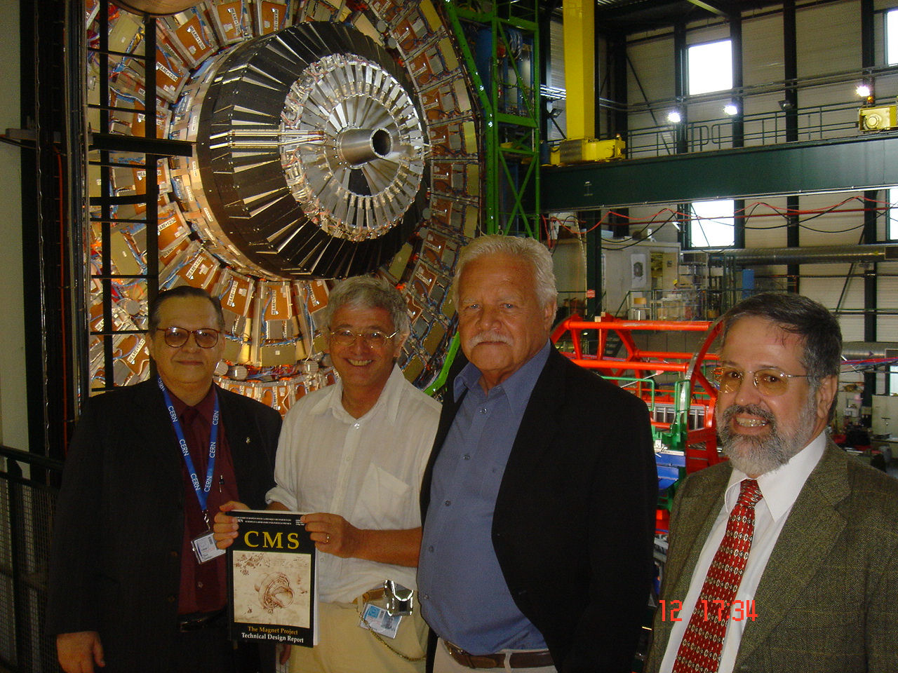

Slide 32
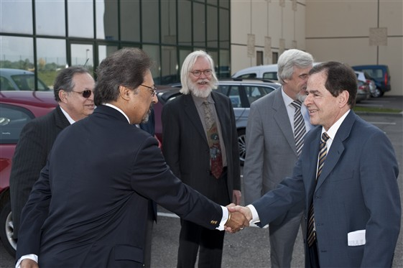
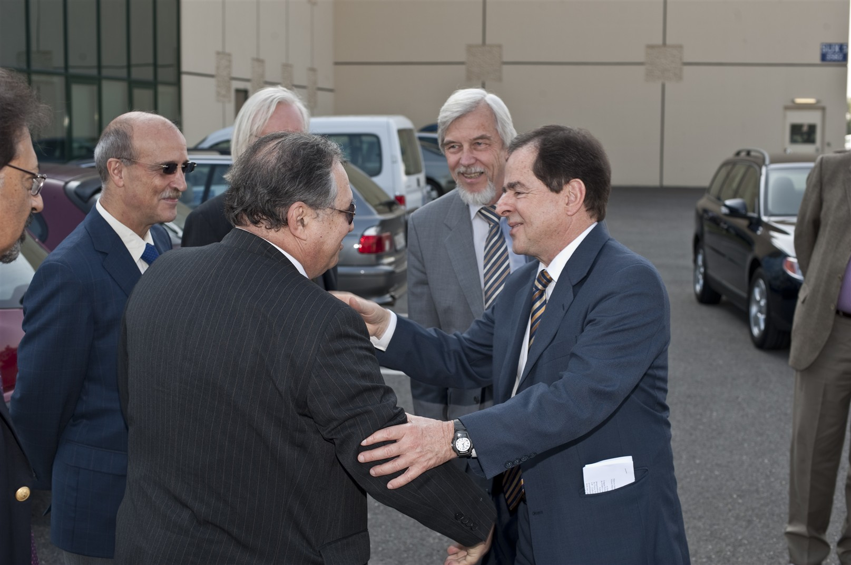
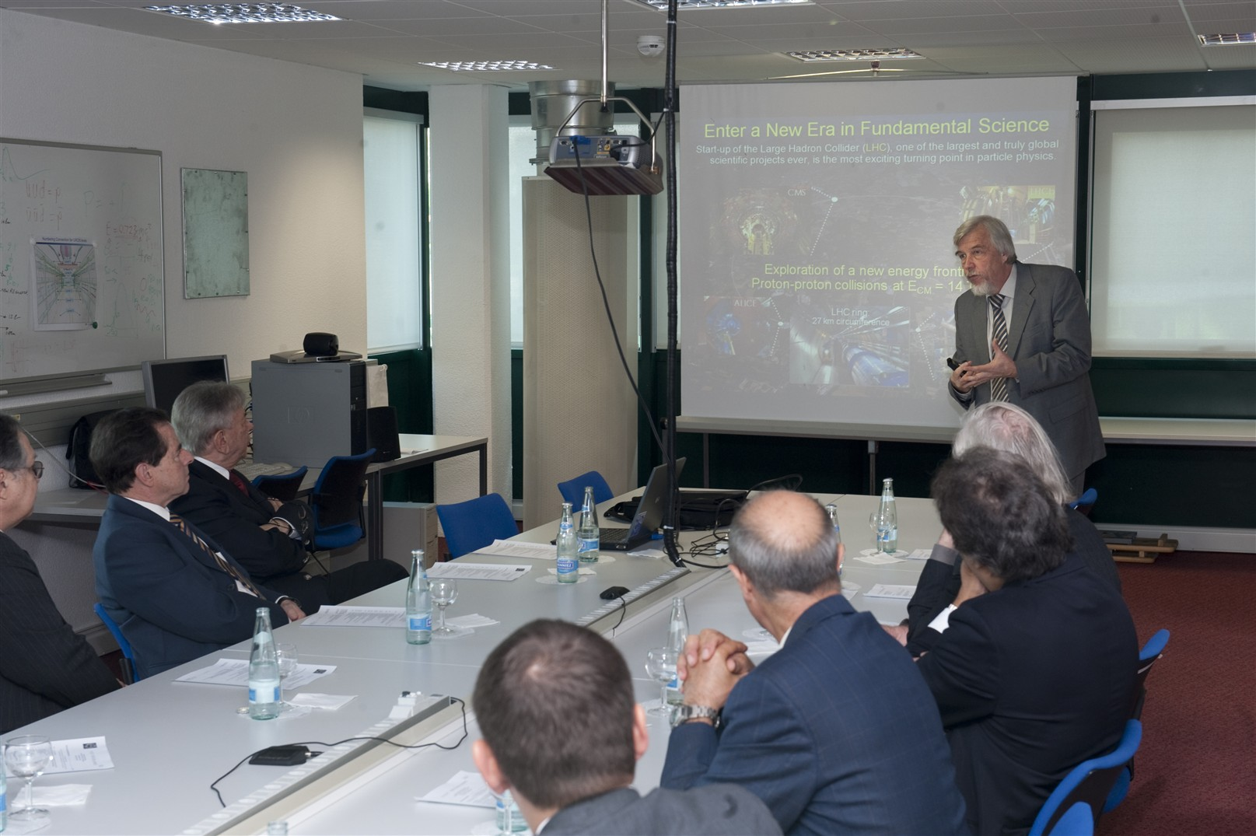
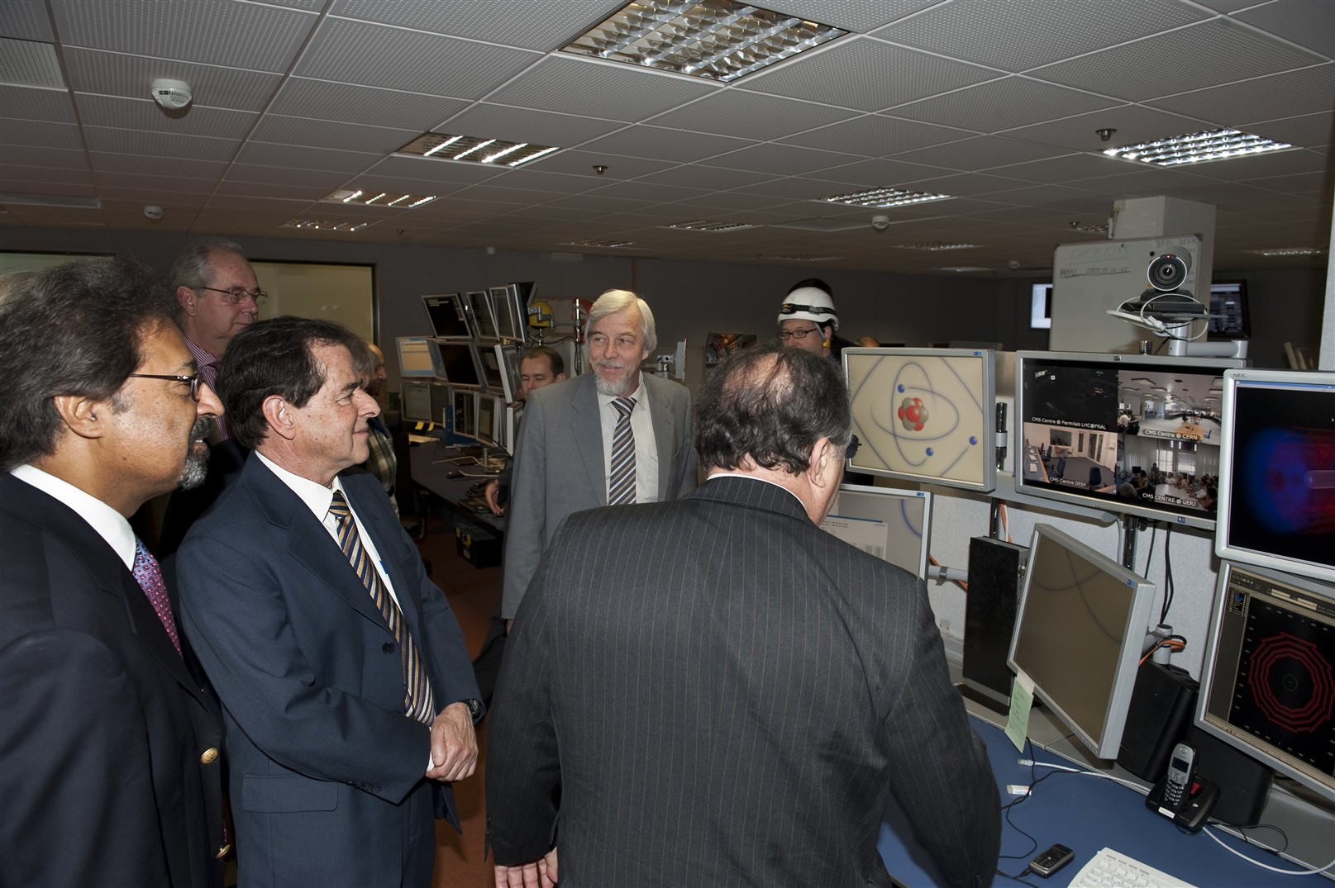
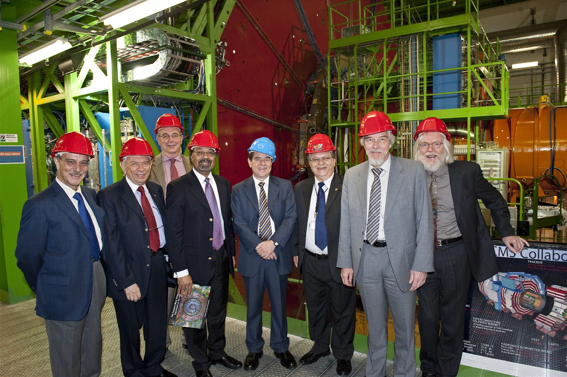
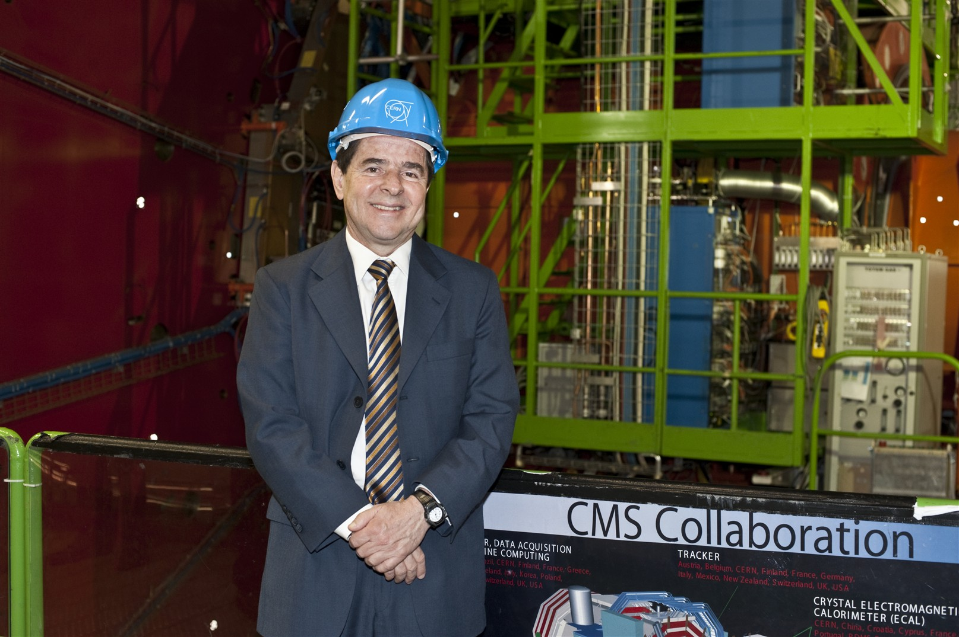
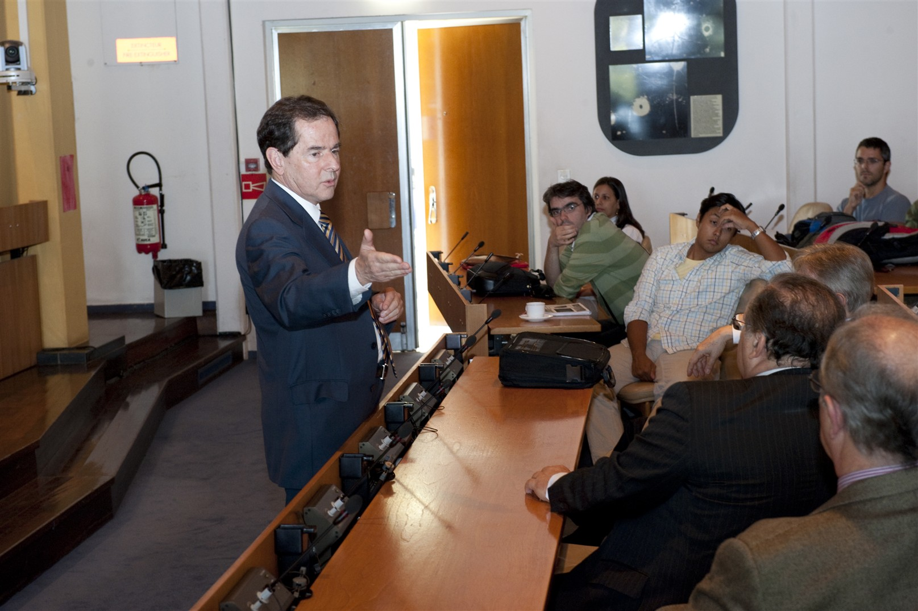
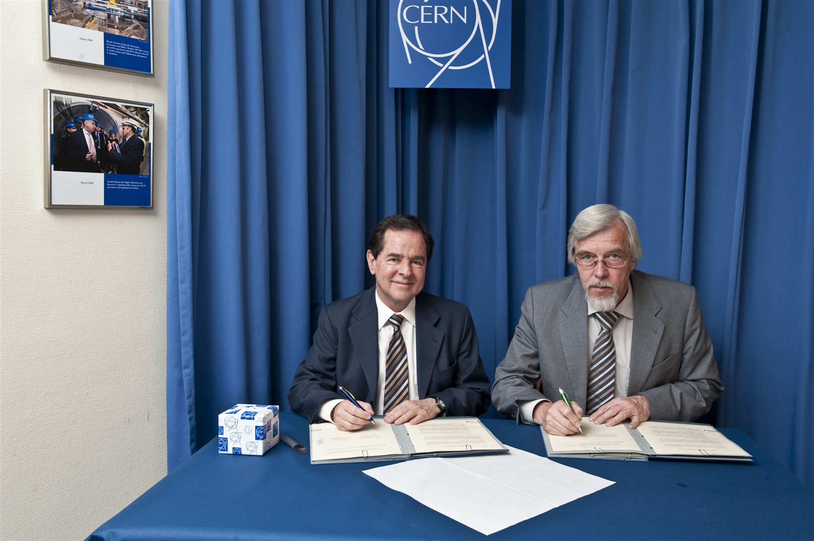

Slide 33
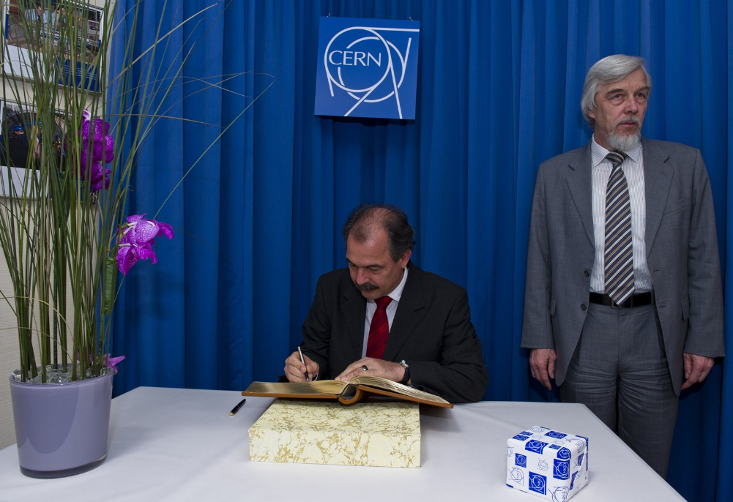

Slide 34
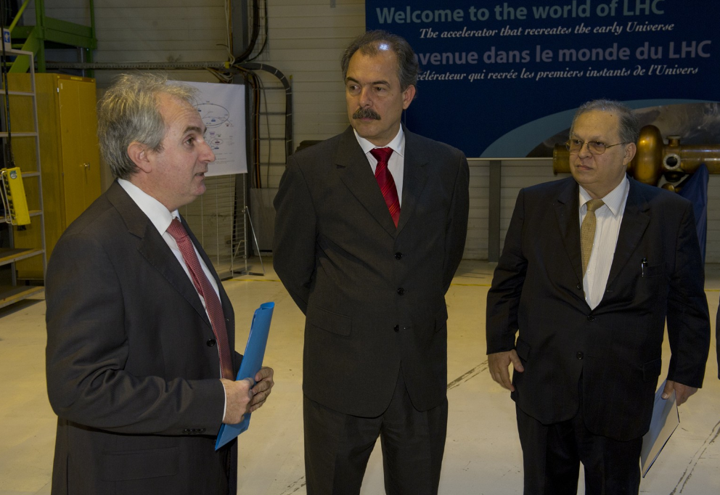

Slide 35
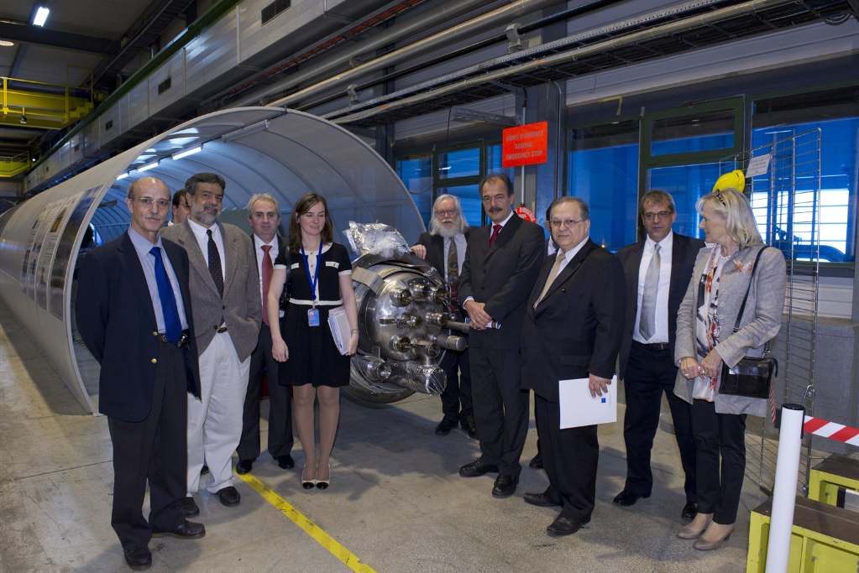

Slide 36
Thank you

Slide 37
Backup Slides

Slide 38
Higgs
:
The LHC will stablish the future of the Particle
Physics independent of the new discoveries.
Higgs Bosons
Dark Matter
Physics of Heavy Ions - Plasma
Matter x Antimatter
Supersimetry
Extra Dimensions
Jets and Multijets (QCD)
Leptoquarks
g g scattering
Centauros
New Physics…..
………………………………………
The Higgs Boson, or testing mechanisms of spontaneous symmetry breaking are part of the most popular subjects studied at the LHC (CMS, ATLAS)
Mode | Mass Range (GeV/c²) | Dataset (fb⁻¹)
H à γγ | [110-150] | 1.7
qq->VH; H à bb | [110-135] | 1.1
H à ττ | [110-145] | 1.6
H àWW à2l 2ν | [110-600] | 1.5
H à ZZ à4l | [110-600] | 1.7
H à ZZ à2l2τ | [180-600] | 1.1
H à ZZ à2l2j | [226-600] | 1.6
H à ZZ à2l2ν | [250-600] | 1.5
Difficulties come from pile-up > 7

Slide 39
Dark Matter
The LHC will stablish the future of the Particle
Physics independent of the new discoveries.
Higgs Bosons
Dark Matter
Physics of Heavy Ions - Plasma
Matter x Antimatter
Supersimetry
Extra Dimensions
Jets and Multijets (QCD)
Leptoquarks
g g scattering
Centauros
New Physics…..
………………………………………
There is a consensus among cosmologists, astrophysicists and astronomers that only 4% of visible matter in the Universe is known.
The rest is known as dark matter is:
26% Dark Energy and
70% is constituted as a challenge to physicists. Supersimetric particles can be one example to find Dark Mater. (ATLAS, CMS,…)
A good paper to get more information about Supersimetry and Dark Matter
can be “Indications of Suppression of Excited Υ States in Pb-Pb Collisions
at TeV ”
Chatrchyan et al.*(CMS Collaboration)
PRL 107, 052302 (2011)
And
CMS Collaboration, arXiv:1101,1628 [hep-ex]
CMS Collaboration, arXiv:1102,1628 [hep-ex]
CMS Collaboration, arXiv:1102,5290 [hep-ex]

Slide 40
Heavy Ions
The LHC will stablish the future of the Particle
Physics independent of the new discoveries.
Higgs Bosons
Dark Matter
Physics of Heavy Ions - Plasma
Matter x Antimatter
Supersimetry
Extra Dimensions
Jets and Multijets (QCD)
Leptoquarks
g g scattering
Centauros
New Physics…..
………………………………………
The CMS also will have run with heavy ions. It is with Pb x Pb at very high energy.
The Focus is the plasma of Quarks and Gluons. (ALICE, ATLAS, CMS)
Heavy Ions
For more information go to ALICE PbPb publications:
-Multiplicity PRL, Vol.105,2010, 252301
Elliptic flow of Charged Particles PRL, Vol.105,2010, 252302
R_{AA} of Charged Particles PLB, Vol.696,2011, 30
Centrality dependence of dN_{CH}/dη PRL, Vol. 106,2011, 32301
…………………………………..

Slide 41
Matter x Antimatter
The LHC will stablish the future of the Particle
Physics independent of the new discoveries.
Higgs Bosons
Dark Matter
Physics of Heavy Ions - Plasma
Matter x Antimatter
Supersimetry
Extra Dimensions
Jets and Multijets (QCD)
Leptoquarks
g g scattering
Centauros
New Physics…..
………………………………………
Matter x Antimatter
This is a Subject that LHCb experiment is studying and CP Violation. (LHCb, CMS...)

Slide 42
Supersymmetry
The LHC will stablish the future of the Particle
Physics independent of the new discoveries.
Higgs Bosons
Dark Matter
Physics of Heavy Ions - Plasma
Matter x Antimatter
Supersimetry
Extra Dimensions
Jets and Multijets (QCD)
Leptoquarks
g g scattering
Centauros
New Physics…..
………………………………………
Supersymmetry
There are a significatif number of new particles predict by the Supersimetric theories.
The process related Bosons and Fermions. The new particles are for exemple Squarks, Gluinos, Gravitinos and neutralinos.

Slide 43
Extra Dimensions
The LHC will stablish the future of the Particle
Physics independent of the new discoveries.
Higgs Bosons
Dark Matter
Physics of Heavy Ions - Plasma
Matter x Antimatter
Supersimetry
Extra Dimensions
Jets and Multijets (QCD)
Leptoquarks
g g scattering
Centauros
New Physics…..
………………………………………
Extra Dimensions
There are 3 dimensions of space and one of time and with that we describe a lot of thing. The ideia is that perhaps there are other dimensions in which we can see not observable phenomena.
Como evoluiram as tecnologias para fazermos essas investigações?

Slide 44
Jets and Multijets
The LHC will stablish the future of the Particle
Physics independent of the new discoveries.
Boson de Higgs – (origem das massas?)
A natureza da matéria escura
O Plasma primordial
Matéria x Antimatéria
Supersimetria
Dimensões Extra
Jets and Multijets
Leptoquarks
Espalhamento γ γ
New Physics…..
Centauros
………………………………………
JETS AND MULTIJETS
The study of Jets is a way to understand the dynamic of QCD and the component hard of the interactions. In CMS we have a group stadying for Forward Jets on.
Como evoluiram as tecnologias para fazermos essas investigações?

Slide 45

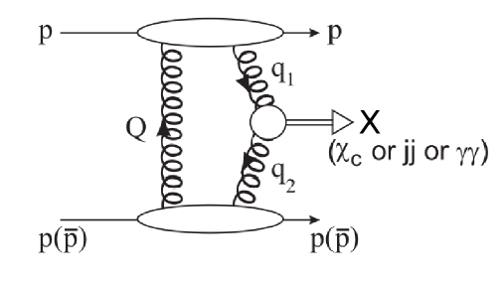
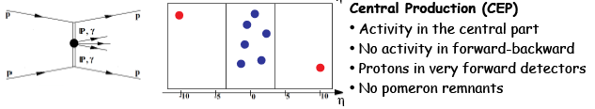
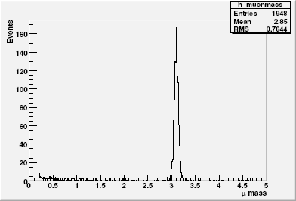
Análises em Física Difrativa: Produção Exclusiva Central de χ_{C0}, dijatos e γγ
Semelhante à produção de Higgs mas com maior seção de choque
Análise em andamento
Estudo de cortes
Efeito do “pile-up”
Trigger para eventos exclusivos

Slide 46
The LHC will stablish the future of the Particle
Physics independent of the new discoveries.
Higgs Bosons
Dark Matter
Physics of Heavy Ions - Plasma
Matter x Antimatter
Supersimetry
Extra Dimensions
Jets and Multijets (QCD)
Leptoquarks
g g scattering
Centauros
New Physics…..
………………………………………
LEPTOQUARKS
The Simetry of Lepton-Quark in the Standard Model do not forbid the existence of a State composed by both Quarks and Leptons like an atome. The Grand Unified Theories predict the existence of Leptoquarks.
Como evoluiram as tecnologias para fazermos essas investigações?

Slide 47
The LHC will stablish the future of the Particle
Physics independent of the new discoveries.
Higgs Bosons
Dark Matter
Physics of Heavy Ions - Plasma
Matter x Antimatter
Supersimetry
Extra Dimensions
Jets and Multijets (QCD)
Leptoquarks
g g scattering
Forward Physics
New Physics…..
………………………………………
FORWARD PHYSICS
Three main sub-detectors: CASTOR, ZDC, and HPS (FP420)
Double Pomeron, Jets and Multijets, Central Production, Heavy Flavor, Higgs , they are all topics under study on CMS.

Slide 48
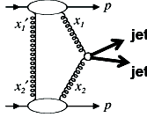
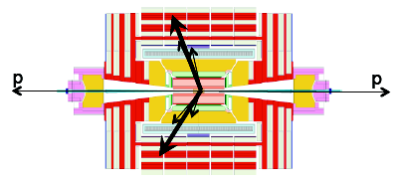
For Diffraction Physics: Central Production becomes very important
In Exclusive Dijets.
Dijets + Rapidity Gap
Triggers:
HLT_ExclusiveDijets
Profile of the jets
Good cuts on Δη and Δφ
Same for HF+ , HF- region

Slide 49

The LHC will stablish the future of the Particle
Physics independent of the new discoveries.
Higgs Bosons
Dark Matter
Physics of Heavy Ions - Plasma
Matter x Antimatter
Supersimetry
Extra Dimensions
Jets and Multijets (QCD)
Leptoquarks
g g scattering
Centauros
New Physics…..
………………………………………
CENTAURO
Castor was built to observe Centauros and Strange Objects in CMS.

