Slide 1
The CHAIN project and its worldwide interoperability program
Roberto Barbera, Univ. of Catania and INFN - Italy
TICAL 2012 – CLARA-TEC Session
Lima, 2 July 2012

Slide 2
Outline
The CHAIN project and its vision
The CHAIN worldwide interoperability program
The Catania Science Gateway framework
Summary and conclusions

Slide 3
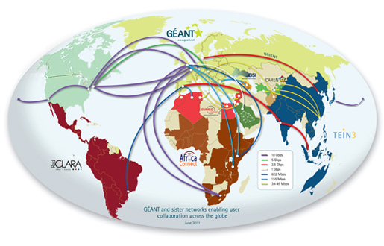
The Global Network
(http://global.geant.net)

Slide 4
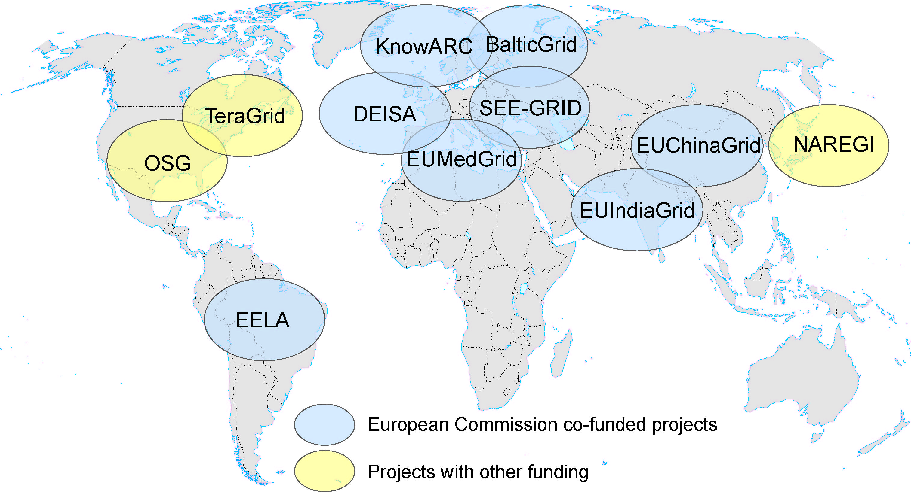

The Global Grid
CNGrid
EUAsiaGrid
NKN & Garuda
SAGrid & SANREN
GISELA

Slide 5






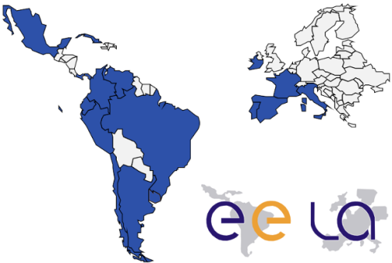
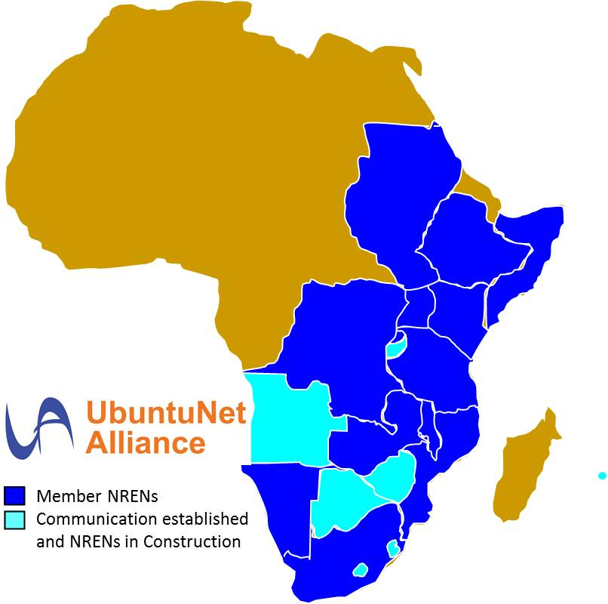
CHAIN: global coverage
Coordination & Harmonisation of Advanced eINfrastructures

Slide 6

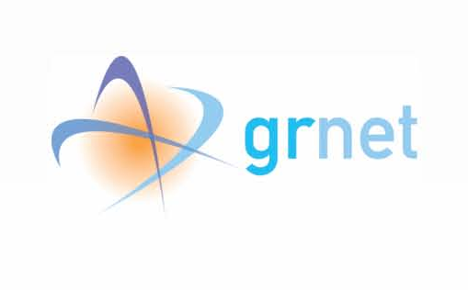






Project information
(more at www.chain-project.eu)
Grant Agreement for a total EC contribution of 1.1 M€
Total cost: about 1.9 M€
Start Date: 1st December 2010 - Duration 24 Months
Partners:
  INFN (Italy - Coordinator)
  CESNET (Czech Rep.)
  CIEMAT (Spain)
  GRNET (Greece)
  IHEP (China)
  UBUNTUNET (Africa)
  CLARA (Latin America)
  PSA (India)
  ASREN (Med./Middle East/Gulf) Since 1 August 2011

Slide 7
Project objectives
Define a strategy and a model for external collaboration, in close collaboration with EGI.eu which will enable operational and organisation interfacing of EGI and external e-Infrastructures
Validate this model, as a proof-of-principle, by supporting the extension and consolidation of worldwide Virtual Research Communities
Explore and propose concrete steps forward towards the coordination with other projects and initiatives (e.g. EGI.eu, EUMEDGRID-Support, EUIndiaGrid2, LinkSCEEM2, NKN & Garuda, etc.)

Slide 8
Project strategic vision
A world-wide Distributed Computing Infrastructure can address big scientific challenges that are not manageable with departmental computing systems
Virtual Research Communities can transparently access different kind of resources: scientific applications and tools, Data Repositories, down to CPUs and Disks. The vision is that of VRCs using resources ubiquitously across different administrative domains
Regional e-Infrastructures should be made interoperable among each other. CHAIN is committed to promote and validate a proof-of-concept that addresses this

Slide 9
Project workplan
State of the Art Assessment
(WP2)
Disseminate (WP5)
Involve the VRCs
(WP3)
Analyse the different Regional Approaches
(WP2, WP4)
Demonstrate the usefulness of interoperation
(WP3, WP4)
Propose a Road-Map and Intermediate solutions
(WP4, WP3)
Make Recommendations
(WP2, WP3, WP4)

Slide 10
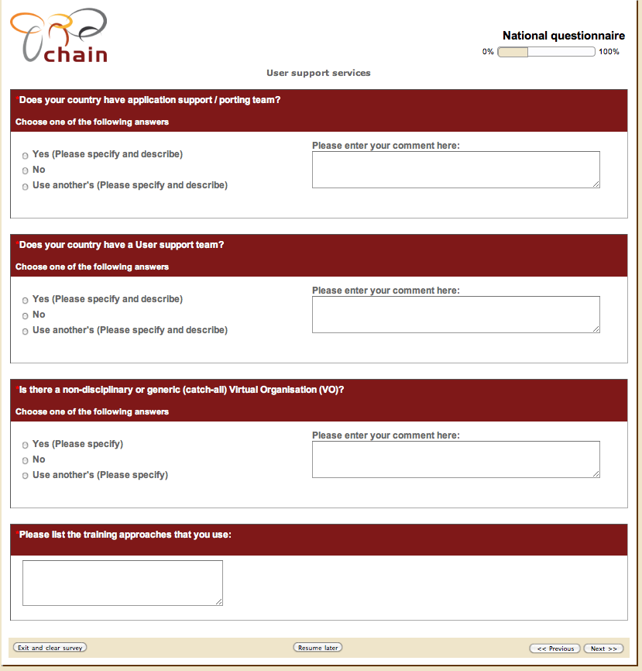
State of the art analysis
Analysis of existing NGI literature and related questionnaires
Creation of the regional and NGI questionnaires
Questionnaires being implemented and published online
Collection of contact points from all continents
Questionnaire is kept open and collection of contact points from all continents is continued
Questionnaire data provided through the CHAIN Knowledge Base

Slide 11
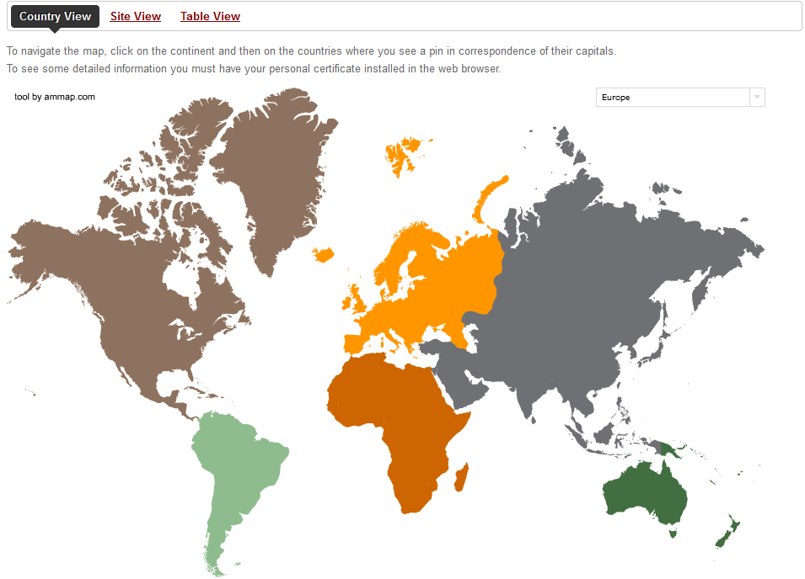
The CHAIN Knowledge Base
(www.chain-project.eu/knowledge-base)
Largest e-Infrastructure related knowledge base.
Information dynamically available for about half of the countries of the world.

Slide 12
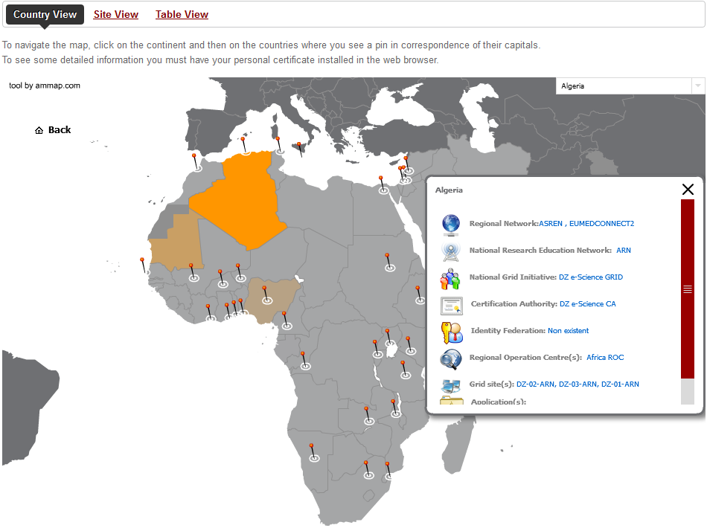
The CHAIN Knowledge Base
(www.chain-project.eu/knowledge-base)
RREN(s)
NREN
NGI
CA(s)
Id.Fed(s)
ROC(s)
Grid site(s)
Application(s)

Slide 13
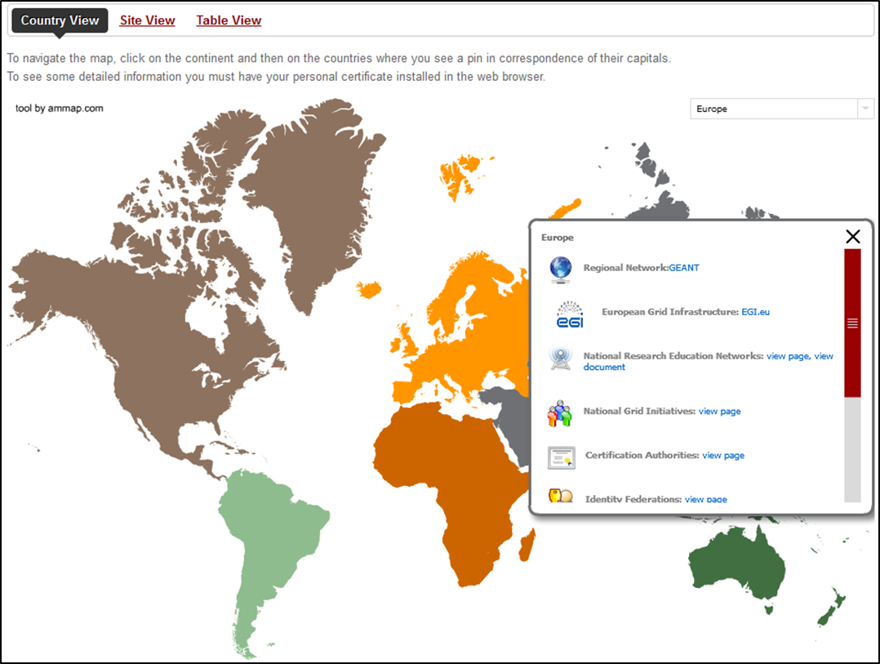
The CHAIN Knowledge Base
(www.chain-project.eu/knowledge-base)
Global view for Europe dynamically linked to the EGI.eu databases.

Slide 14
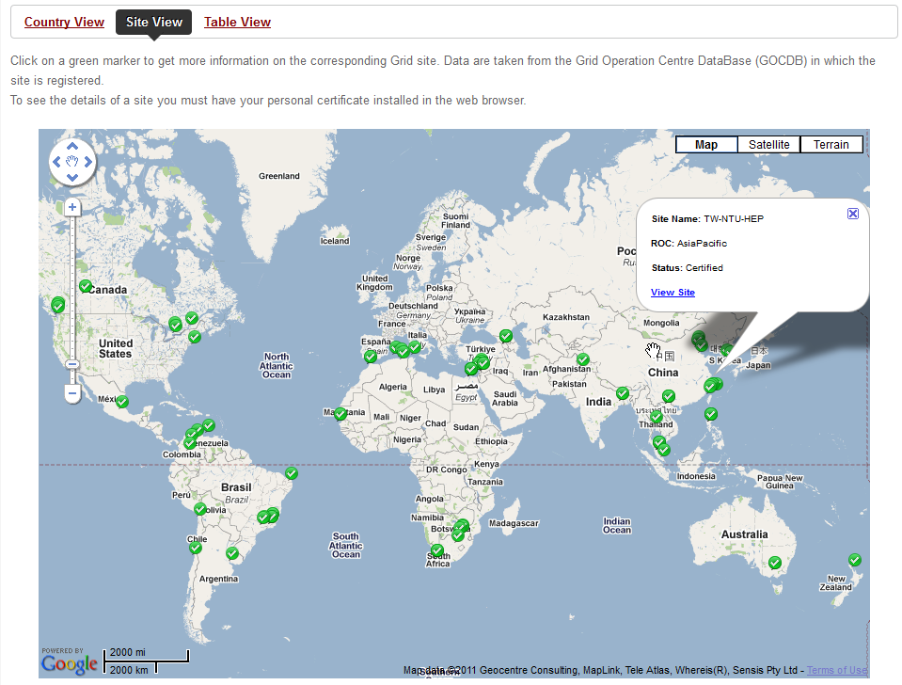
The CHAIN Knowledge Base
(www.chain-project.eu/knowledge-base)

Slide 15






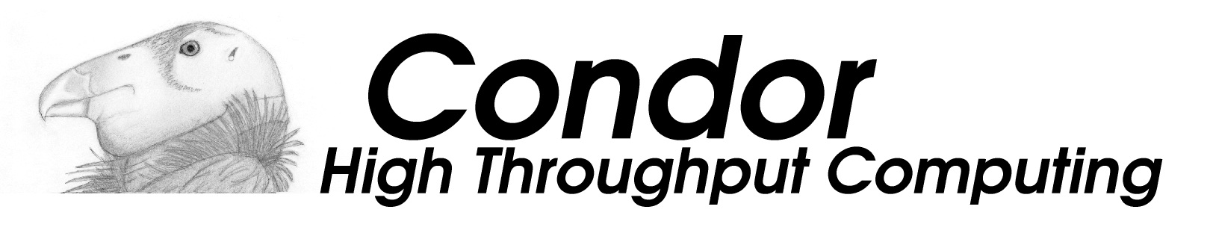


The “non-Global” middleware
CNGrid
EUAsiaGrid
NKN & Garuda
SAGrid & SANREN
GISELA

Slide 16
Interoperability
(http://en.wikipedia.org/wiki/Interoperability)
Interoperability is a property referring to the ability of diverse systems and organizations to work together (inter-operate). The term is often used in a technical systems engineering sense, or alternatively in a broad sense, taking into account social, political, and organizational factors that impact system to system performance;
According to ISO/IEC 2382-01 (Information Technology Vocabulary, Fundamental Terms), interoperability is "The capability to communicate, execute programs, or transfer data among various functional units in a manner that requires the user to have little or no knowledge of the unique characteristics of those units".

Slide 17
Objectives of the CHAIN worldwide interoperability program
To demonstrate that:
  e-Infrastructures can be made interoperable to each other using standards
    with the meaning of interoperability given in the previous slides;
  Virtual Research Communities’ specific applications can be submitted from anywhere and run everywhere

Slide 18
Requirements
The user interface must be only web based
Users must be transparently authenticated & authorised on all e-Infrastructures without any additional human/machine intervention
There must be the smallest possible interaction with both site managers and e-Infrastructure operators
No modification of the middleware should be required to their developers

Slide 19
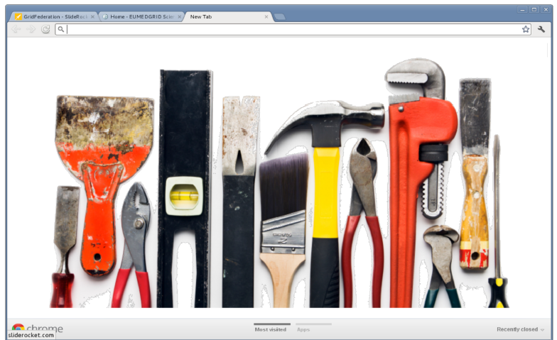
Community-driven web portals have started to integrate Grid Tools and Applications
“A Science Gateway is a community-developed set of tools, applications, and data that is integrated via a portal or a suite of applications, usually in a graphical user interface, that is further customized to meet the needs of a specific community.”
Teragrid/XSEDE

Slide 20
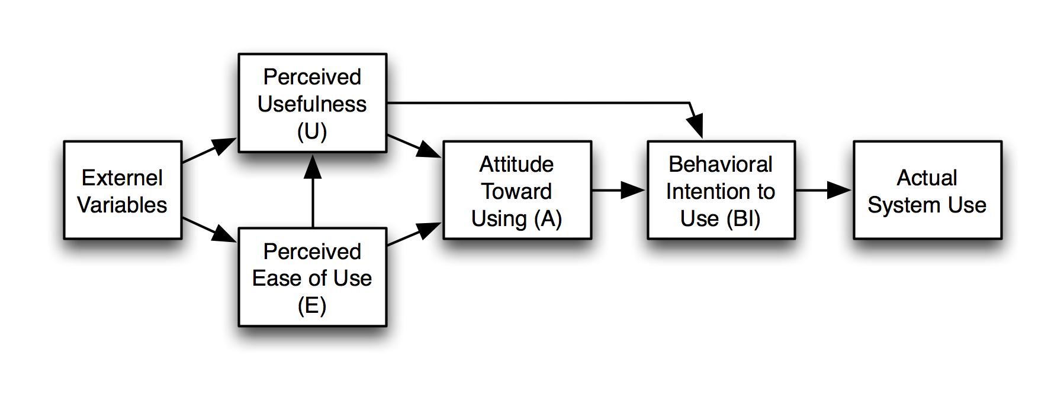
IT acceptance model – the Grid
Development of
Science Gateway
Requirement
for sustainability
Davis, F. D. (1989), "Perceived usefulness, perceived ease of use, and user acceptance of information technology", MIS Quarterly 13(3): 319–340

Slide 21
EGI Portal & Traceability Policies (1/2)
Science Gateways
Portal Classes
Portal Class | Executable | Parameters | Input
Simple one-click | provided by portal | provided by portal | provided by portal
Parameter | provided by portal | chosen from enumerable and limited set | chosen from repository vetted by the portal
Data processing | provided by portal | chosen from enumerable and limited set | provided by user
Job management | provided by user | provided by user | provided by user

Slide 22
EGI Portal & Traceability Policies (2/2)
The Portal, the VO the Portal is associated to, and the Portal manager are all individually and collectively responsible and accountable for all interactions with the Grid
The Portal must be capable of limiting the job submission rate
The Portal must keep audit logs for all interactions with the Grid as defined in the Traceability and Logging Policy (minimum 90 days)
The Portal manager and operators must assist in security incident investigations
Where relevant, private keys associated with (proxy) certificates must not be transferred across a network, not even in encrypted form

Slide 23

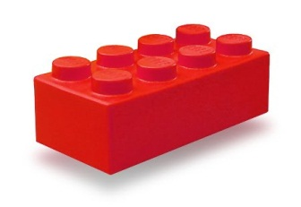
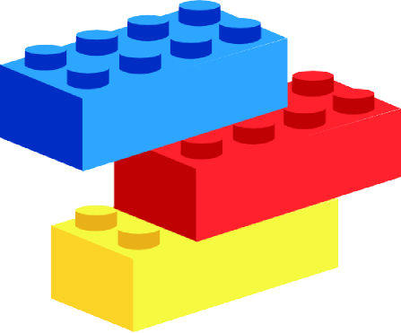
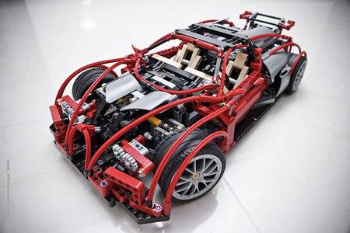
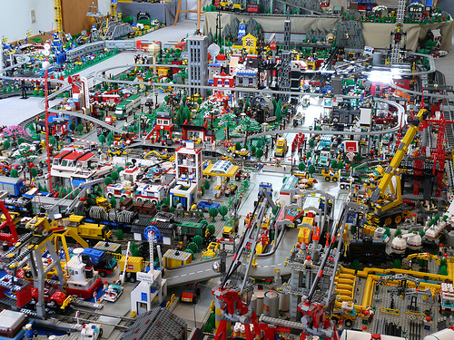
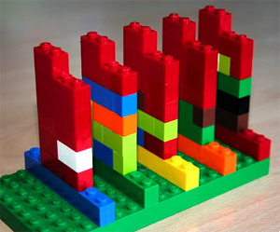
Primary requirement: building Science Gateways should be like playing with
Standards
Simplicity
Easiness of use
Re-usability
Sc. Gtwy A
Sc. Gtwy E
Sc. Gtwy B
Sc. Gtwy C
Sc. Gtwy D

Slide 24
Summary of standards adopted
The framework for Science Gateways developed at Catania is fully web-based and adopts official worldwide standards and protocols, through their most common implementations
These are:
  The JSR 168 and JSR 286 standards (also known as "portlet 1.0" and "portlet 2.0" standards)
  The OASIS Security Assertion Markup Language (SAML) standard and its Shibboleth and SimpleSAMLphp implementations
  The Lightweight Direct Access Protocol, and its OpenLDAP implementation
  The Cryptographic Token Interface Standard (PKCS#11) standard and its Cryptoki implementation
  The Open Grid Forum (OGF) Simple API for Grid Applications (SAGA) standard and its JSAGA implementation

Slide 25







Our reference model
Embedded Applications
Administrator
Power User
Basic User
.......
App. 1
App. 2
App. N
Science
Gateway
Standard-based (SAGA) middleware-independent
Grid Engine
Users from different organisations having different roles and privileges

Slide 26











AuthN & AuthZ Schema
Science Gateway
Authorisation
Authentication
1. Register to a Service
GrIDP
(“catch-all”)
IDPCT
(“catch-all”)
Social Networks’ Bridge IdP
IDP_y
2. Sign in
LDAP
.........

Slide 27
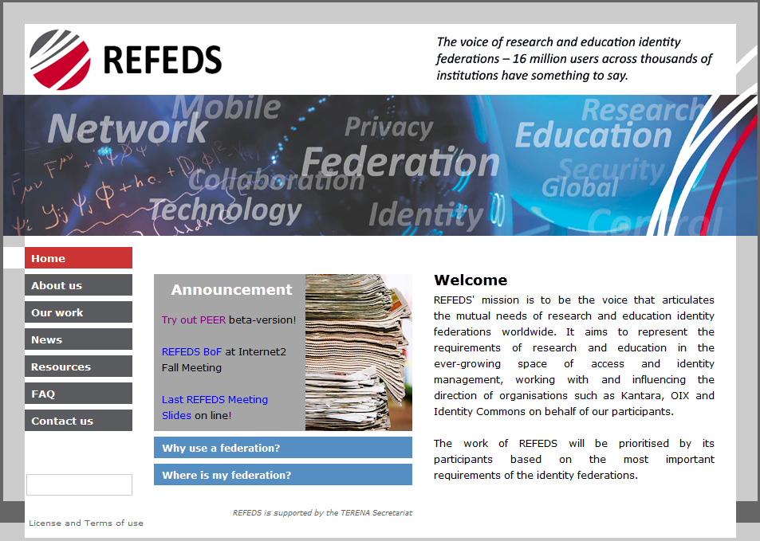
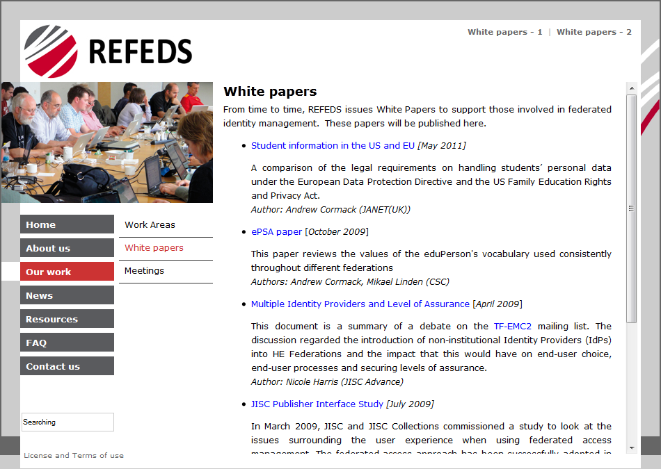
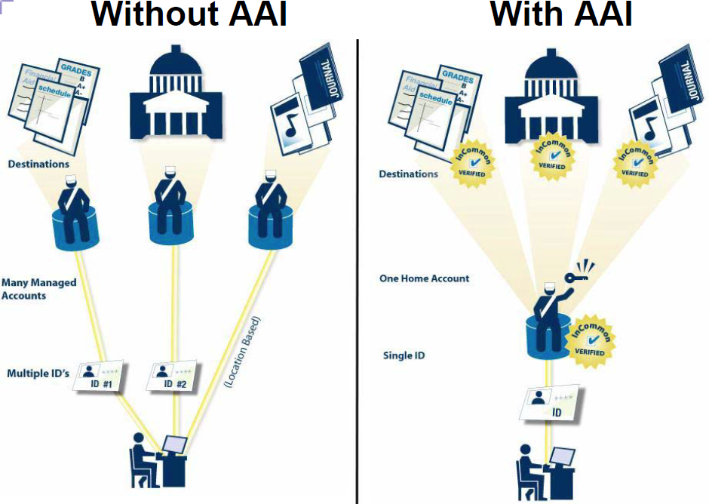
Identity Federations
(https://refeds.org)
An Identity Federation consists of “[…] the agreements, standards, and technologies that make identity and entitlements portable across autonomous domains.”
Burton Group

Slide 28
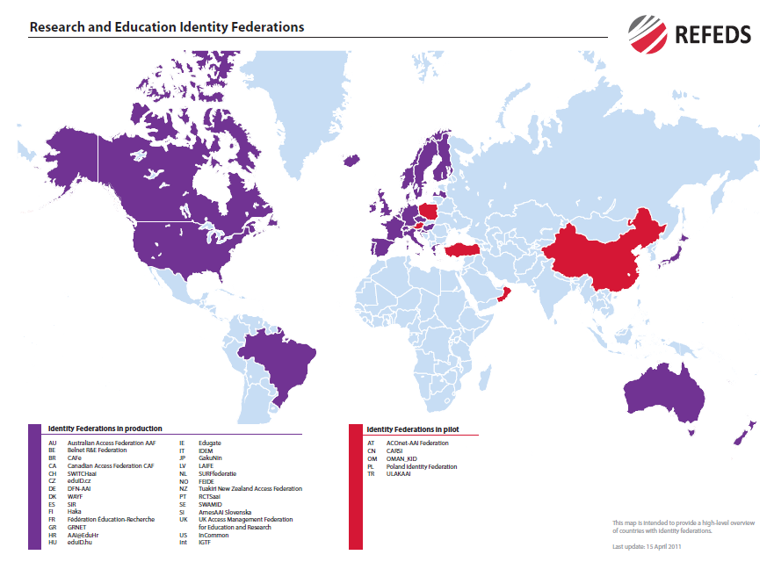
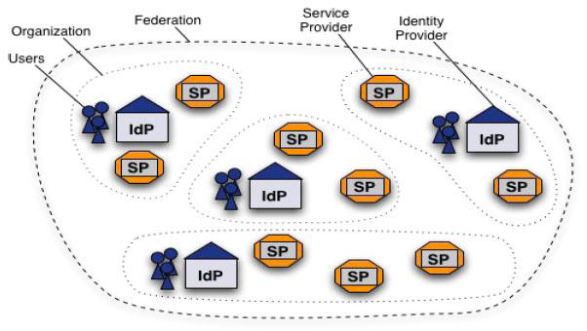
IDEM Identity Federation in Italy
(www.idem.garr.it)
IDEM figures:
35 Members;
13 Partners;
59 Identity Providers;
70 Services Providers
>3,000,000 end users;
~50% of the Italian higher education & research community
Students with e-identity

Slide 29
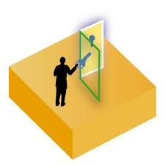

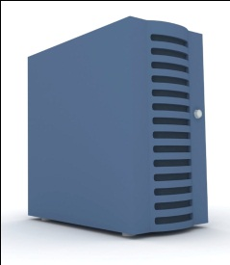




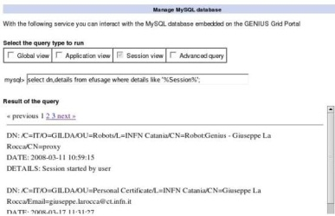

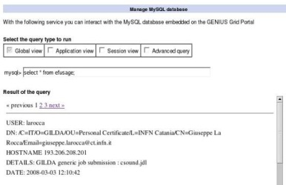
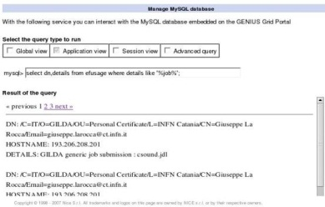
Science Gateway access workflow
User Registry
eToken server
2’. authN
2”. authZ
3. create a proxy from an eToken
server with robot certificates
Identity Provider
1. sign in
6. get the results
4. execute action
The Grid
User
5. get output
Admin
3’/4’. track
user
Compliant with the EGI.eu Portal and Traceability Policies

Slide 30
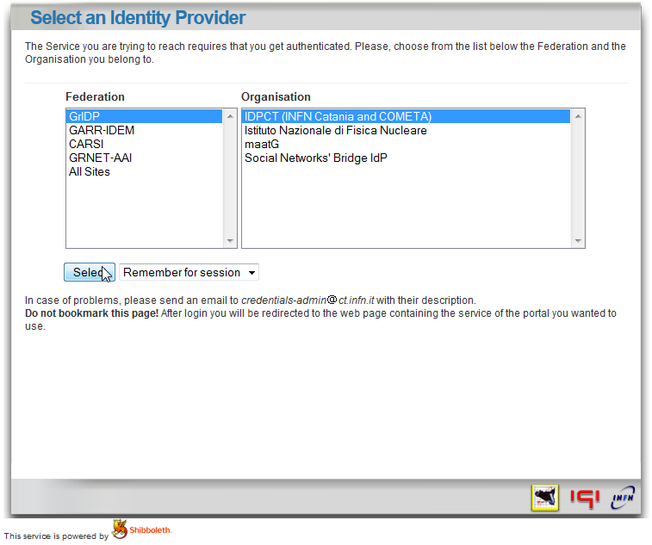
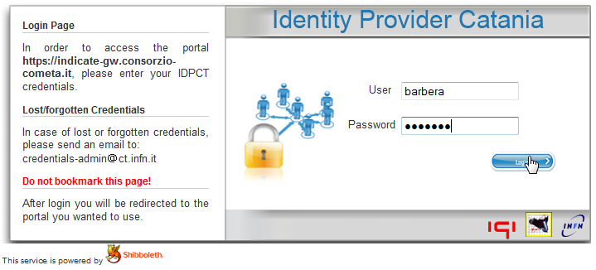
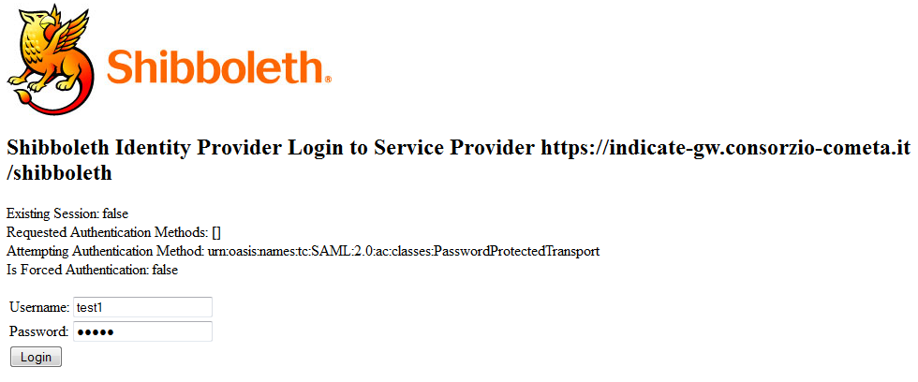
The Authentication Procedure
Identity Federations’ discovery service
«catch-all» Identity Provider
http://idp.ct.infn.it

Slide 31
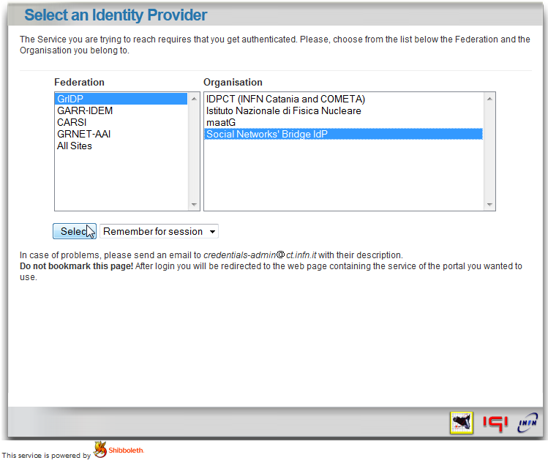
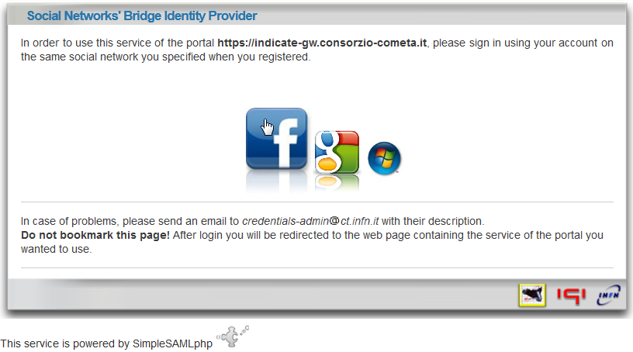
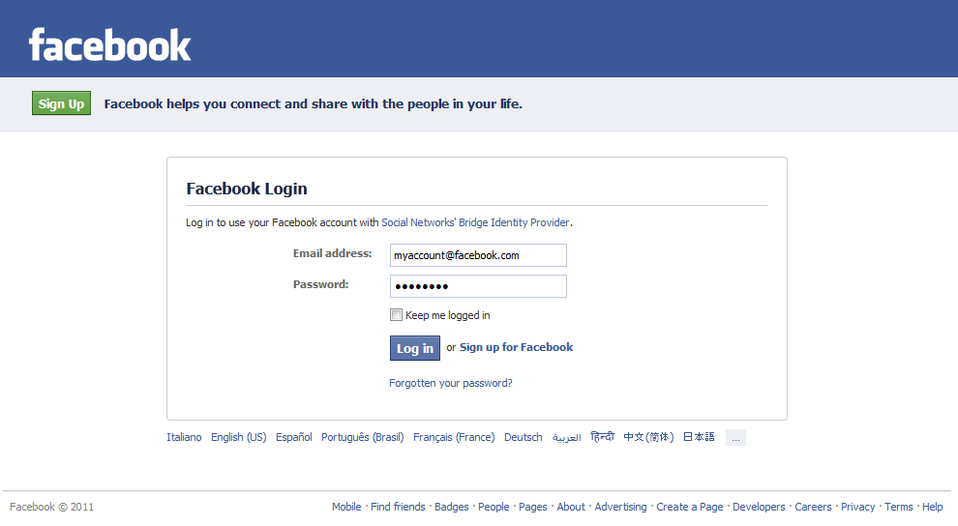
The Social Networks’ Bridge Identity Provider
(https://idpsocial.ct.infn.it)
Identity Federations’ discovery service
For more information watch the video
www.youtube.com/watch?v=w6wfuGUwVVU

Slide 32
The Catania Grid Engine
Liferay Portlets
Science
GW 1
Science
GW 2
Science
GW 3
Grid Engine
eToken
Server
Science GW Interface
Data Engine
Job Engine
Users
Track &
Monit.
Users
Tracking
DB
SAGA/JSAGA API
Grid MWs

Slide 33

Multi-Infrastructures Grid Engine
EUMEDGRID
Infrastr. Info
(BDII,VO, etc.)
GISELA
Infrastr.
Info
Other
Infrastr.
Info
EUMEDGRID
e-Infrastructure
Submit
Multi-Infrastructure
Science Gateway
GISELA
e-Infrastructure
User
Other
e-Infrastructure

Slide 34

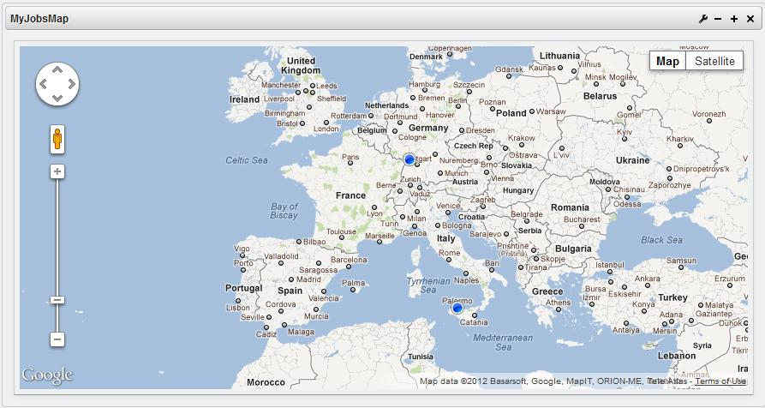






Job Engine – Interoperability
gLite-based e-Infrastructures/Projects
EUAsiaGrid
EUChinaGRID
EU-IndiaGrid
EUMEDGRID
GISELA
IGI (Italy)
SAGrid (South Africa)

Slide 35
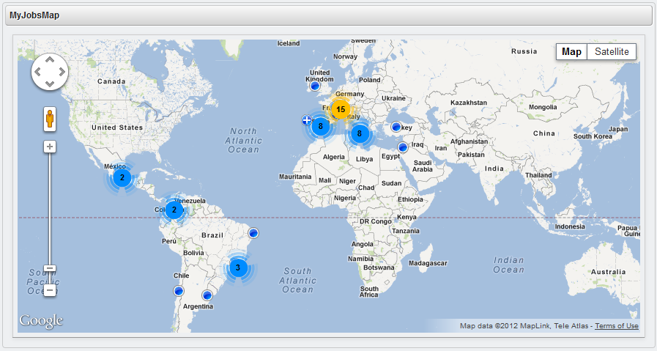
MyJobsMap (1/3)

Slide 36
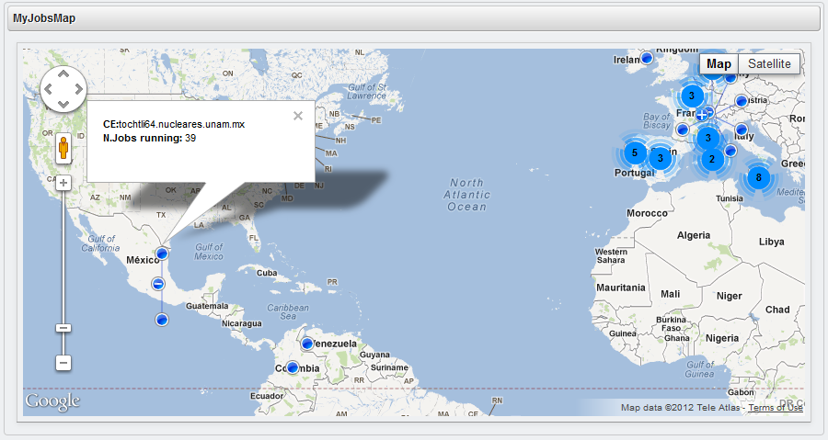
MyJobsMap (2/3)

Slide 37
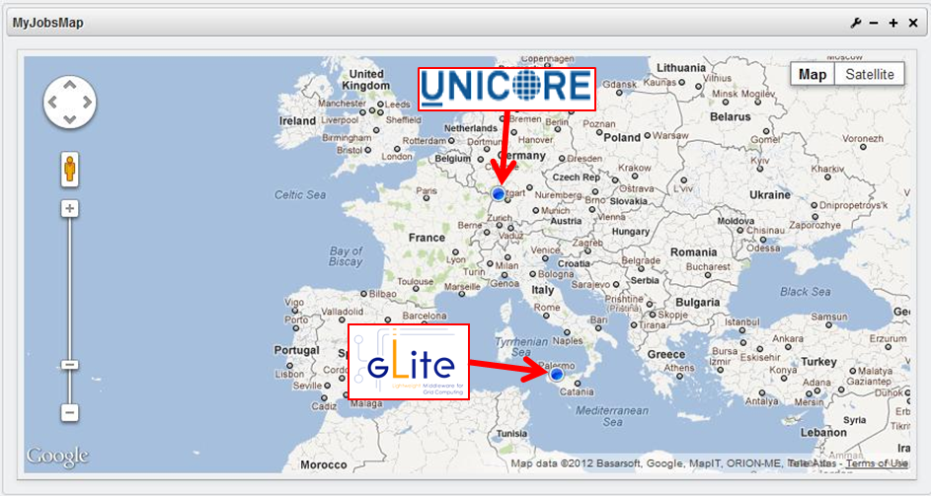
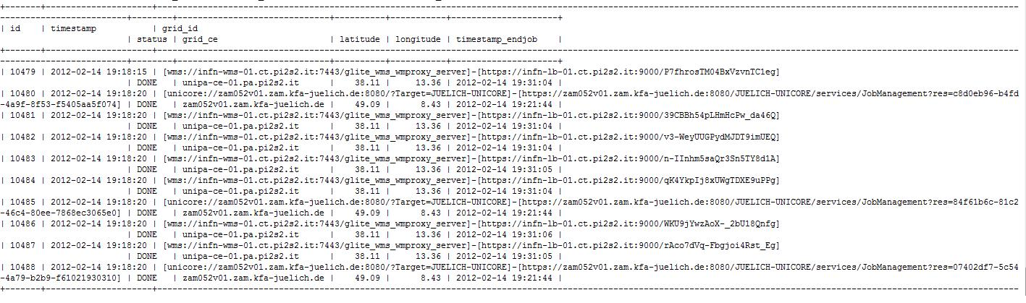
MyJobsMap (3/3)
Both sequential and MPI-enabled
jobs successfully executed
The CHAIN project is preparing a demo of worldwide interoperability among gLite, Globus, Unicore, OurGrid,
GOS, and GARUDA to be presented both at the next
EGI Technical Forum and Supercomputing 2012

Slide 38
Summary and conclusions
The CHAIN project aims to provide a comprehensive vision on the evolution of Regional e-Infrastructures
The CHAIN worldwide interoperability programs aims to demonstrate that a users can access a global e-Infrastructures in a seamless and ubiquitous way
The Catania Science Gateway framework with support for Identity Federations and Social Networks changes the way Grid infrastructures are used, hugely widening their potential user base across the continents, especially non-IT experts and the “citizen scientist”, yet keeping the required security
The adoption of standards (JSR 286, SAGA, SAML, etc.) represents a concrete investment towards sustainability

Slide 39
Thank you!

