Slide 1

Measurements WG
(GT-Mediciones)
Prof. José Augusto Suruagy Monteiro
Universidade Federal de Pernambuco
suruagy@cin.ufpe.br

Slide 2
Measurements WG Goals
Build upon the work started in the previous period (03/2009 – 03/2011) by the Measurements WG.
Deployment of a monitoring infrastructure based on perfSONAR

Slide 3
Long Term Vision
Deployment of monitoring nodes in RedCLARA’s backbone
Deployment of at least two monitoring nodes in each NREN connected to RedCLARA
Deployment of monitoring infrastructures in interested NRENs
Instalation of monitoring nodes in end user institutions

Slide 4
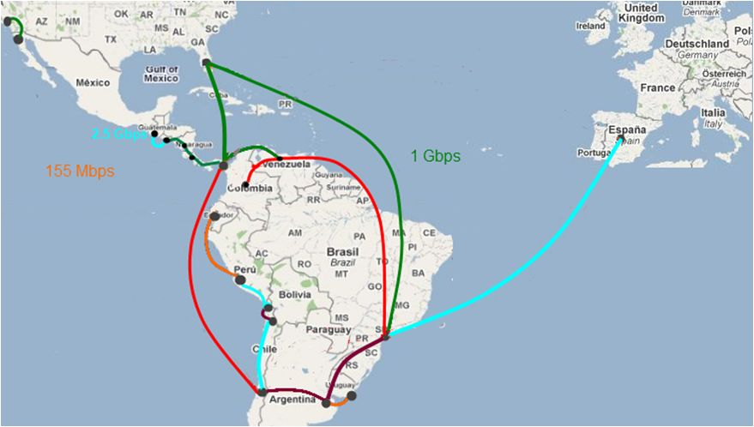

Proposed MPs in the Future Backbone

Slide 5
Tasks
  Task 01: Deployment and tests with perfSONAR MDM
  Task 02: Deployment and tests with the most recent version of the perfSONAR Performance Toolkit (pS-PT)
  Task 03: Test the tools with IPv6
  Task 04: Interoperability tests between pS-PT and perfSONAR MDM
Task 05: Recommendations on the software to be deployed for RedCLARA’s backbone monitoring infrastructure
Task 06: Elaboration of the maintenance procedures for RedCLARA’s backbone monitoring infrastructure
Task 07: Dissemination and Training in perfSONAR usage

Slide 6
Reviewed Schedule

Slide 7
Tasks
  Task 01: Deployment and tests with perfSONAR MDM
  Task 02: Deployment and tests with the most recent version of the perfSONAR Performance Toolkit (pS-PT)
  Task 03: Test the tools with IPv6
  Task 04: Interoperability tests between pS-PT and perfSONAR MDM
Task 05: Recommendations on the software to be deployed for RedCLARA’s backbone monitoring infrastructure
Task 06: Elaboration of the maintenance procedures for RedCLARA’s backbone monitoring infrastructure
Task 07: Dissemination and Training in perfSONAR usage

Slide 8
Task 01: Deployment and tests with perfSONAR MDM
Deployment and tests with perfSONAR MDM (developed by Géant)
Recommendation for the best solution to be deployed in RedCLARA’s backbone
Collaboration with Géant’s team for the installation and test troubleshooting among our sites and with MPs in Europe

Slide 9

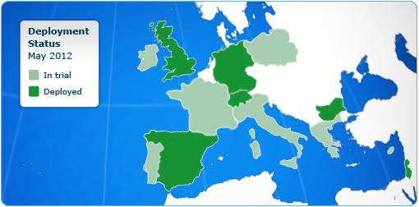

perfSONAR MDM Deployments
DANTE is finalizing its implementation across the GÉANT backbone with 35 MPs in the PoPs across the network
7 NRENs are road-testing the service

Slide 10
perfSONAR-MDM Status
Version 3.3 is the latest stable release
New Version:
  Includes a new HADES MP and MA.
    RPM Distribution ready
    Debian Distribution in preparation
  Currently the HADES MP in Madrid already supports OWAMP (answers to on-demand tests)
  They are working on an OWAMP MP which should be available soon

Slide 11
perfSONAR MDM Independent Deployment in RedCLARA
Suggested set of services:
  HADES MP (90 packets every minute)
  BWCTL MP (tests every 6 hours)
  SQL MA (data stored for 12 months)
  These services could be configured in a static fashion without the need for a LS
  It would be nicer if the services would be visible from other parties via a LS

Slide 12
Next Steps (perfSONAR MDM)
Confirmation of sites and machine configurations for the experimental deployment
  VC 23/05/12: CEDIA, RAAP, RAU, RNP e RedCLARA (others are welcomed to join)
Decide where the SQL MA and possibly LS will be deployed – Pending
Webconf with Géant team for instructions on how to deploy and configure the services:
  Held on 05/06/12
Deployment, configuration and tests (IPv4 and IPv6)
  Currently in Progress (BWCTL-MP) @ CEDIA, RAU, REUNA y RNP
Report elaboration

Slide 13
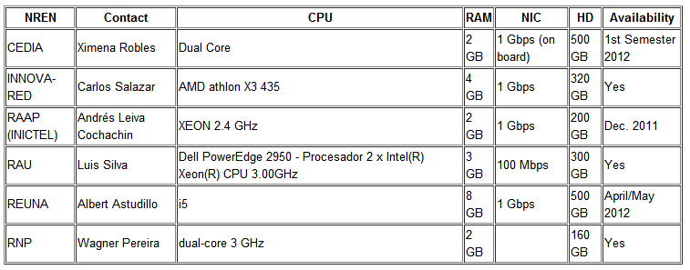
Available Machines
http://comunidades.redclara.net/wiki/gtmediciones/index.php/Available_Machine_Configuration_for_Experimental_Deployment

Slide 14
Available Machines in RedCLARA’s backbone
Gustavo Garcia (RedCLARA) pointed out the existence of machines in RedCLARA's backbone that are supposed to be used for deploying perfSONAR.
  Albert (REUNA) had reported problems with the flavor of the OS installed in the machines which supposedely would prevent the deployment of the MDM package (rpm version).

Slide 15
MDM Deployment Strategy
Szymon presented two options for deployment:
  single BWCTL MP:
    Appropriate for the international connection: results for regular tests would be stored at Géant's Measurement Archive service (SQL MA).
  multiple BWCTL MPs + one SQL MA:
    Should be our case with the services being deployed
    Still pending the selection of a machine to install the SQL MA (suggestions/availability are welcome)

Slide 16
Tasks
  Task 01: Deployment and tests with perfSONAR MDM
  Task 02: Deployment and tests with the most recent version of the perfSONAR Performance Toolkit (pS-PT)
  Task 03: Test the tools with IPv6
  Task 04: Interoperability tests between pS-PT and perfSONAR MDM
Task 05: Recommendations on the software to be deployed for RedCLARA’s backbone monitoring infrastructure
Task 06: Elaboration of the maintenance procedures for RedCLARA’s backbone monitoring infrastructure
Task 07: Dissemination and Training in perfSONAR usage

Slide 17
Synergy with GISELA
Grid Initiatives for e-Science virtual communities in Europe and Latin America
www.gisela-grid.eu
Objective:
  To guarantee the long-term sustainability of the European – Latin American e-Infrastructure and thus ensure the continuity and enhancement of the Virtual Research Communities (VRC) using it.

Slide 18
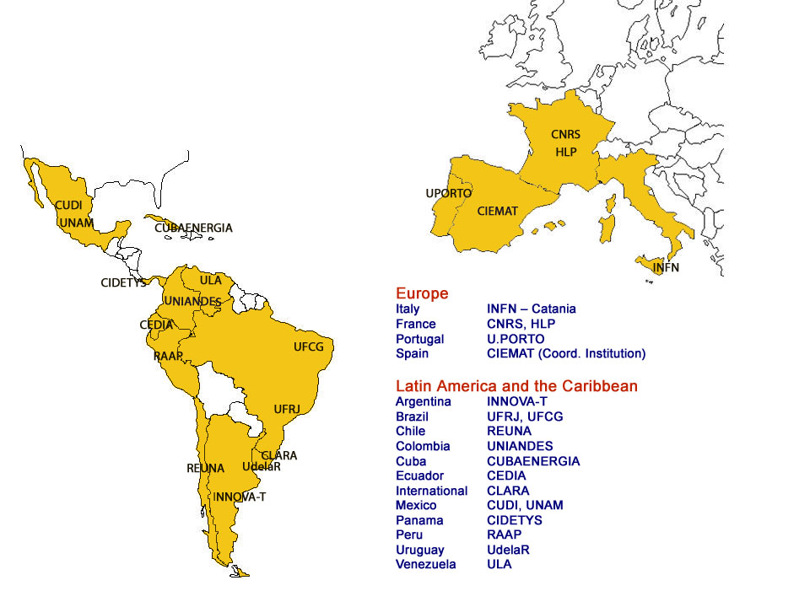
GISELA Sites

Slide 19
MonGISELA
MonGISELA site: http://mongisela.cecalc.ula.ve/
  One-way delay tests using pS-Performance Toolkit v.3.2.1.1
Measurement Points:
  Brasil: UFRJ
  Colombia: UIS
  Ecuador: CEDIA
  Panamá: UTP
  Venezuela: ULA

Slide 20
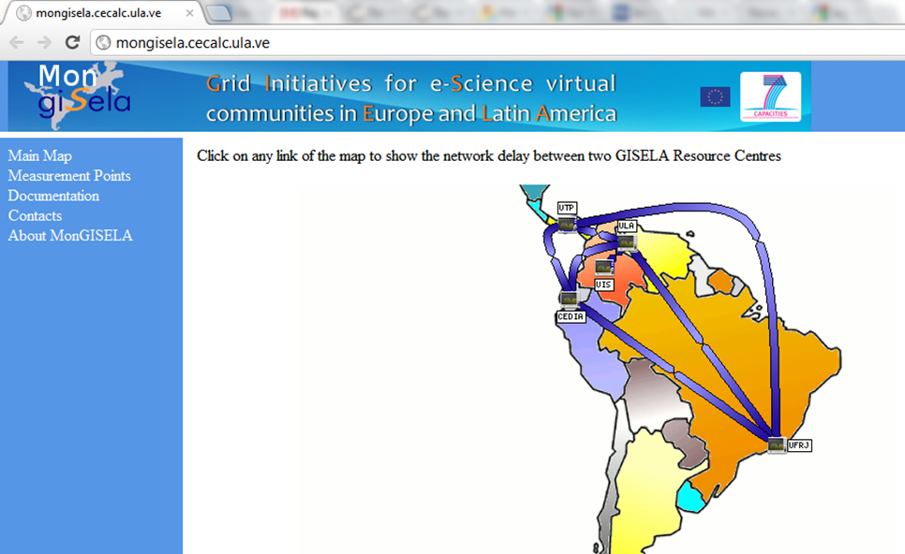
Mongisela.cecalc.ula.ve

Slide 21
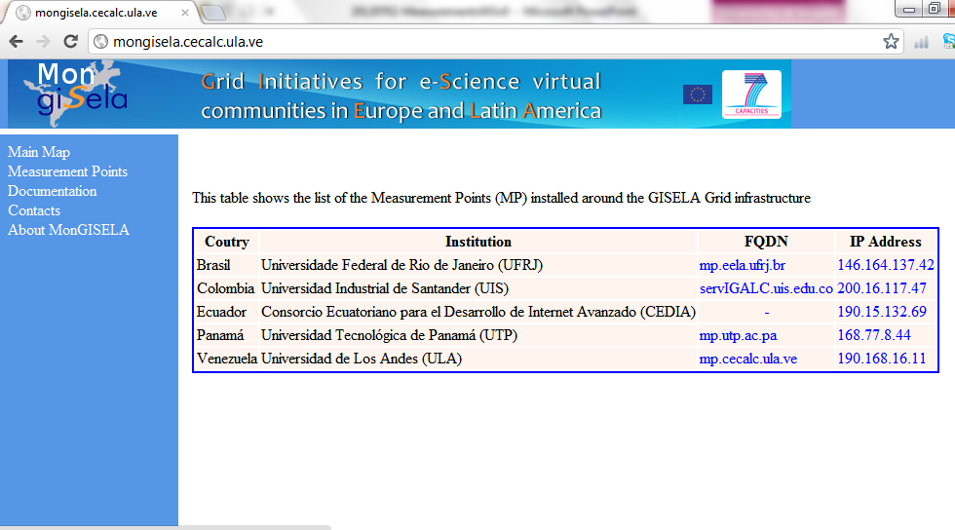
MonGISELA Measurement Points

Slide 22
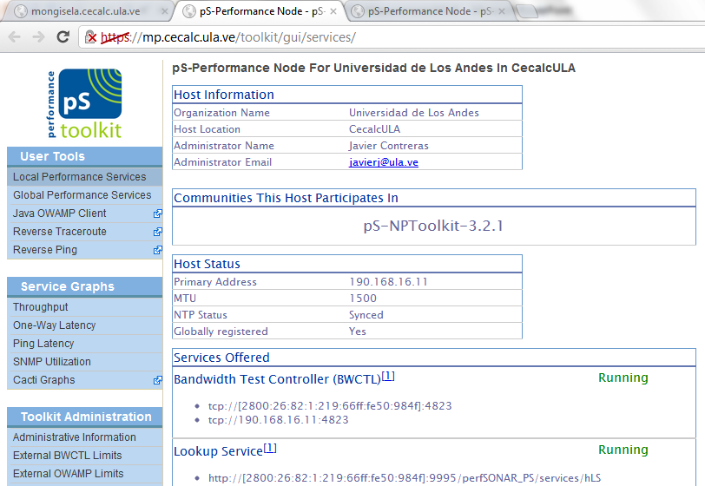
MonGISELA: ULA-VE MP

Slide 23
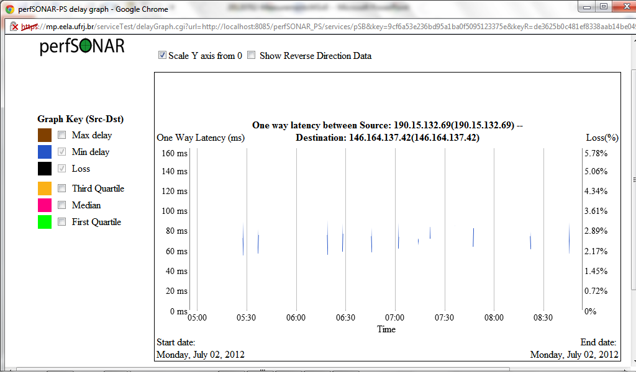

Some Results (CEDIA $→$ UFRJ)

Slide 24
MonGISELA
MonGISELA Portal can be extended to report our Measurement WG collected data.
A report was generated on the experiences with perfSONAR-MDM and the pS-Performance Toolkit.

Slide 25
Tools Versions
BWCTL
  MDM: version 1.2a
  psPT 3.2.1.1 (MonGISELA): version 1.3
  pSPT 3.2.2: version 1.4 – Added support for -6 and -4 flags to explicitly set IPv4/Ipv6 behavior
OWAMP
  psPT 3.2.1.1 (MonGISELA): v3.2rc2
  pSPT 3.2: v3.3 – Added support for -6 and -4 flags to explicitly set IPv4/Ipv6 behavior

Slide 26
WG Ways of Communication
Communities in RedClara’s site (started on 07/02/12)
  GT-Mediciones (http://www.redclara.net/index.php?option=com_community&view=groups&task=viewgroup&groupid=100&Itemid=543&lang=es)
  To join the group it is necessary to register.
Wiki (started on 07/02/12):
  http://www.redclara.net/wiki/gtmediciones
  To view and edit is also necessary to register first.

Slide 27
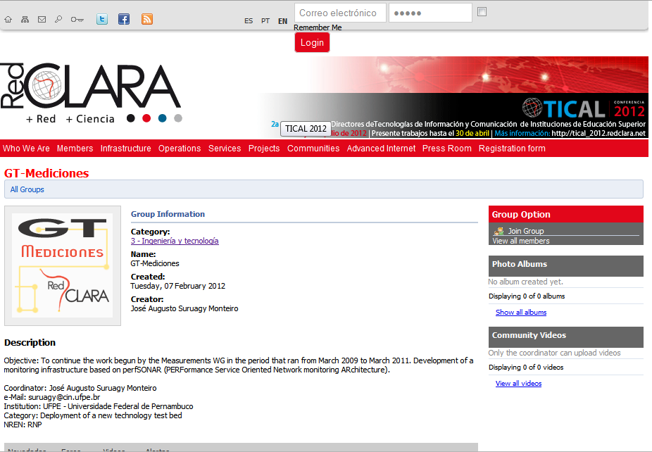

Slide 28
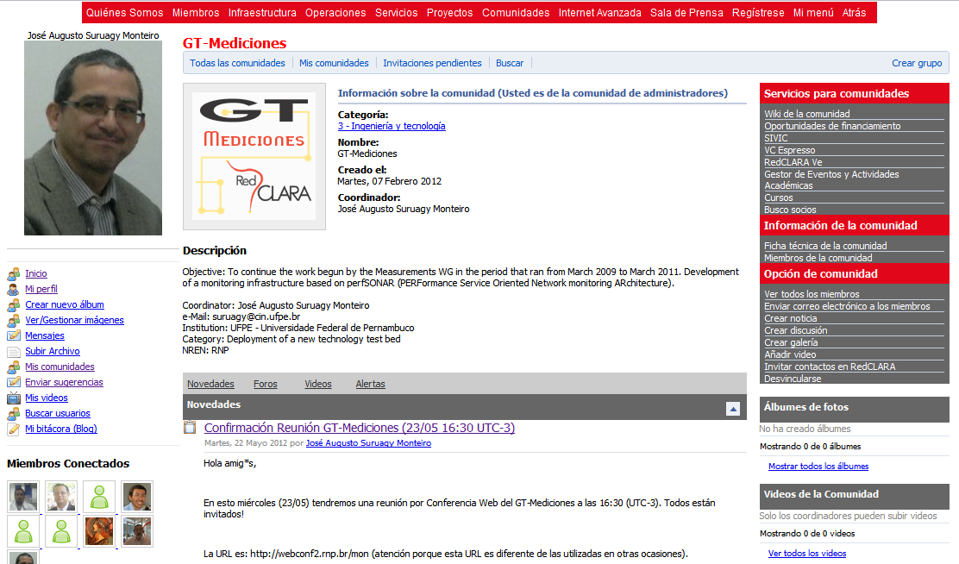

Slide 29
Current Community Members
Alex Moura
Andres Leiva
Carlos Gonzales
José Suruagy (2x)
Maria José
Nidia Ximena Robles
Seg RedCLARA
Thomas Fryer

Slide 30
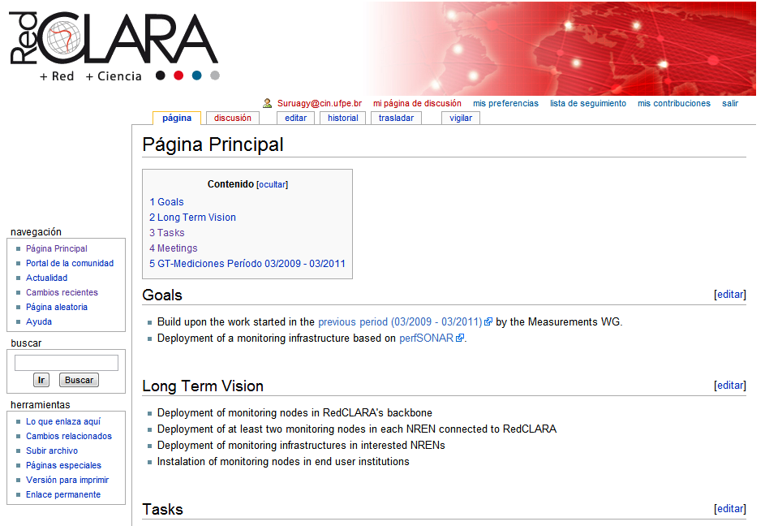

Slide 31
WG Ways of Communication
AP (Action Point):
  Everyone interested should register in RedClara website and request participation in the “GT-Mediciones” community.

Slide 32
Measurements WG
(GT-Mediciones)
Prof. José Augusto Suruagy Monteiro
Universidade Federal de Pernambuco
suruagy@cin.ufpe.br

